Slide 1
Southwest Asia Today
Dubai, UAE

Slide 2
Georgia 7th Grade Standards
Compare and contrast the economic systems in Israel, Saudi Arabia and Turkey
Evaluate how the literacy rate affects the standard of living
Explain the primary function of the Organization of Petroleum Exporting Countries
Explain how most countries have a mixed economy located on the continuum between pure market and pure command.

Slide 3
Standard of Living vs. Literacy Rate & GDP per capita
Literacy Rate – percentage of the population at a specific age that can read and write
GDP per capita – GDP based on population
Standard of Living – the degree of wealth and material comfort available to the general population of a country.
GDP – total value of all goods and services (Gross Domestic Product)
Are literacy rate and GDP linked to standard of living?

Slide 4
High Standards of Living vs. Low Standards of Living
Israel
Population – 8,049,314
Literacy rate – 97.8%
GDP per capita - $32,700
Manufacturing, technology
Saudi Arabia
Population – 27,752,316
Literacy rate – 94.7%
GDP per capita - $52,200
Oil production
Yemen
Population – 26,737,317
Literacy rate – 70%
GDP per capita - $3,800
Oil production, coffee, fish
Afghanistan
Population – 32,564,342
Literacy rate – 38%
GDP per capita - $1,900
Agriculture

Slide 5
Other Standards of Living
United States
Literacy Rate – 99%
GDP per capita - $54,600 (pop.=321,368,864)
Qatar
Literacy Rate – 97.3%
GDP per capita - $143,400 (2,194,817)
Iraq
Literacy Rate – 79.7%
GDP per capita $14,600 (37,056,169)
Cuba
Literacy Rate 99.8%
Second highest in world
GDP per capita - $10,200
(11,031,433)
China
Literacy Rate – 96.4%
GDP per capita - $12,900
Population – 1,367,485,388
Highest in the world

Slide 6
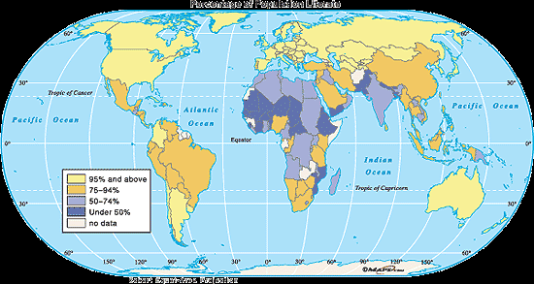
World Literacy Map

Slide 7
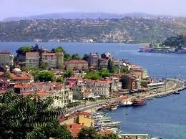
The Eastern Mediterranean
Includes Turkey*, Jordan, Israel*, Lebanon, Syria, and Palestinian territories
Faced many conflicts
Struggle to achieve peace
Camp David Accords
Not much oil but they do have areas with mild climates and fertile lands
Farming is important

Slide 8
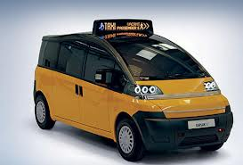
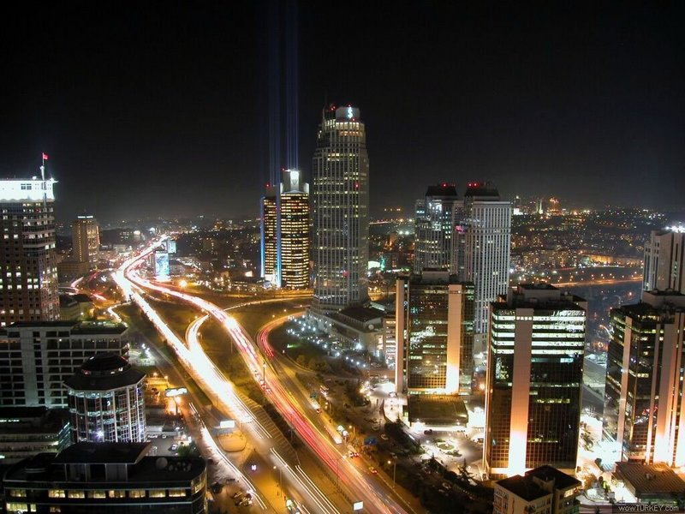
Turkey
Mild Mediterranean climate (cooler, gets rain)
Largest population in SWA (79,000,000)
Agriculture for local use
Exports cotton and tobacco
Produces textiles, steel, and cars
Gradually moved from gov’t-directed economy to more private enterprise
75% of people live in cities

Slide 9
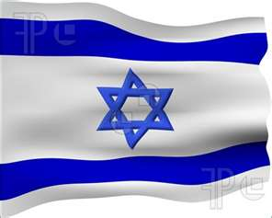
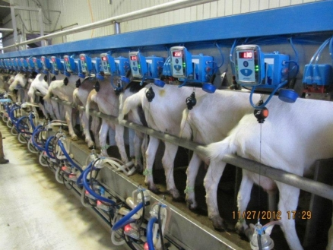
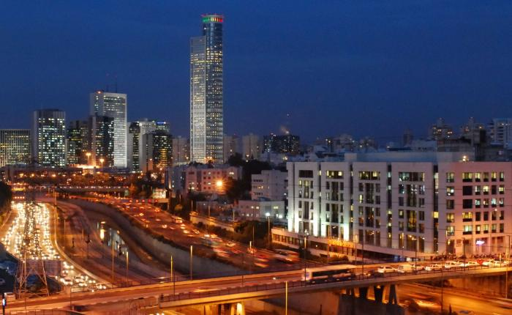
Israel
Highly developed and industrial economy
High tech manufacturing (aviation, computers), financial services, timber, and agriculture
Government owns many businesses but is gradually privatizing companies
moving from command toward market

Slide 10
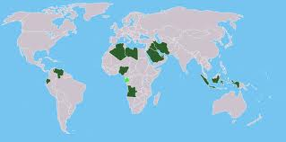
Arabian Peninsula
Saudi Arabia*, Yemen, UAE, Oman, Qatar, Bahrain
Oil exports support economies
Oil discovered in 1930’s
Major suppliers of the world’s energy
Petrochemicals
products made from petroleum and natural gas
plastics, cosmetics, detergents, fertilizers, etc.
OPEC
Organization of Petroleum Exporting Countries
Decides how much oil to produce and the price
12 member nations around the world

Slide 11
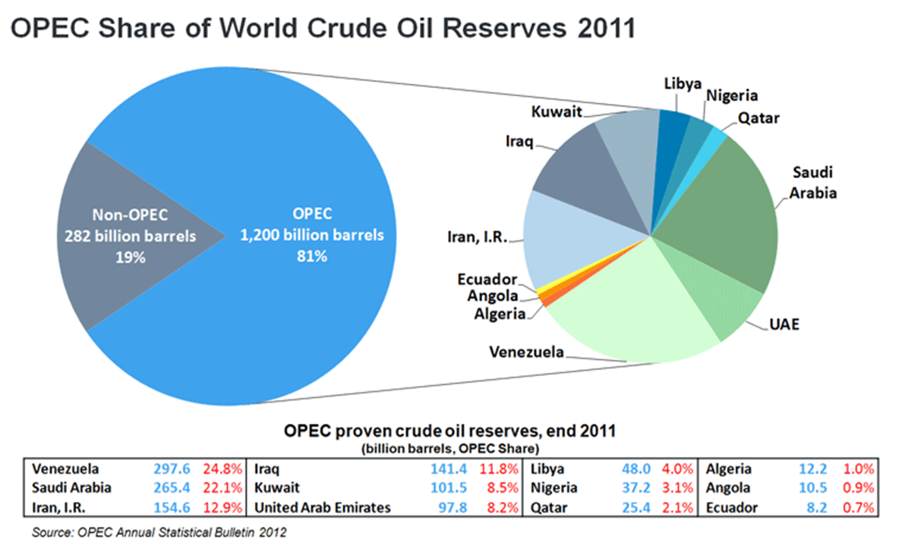

Slide 12
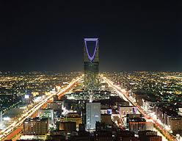
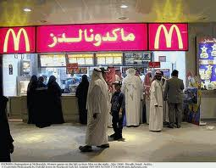
Saudi Arabia
World’s second leading producer of oil
Schools, hospitals, roads, and airports built with oil income
Building new industries to diversify economy
95% of oil industry operated by government
Relies on specialized labor from other countries
Gov’t trying to increase private ownership of business

Slide 13
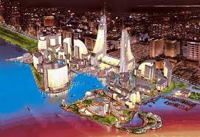
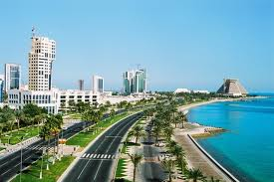
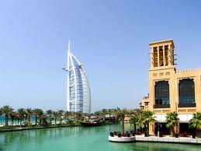
The Persian Gulf Countries
Includes Kuwait, Bahrain, Qatar, and the United Arab Emirates (UAE)
Profits from oil exports used to build strong, wealthy economies
Education, health care, and other services provided to citizens for free
Diversifying economy in case oil runs out

Slide 14
Diversification (from www.strategyand.pwc.com)
Creating an economy that depends on a variety of goods and services for income (instead of just one)
Purpose: To make a country’s economy sustainable (long-lasting)
In the Middle East:
Too many countries’ economies depend only on oil, and oil is a non-renewable resource. It will eventually run out.
Possible Ways to Diversify:
Tourism, Clothing, Agriculture, Manufacturing

Slide 15
Economic continuum
Command
•
SA T
I
Market
•
•
•
62 63 70

Slide 16
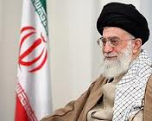
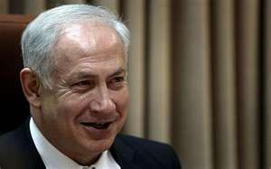
Governments of Middle East
Let’s review the different types of governments
Absolute Monarchy
Dictatorship
Autocracy
Oligarchy
Democracy
Parliamentary
Presidential
Theocracy
King Salman (SA)
Hasan Ruhani (Ir.)
Ayatollah Khameini (Ir.)
Benjamin Netanyahu (Is.)

Slide 17
Standard SS7CG5 The student will explain the structures of the national governments of Southwest Asia (Middle East)
a. Compare the parliamentary democracy of the State of Israel, the monarchy of the kingdom of Saudi Arabia, and the theocracy of the Islamic Republic of Iran, distinguishing the form of leadership and the role of the citizen in terms of voting rights and personal freedoms.

Slide 18
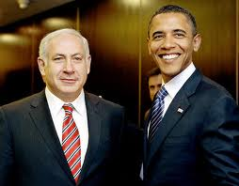
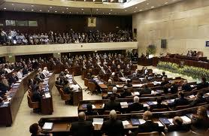
Israel
Parliamentary Democracy
Prime Minister comes from within Parliament, and Parliament is elected by the people.
Parliament is known as Knesset (120 members, 4 yr. terms)
Coalition government of many parties.
Prime Minister is Benjamin (Bibi) Netanyahu
President (Reuven Rivlin) is a ceremonial role, not part of three branches
Major issue is security.
All citizens 18 and over can vote and speak freely.

Slide 19
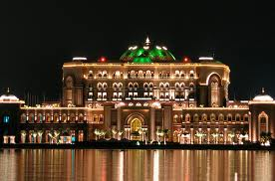
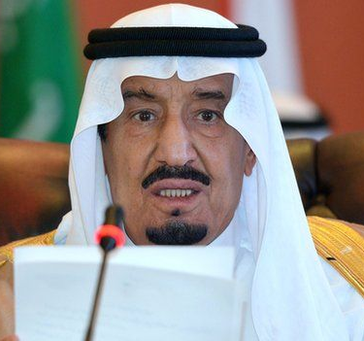
Saudi Arabia
Islamic absolute monarchy (Al-Saud dynasty)
The king inherits his position
Qur’an is the constitution of the country, which is governed on the basis of Islamic law (Shari’a).
No political parties and no national elections
Cabinet is appointed by king (many are royal family members)
Citizens (Women – first voted in 2015) elect local council members. Voting age is 21, not 18!
The King of Saudi Arabia is both head of state and the head of government
King Salman inherited throne in Jan. 2015 when half-brother, King Abdullah, died (who had ruled since 2005).
http://www.bbc.com/news/world-middle-east-14703478

Slide 20
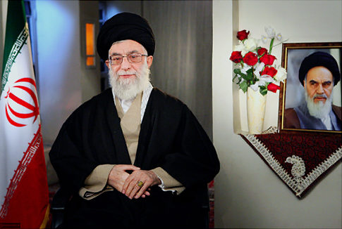
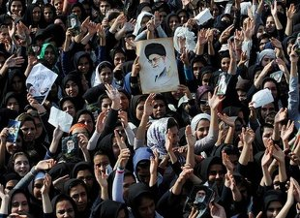
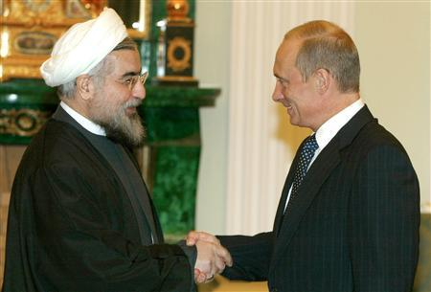
Iran
Theocracy/Presidential Democracy
Ayatollah Ali Khamenei is the Head of State (1989-present)
Religious leader – theocracy
“Supreme Leader” according to Qur’an
Appointed by special committee for life
Election of president in June 2013
Citizens 18 and over can vote.
President Hasan Ruhani:
“My government will be one of prudence and hope and my message is about saving the economy, reviving ethics and interaction with the world.”

Slide 21
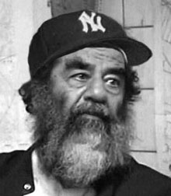
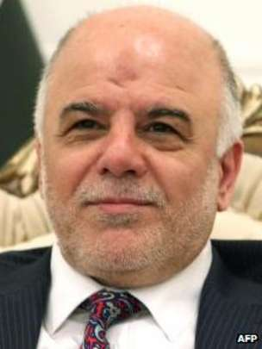
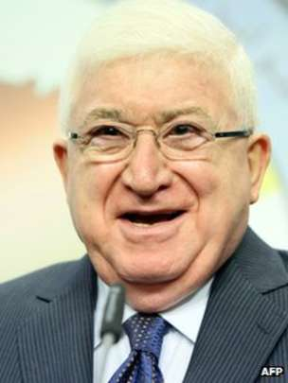
Iraq
Saddam Hussein (former dictator)was captured (2003) by U.S. and tried by the Iraqi government.
U.S. has sponsored elections but split between Sunni, Shiite, and Kurds has made free elections difficult.
2010 open and free elections
Parliamentary Government
Prime Minister – Haider al-Abadi (not elected – asked by Parliament, in Sept. 2014 – Shia but has more Sunni and Kurdish support than old leader)
President: Fuad Masum (second ethnic Kurd – elected by parliament July 2014)
U.S. soldiers are leaving
Violence continues to disrupt stability
http://www.bbc.com/news/world-middle-east-14544543

Slide 22
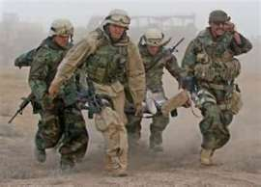
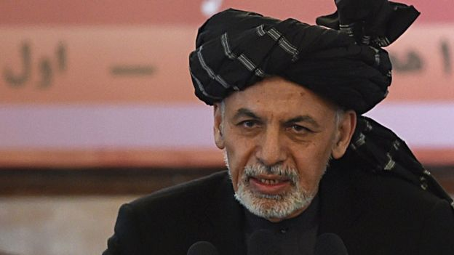
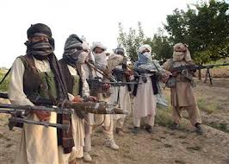
Afghanistan
Theocracy and democracy
United States’ goal: stabilize and bring democracy.
Constitution set in 2004 with help of N.A.T.O.
Ashraf Ghani
President sworn in in September 2014 following months of bitter argument over who won the election
He replaced Hamid Karzai, who led the country for twelve years after the Taliban were overthrown in 2001.
Taliban still in control of parts of southern and southeastern Afghanistan and Pakistan
Democracy has been slow to grow because of fear and influence of Taliban
Oct. 2015 – President Obama announced plan to keep 5,500 troops there indefinitely
Had pledged to get all troops out
Taliban and its Pakistani supporters can’t just wait out the U.S. any more.
https://www.washingtonpost.com/politics/obama-and-pakistani-leader-focus-on-peace-talks-in-afghanistan/2015/10/22/2afff154-78bc-11e5-a958-d889faf561dc_story.html
http://www.bbc.com/news/world-south-asia-12011352

