Slide 1
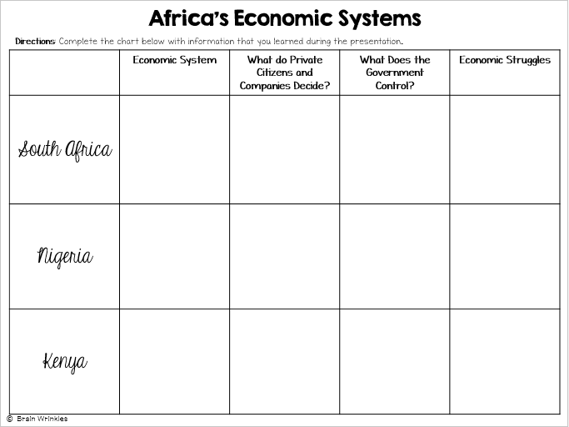
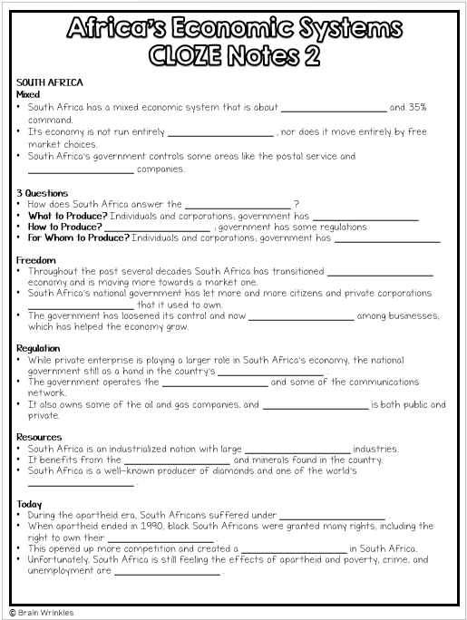
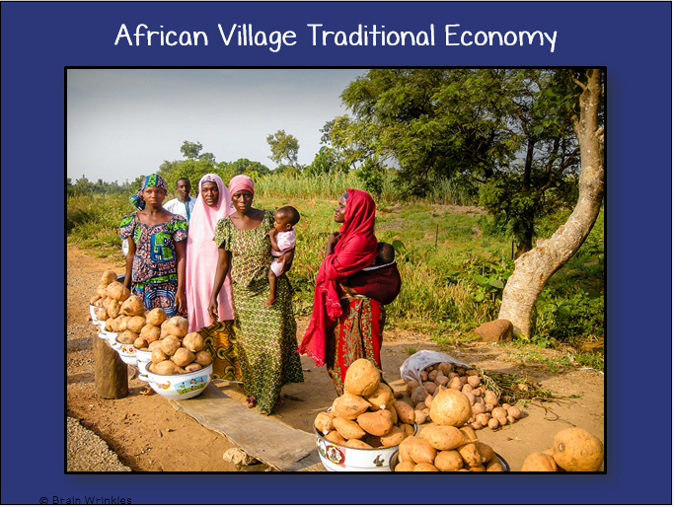
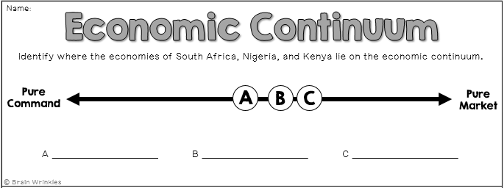
Africa’s
ECONOMIC
SYSTEMS
ECONOMIC
SYSTEMS
Presentation, Graphic Organizers, & Activities

Slide 2
Let’s Review
Do you remember the ___________________ that every country must answer when developing its economic plan?
What goods/services ___________________ ?
___________________ be produced?
___________________ the goods/services?
The way a country answers these questions determines what kind of ___________________ it will have: Traditional, Command, Market
Traditional
All economic decisions are based on customs, traditions, & beliefs ___________________ .
People will make what they always made and do the ___________________ their parents did.
The exchange of goods is done through bartering. Bartering = trading ___________________
___________________ have traditional economies
Command
All economic decisions are made by the ___________________ .
The government owns most of the property, sets the prices of goods, ___________________ of workers, plans what will be made…everything.
This system has not been very successful; more and more countries are ___________________ .
This system is ___________________ to live under; because of this, there are no PURE command countries in the world today.
Some countries are close: ___________________ , former Soviet Union, North Korea, former East Germany, etc.
All of these countries have the same type of government: ___________________ ! The government is in control of everything.
Market
Economic decisions are made based on the ___________________ that occur as buyers & sellers interact in the market place.
The government has ___________________ over the economy; private citizens answer all economic questions.
In a truly free market economy, the government would ___________________ at all. Scary…
There would be ___________________ to make sure goods/services were safe. *Food! Medicine!
There would be no laws to ___________________ from unfair bosses.
Because of this, there are ___________________ economies, but some countries are closer than others.
Hmmm…
Since there are ___________________ that are purely command or purely market, what does that make them?
Most ___________________ have some characteristics of both systems, so we keep it simple and call them: MIXED.
Of course, most countries’ economies are ___________________ of system than another.
© Brain Wrinkles
Africa’s Economic Systems
CLOZE Notes 1

Slide 3
SOUTH AFRICA
Mixed
58.3 on Heritage Freedom Index
Its economy is not run entirely ___________________ , nor does it move entirely by free market choices.
South Africa’s government controls some areas like the postal service and ___________________ companies.
3 Questions
How does South Africa answer the ___________________ ?
What to Produce? Individuals and corporations; government has ___________________
How to Produce? ___________________ ; government has some regulations
For Whom to Produce? Individuals and corporations; government has ___________________
Freedom
Throughout the past several decades South Africa has transitioned ___________________ economy and is moving more towards a market one.
South Africa’s national government has let more and more citizens and private corporations ___________________ that it used to own.
The government has loosened its control and now ___________________ among businesses, which has helped the economy grow.
Regulation
While private enterprise is playing a larger role in South Africa’s economy, the national government still as a hand in the country’s ___________________ .
The government operates the ___________________ and some of the communications network.
It also owns some of the oil and gas companies, and ___________________ is both public and private.
Resources
South Africa is an industrialized nation with large ___________________ industries.
It benefits from the ___________________ and minerals found in the country.
mining (world's largest producer of platinum, gold, chromium)
South Africa is a well-known producer of diamonds and one of the world’s ___________________ .
Today
During the apartheid era, South Africans suffered under ___________________ .
When apartheid ended in 1990, black South Africans were granted many rights, including the right to own their ___________________ .
This opened up more competition and created a ___________________ in South Africa.
Unfortunately, South Africa is still feeling the effects of apartheid and poverty, crime, and unemployment are ___________________ .
© Brain Wrinkles
Africa’s Economic Systems
CLOZE Notes 2

Slide 4
NIGERIA
Mixed
57.3 on Heritage Freedom Index
In 2015, Nigeria surpassed South Africa to become the ___________________ in Africa.
3 Questions
How does Nigeria answer the three ___________________ ?
What to Produce? ___________________ ; government regulates oil and agriculture
How to Produce? Individuals and corporations; government ___________________
For Whom to Produce? Individuals and ___________________ ; government regulates oil and agriculture
Freedom
In recent years, Nigeria has transitioned away from a ___________________ and is moving more towards a market one.
Citizens are ___________________ and start their own businesses.
Regulation
Private enterprise is playing a larger role in Nigeria’s economy; however, the Nigerian government still controls large parts of the country’s two most important industries— ___________________.
Recently, the national government has been giving more control of these industries to private businesses in hopes of ___________________ and the standard of living for Nigerians.
Resources
Nigeria is fortunate in that it has many ___________________ .
___________________, oil was discovered in the country.
Since then, Nigeria’s economy has grown based on its ___________________ to countries around the world.
Nigeria is the ___________________ in Africa.
Today
Since gaining its independence in 1960, Nigeria has been ruled by ruthless ___________________ .
Under strict government control, Nigeria had mostly a ___________________ .
Today, the country is more democratic and the government is ___________________ to its citizens.
Nigeria’s government has been partnering with private businesses to provide greater access to electricity, improve roads, and to ___________________ .
© Brain Wrinkles
Africa’s Economic Systems
CLOZE Notes 3

Slide 5
KENYA
Mixed
55.1 on Heritage Freedom Index
High levels of ___________________ have hurt the country’s overall score on the Index of Economic Freedom.
3 Questions
How does Kenya ___________________ economic questions?
What to Produce? ___________________ corporations; government regulates mining, banking, oil refining, & electricity
How to Produce? Some individuals and corporations; ___________________ mining, banking, oil refining, & electricity
For Whom to Produce? Some individuals and corporations; government regulates mining, banking, oil refining, & ___________________
Freedom
Kenya’s citizens are allowed to own property and start ___________________ .
Businesses decide what to produce and how, and ___________________ for their products.
Unfortunately, because of corruption and bribery in Kenya’s government, laws meant to protect businesses are ___________________ .
Regulation
Kenya’s government owns all or part of several industries including ___________________ , electricity, mining, and oil refining.
Resources
Kenya is the banking, transportation ,and ___________________ hub of East Africa.
Agriculture, ___________________ , and manufacturing have helped Kenya become the strongest economy in the region.
Primary Industry: small-scale consumer goods (plastic, furniture, batteries, textiles, clothing, soap, cigarettes, flour)
Today
In recent years, Kenya’s agriculture industry has ___________________ .
Also, the tourism industry has declined due to ___________________ within the region.
Fortunately, Kenya’s ___________________ .
Economists predict that it will continue to ___________________ as the quality of life for Kenyans improves.
© Brain Wrinkles
Africa’s Economic Systems
CLOZE Notes 4

Slide 6
Africa’s
Economic
Systems
South Africa, Nigeria,
and Kenya
© Brain Wrinkles

Slide 7
STANDARDS:
SS7E1 Analyze different economic systems.
Compare how traditional, command, and market economies answer the economic questions of 1-what to produce, 2-how to produce, and 3-for whom to produce.
Explain that countries have a mixed economic system located on a continuum between pure market and pure command.
Compare and contrast the economic systems in South Africa, Nigeria, and Kenya.
© Brain Wrinkles

Slide 8
Let’s Review
Do you remember the three questions that every country must answer when developing its economic plan?
What goods/services will be produced?
How will goods/services be produced?
Who will consume the goods/services?
The way a country answers these questions determines what kind of economic system it will have:
Traditional Command Market
© Brain Wrinkles

Slide 9
Traditional
All economic decisions are based on customs, traditions, & beliefs of the past.
People will make what they always made and do the same things their parents did.
The exchange of goods is done through bartering.
Bartering = trading without using money
Rural African villages have traditional economies.
© Brain Wrinkles

Slide 10
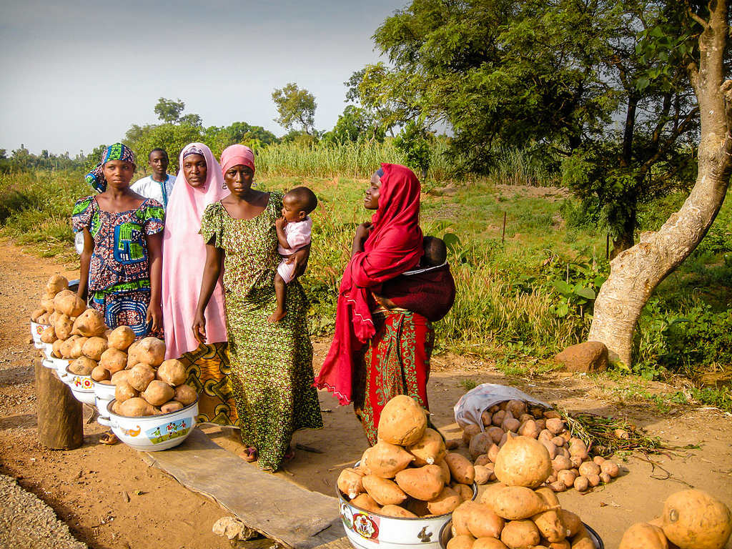
African Village Traditional Economy
© Brain Wrinkles

Slide 11
Command
All economic decisions are made by the Government.
The government owns most of the property, sets the prices of goods, determines the wages of workers, plans what will be made…everything.
This system has not been very successful; more and more countries are abandoning it.
© Brain Wrinkles

Slide 12
Command
This system is very harsh to live under; because of this, there are no PURE command countries in the world today.
Some countries are close: Cuba, former Soviet Union, North Korea, former East Germany, etc.
All of these countries have the same type of government: Communist! The government is in control of everything.
© Brain Wrinkles

Slide 13
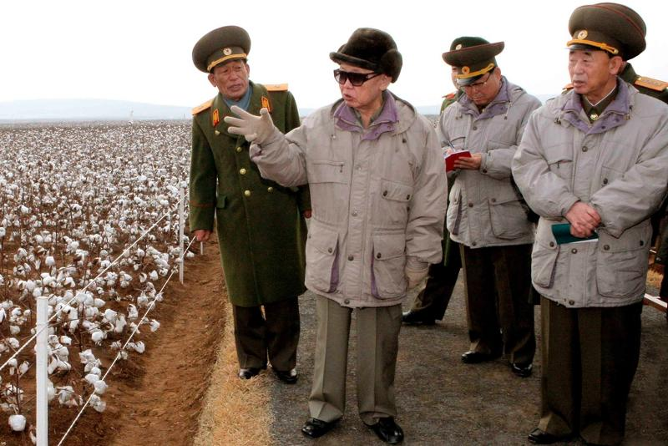
North Korea’s Command Economy
© Brain Wrinkles

Slide 14
Market
Economic decisions are made based on the changes in prices that occur as buyers & sellers interact in the market place.
The government has no control over the economy; private citizens answer all economic questions.
In a truly free market economy, the government would not be involved at all. Scary…
There would be no laws to make sure goods/services were safe. *Food! Medicine!
There would be no laws to protect workers from unfair bosses.
Because of this, there are no PURE market economies, but some countries are closer than others.
© Brain Wrinkles

Slide 15
Hmmm…
Since there are no countries that are purely command or purely market, what does that make them?
Most democratic countries have some characteristics of both systems, so we keep it simple and call them: MIXED.
Of course, most countries’ economies are closer to one type of system than another.
© Brain Wrinkles

Slide 16
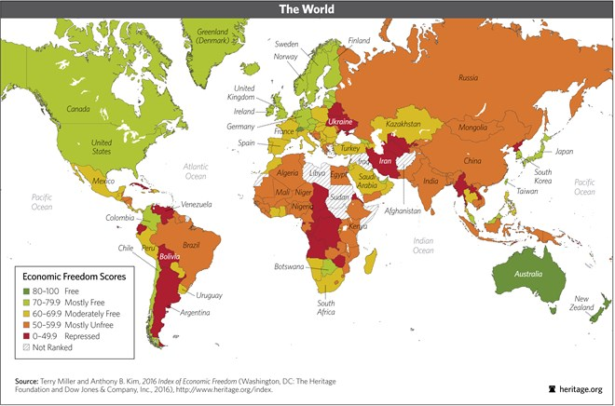
2016 Index of Economic Freedom
© Brain Wrinkles

Slide 17
SOUTH
AFRICA
© Brain Wrinkles

Slide 18
Mixed
58.5 on Heritage Freedom Index (HFI)
Its economy is not run entirely by the government, nor does it move entirely by free market choices.
South Africa’s government controls some areas like the postal service and some oil and gas companies.
© Brain Wrinkles

Slide 19
3Questions
How does South Africa answer the three economic questions?
What to Produce? Individuals and corporations; government has some regulations
How to Produce? Individuals and corporations; government has some regulations
For Whom to Produce? Individuals and corporations; government has some regulations
© Brain Wrinkles

Slide 20
Freedom
Throughout the past several decades South Africa has transitioned away from a command economy and is moving more towards a market one.
South Africa’s national government has let more and more citizens and private corporations take over industries that it used to own.
The government has loosened its control and now encourages competition among businesses, which has helped the economy grow.
© Brain Wrinkles

Slide 21
Regulation
While private enterprise is playing a larger role in South Africa’s economy, the national government still as a hand in the country’s economic planning.
The government operates the postal service and some of the communications network.
It also owns some of the oil and gas companies, and healthcare is both public and private.
© Brain Wrinkles

Slide 22
Resources
South Africa is an industrialized nation with large service and manufacturing industries.
It benefits from the abundant precious metals and minerals found in the country.
Primary Industry: mining (world's largest producer of platinum, gold, chromium)
South Africa is a well-known producer of diamonds and one of the world’s top producers of gold.
© Brain Wrinkles

Slide 23
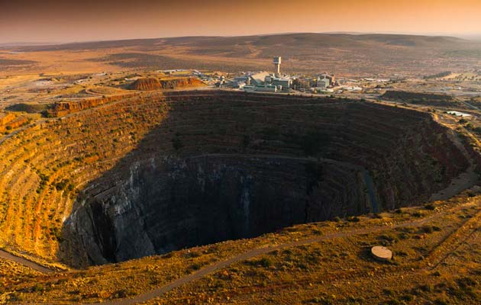
Finsch Diamond Mine, South Africa
© Brain Wrinkles

Slide 24
Today
During the apartheid era, South Africans suffered under segregation laws.
When apartheid ended in 1990, black South Africans were granted many rights, including the right to own their own businesses.
This opened up more competition and created a stronger market economy in South Africa.
Unfortunately, South Africa is still feeling the effects of apartheid and poverty, crime, and unemployment are problems the country faces.
© Brain Wrinkles

Slide 25
NIGERIA
© Brain Wrinkles

Slide 26
Mixed
57.3 on Heritage Freedom Index
In 2015, Nigeria surpassed South Africa to become the largest economy in Africa.
© Brain Wrinkles

Slide 27
3Questions
How does Nigeria answer the three economic questions?
What to Produce? Individuals and corporations; government regulates oil and agriculture
How to Produce? Individuals and corporations; government regulates oil and agriculture
For Whom to Produce? Individuals and corporations; government regulates oil and agriculture
© Brain Wrinkles

Slide 28
Freedom
In recent years, Nigeria has transitioned away from a mostly command economy and is moving more towards a market one.
Citizens are free to own property and start their own businesses.
© Brain Wrinkles

Slide 29
Regulation
Private enterprise is playing a larger role in Nigeria’s economy; however, the Nigerian government still controls large parts of the country’s two most important industries—oil and agriculture.
Recently, the national government has been giving more control of these industries to private businesses in hopes of improving the economy and the standard of living for Nigerians.
© Brain Wrinkles

Slide 30
Resources
Nigeria is fortunate in that it has many valuable natural resources.
In the 1970s, oil was discovered in the country.
Since then, Nigeria’s economy has grown based on its ability to export oil to countries around the world.
Nigeria is the largest producer of oil in Africa.
© Brain Wrinkles

Slide 31
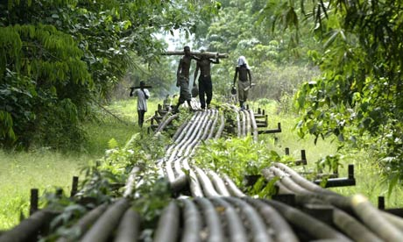
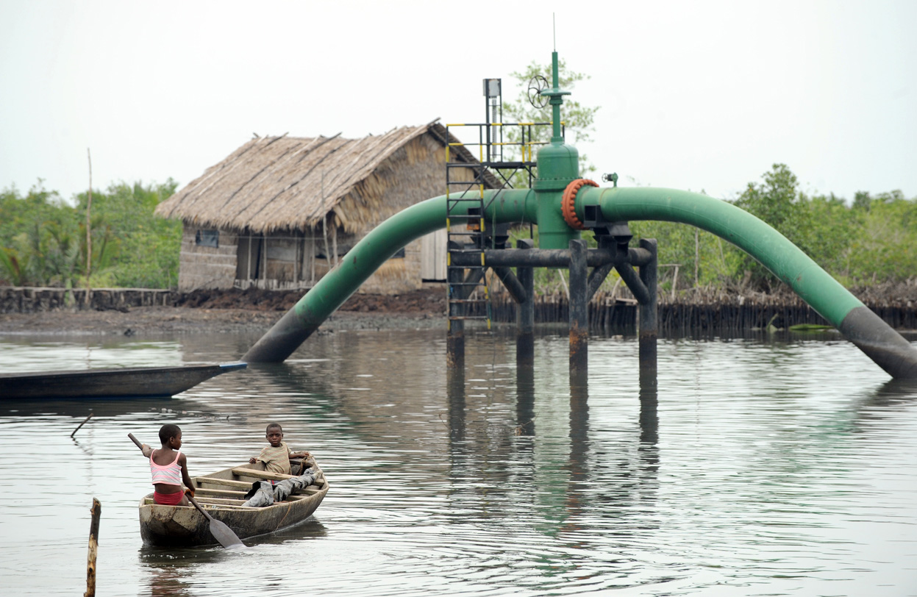
Nigerian Oil Pipes
© Brain Wrinkles

Slide 32
Today
Since gaining its independence in 1960, Nigeria has been ruled by ruthless military dictatorships.
Under strict government control, Nigeria had mostly a command economy.
Today, the country is more democratic and the government is giving more economic freedom to its citizens.
Nigeria’s government has been partnering with private businesses to provide greater access to electricity, improve roads, and to increase agriculture.
© Brain Wrinkles

Slide 33
KENYA
© Brain Wrinkles

Slide 34
Mixed
55.1 on Heritage Freedom Index
High levels of corruption in Kenya’s government have hurt the country’s overall score on the Index of Economic Freedom.
© Brain Wrinkles

Slide 35
3Questions
How does Kenya answer the three economic questions?
What to Produce? Some individuals and corporations; government regulates mining, banking, oil refining, & electricity
How to Produce? Some individuals and corporations; government regulates mining, banking, oil refining, & electricity
For Whom to Produce? Some individuals and corporations; government regulates mining, banking, oil refining, & electricity
© Brain Wrinkles

Slide 36
Freedom
Kenya’s citizens are allowed to own property and start their own businesses.
Businesses decide what to produce and how, and what prices to charge for their products.
Unfortunately, because of corruption and bribery in Kenya’s government, laws meant to protect businesses are not always fairly enforced.
© Brain Wrinkles

Slide 37
Regulation
Kenya’s government owns all or part of several industries including banking, electricity, mining, and oil refining.
© Brain Wrinkles

Slide 38
Resources
Kenya is the banking, transportation ,and communication hub of East Africa.
Agriculture, tourism, and manufacturing have helped Kenya become the strongest economy in the region.
Primary Industry: small-scale consumer goods (plastic, furniture, batteries, textiles, clothing, soap, cigarettes, flour)
© Brain Wrinkles

Slide 39
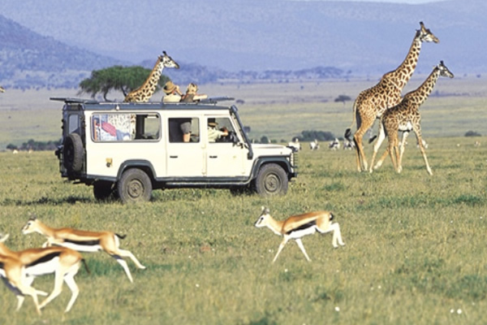
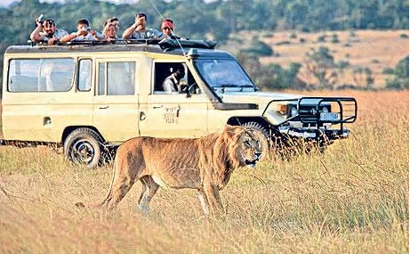
Safari Tour in Kenya
© Brain Wrinkles

Slide 40
Today
In recent years, Kenya’s agriculture industry has suffered from drought.
Also, the tourism industry has declined due to terrorist activity within the region.
Fortunately, Kenya’s economy is recovering.
Economists predict that it will continue to grow stronger as the quality of life for Kenyans improves.
© Brain Wrinkles

