Slide 1
Entry # 23
(9/5/19)
In what year was Israel created?
1918
1928
1938
1948
2. Jordan’s major surface water sources are shared with what two countries?
Iran & Syria
Israel & Syria
Saudi Arabia & Turkey
Iraq & Israel
Exit # 23
(9/5/19)
Why is the little water that is available in Saudi Arabia of poor quality?
It’s polluted with trash
It’s has oil in it
It has salt water intrusion
It’s polluted with chemicals
2. What is desertification?
Turning desert into farmland
Turning farmland into desert
Taking salt out of sea water
Taking salt out of fresh water

Slide 2
Entry # 24
(9/6/19)
1. How many decades of warfare have caused damage to Iraq’s water treatment plants?
7
5
3
1
2. What has allowed Israel to turn once-barren desert land into farmland?
Money from oil
New farming technology
Advancement in computer tech
An abundance of rain water
Exit # 24
(9/6/19)
1. Because rainfall is down where does Israel get its water?
Aquifers
Dams
Lakes
Oceans
2. Jordan is one of the ____ most water scarce countries in the world?
7
8
9
10

Slide 3
Entry # 25
(9/9/19)
1. What large body of water is also causing water pollution for Turkey because also oil spills?
Red Sea
Mediterranean Sea
Dead Sea
Black Sea
2. Syria has a hard time watering the land which causes a shortage in?
Water
Food
Rivers
Oceans
Exit # 25
(9/9/19)
1.In Iraq what food production has decreased because of dams?
Potatoes & Rice
Wheat & Corn
Wheat & Rice
Rice & Rye
2. What country has the world’s largest desalination plant?
Iraq
Saudi Arabia
Afghanistan
Syria

Slide 4
Exit # 26
(9/10/19)
1. What does it mean if something is hijacked?
It is borrowed and then returned
It is set on fire
C. It is won by election
D. It is forcefully taken over
2. After the attack on Pearl Harbor, the U.S. entered WWII. After the attack on 9/11, a War on Terror was announced. What do both attacks have in common?
A. Both attacks were on American soil and caused public outrage
B. Both attacks were on foreign soil and caused public outrage
C. Both attacks involved hijacked planes, which destroyed buildings and lives
D. Both attacks were directed against military targets, not civilian targets
Entry # 26
(9/10/19)
What is the date for the collapse of the twin towers.
Sep. 11, 1999
Sep. 11, 2000
Sep. 11, 2001
Sep. 11, 2002
2. America did declare war on Afghanistan after the 9/11 attacks.
True
False

Slide 5
Entry # 27
(9/11/19)
1. What country was the al Qaeda terrorist from?
Iran
Afghanistan
Iraq
Kuwait
2. Which person was ultimately responsible for the terrorist attacks against America on 9/11?
A. Saddam Hussein
B. Osama bin Laden
C. Yasser Arafat
D. Mahmoud Ahmedinejad
Exit # 27
(9/11/19)
1. What inference has been made about the fourth hijacked plane from 9/11?
A. The passengers took the plane over from the hijackers.
B. The hijackers planned to crash the plane in a field.
C. The plane suffered from a mechanical failure.
D. The hijackers did not know how to properly fly the plane
2. Which phrase best describes al Qaeda?
A. Regimented army
B. Enemy state
C. Criminal network
D. Fascist dictatorship

Slide 6
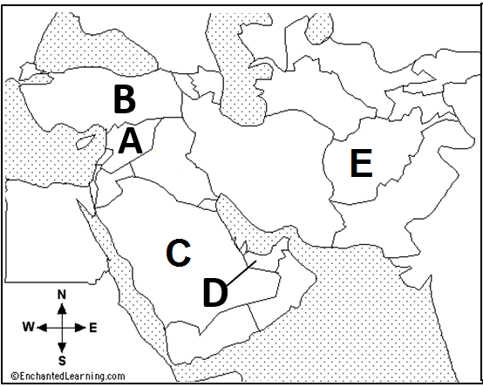
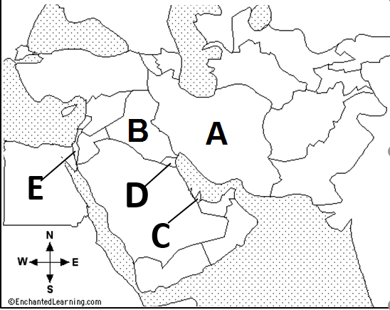
Entry # 28
(9/12/19)
Exit # 28
(9/12/19)
1. Afghanistan_____
2. Saudi Arabia_____
3. Syria____
4. Turkey____
5. UAE_____
1. Kuwait____
2. Iran___
3. Israel____
4. Qatar____
5. Iraq___

Slide 7
Exit # 29
(9/13/19)
1. Lack of water and water rights have lead to __ in SWA?
Abundance of food
Natural disasters
Water wars
Plentiful fertile land
2. Syria has enough water and food to sustain its people?
True
False
Entry # 29
(9/13/19)
1. What is a drawback of desalination?
You can’t get all the salt out of the water
It is very expensive & requires complex technology.
It is only available to one country
Many countries do not know how to use it.
2. What is hydroelectric power?
A. electricity produced from energy of slow moving water
B. electricity produced from energy of rapid moving water
C. electricity produced from wind energy
D. electricity produced from solar energy

Slide 8
Entry # 30
(9/16/19)
What is Saudi Arabia’s most valuable resource?
Water
People
Gold
Oil
2. What is desertification?
The shrinking of deserts
The evaporation of deserts
The expansion of deserts
The avoidance of deserts
Exit # 30
(9/16/19)
How many miles of land does the Middle East have?
4.4 million
3.6 million
2.8 million
1.2 million
2. How much of the land is covered in desert?
More than 1/8
More than 1/4
More than 2/3
More than 1/2

Slide 9
Exit # 31
(9/17/19)
Where is the great Syrian Desert located?
Syria & Iraq
Syria & Iran
Syria & Israel
Syria & Jordan
2. What can provide a temporary water source in the desert?
Mountains
Oases
Plants
Streams
Entry # 31
(9/17/19)
What is the most common landform in SWA?
Beaches
Mountains
Flat Plains
Deserts
2. What is Rub al-Khali?
Waste Land
Empty Quarter
Fertile Land
Plentiful Quarter

Slide 10
Entry # 32
(9/18/19)
Why are deserts not a favorable place to live?
Has lots of rainstorms
Too cold and windy
Extremely hot & arid
Extremely cool & dry
2. How high can the temperatures reach during the day in some areas of the deserts?
520°F
430°F
210°F
125°F
Exit # 32
(9/18/19)
1. What is a Bedouin?
Water Nomad
Desert Nomad
Forest Nomad
Land Nomad
2. What types of homes do Bedouins live in?
Tent camps & Huts
Brick Buildings
Twigs and Mud structure
Recreational Vehicles

Slide 11
Entry # 33
(9/19/19)
1. What natural resource was discovered in SWA that caused people to move from the deserts?
A. Water
B. Oil
C. Gold
D. Silver
2. Over the past _____ years residents have left the desert & moved to cities.
70
60
50
40
Exit # 33
(9/19/19)
What percentage of SWA population remains nomadic herders?
1%
3%
5%
7%
2. What type of herders are many of the Bedouins?
Pigs, Cows, & Chickens
Deer, Goats, & Pigs
Sheep, Camel, & Goat
Sheep, Goats, & Cows

Slide 12
Entry # 34
(9/20/19)
1.What type of products do Bedouins trade?
People and water
Animals and hand made goods
Furs and food
Jewels and Oil
2. Many people leave the desert & move to cities in order to do what?
Better Medical
Better Water
Better Education
Better Jobs
Exit # 34
(9/20/19)
1.How do people travel across the desert in SWA?
On Foot
By Bike
Goats
Camels & ATV’s
2. The Tigris River joins with the Euphrates River to create which river?
Shatt al Arab
Jordan
Nile
Al-Gharraf

Slide 13
Entry # 35
(9/30/19)
1.What is an example of religion?
Christmas
Kurdish
Islam
Persians
2. What is a non-example of religion?
Judaism
Persians
Islam
Christianity
Exit # 35
(9/30/19)
1. What is an example of ethnic groups?
Islam
Christianity
Judaism
Persians
2. What is a non-example of ethnic groups?
Kurds
Hispanics
Christians
Persians

Slide 14
Entry # 36
(10/1/19)
1.How many dominant religions started in Southwest Asia?
1
2
3
4
Exit # 36
(10/1/19)
What is not an ethnic group that we will study in Southwest Asia?
Kurds
Persians
Truks
Arabs

Slide 15
Entry # 37
(10/2/19)
Which of these are you born into?
Kurdish
Christianity
Muslim
Taoism
2. Which of these do you get to choose?
Kurdish
Japanese
Hinduism
American
Exit # 37
(10/2/19)
1.Is ethnicity determined by your skin color?
Yes
No
2. T/F religion is something that you have no choose in?
True
False

Slide 16
Entry # 38
(10/3/19)
What is polytheism?
The belief in one God
The belief in no Gods
The belief in many Gods
2. What is monotheism?
The belief in one God
The belief in no Gods
The belief in many Gods
Exit # 38
(10/3/19)
1.Which religions believes in the 10 Commandments?
Islam & Judaism
Judaism & Christianity
Christianity & Islam
2. Which religion calls it’s God Allah?
Christianity
Judaism
Islam

Slide 17
Entry # 39
(10/4/19)
What is the holy month of Fasting called for Muslims?
Rosh Hashanah
Yom Kippur
Ramadan
Arafat
2. Which city is deemed holy by all 3 religions?
Jerusalem
Mecca
Nazareth
Medina
Exit # 39
(10/4/19)
1.Which religion calls its holy book a bible?
Christianity
Judaism
Islam
2.Which religion is split into 2 sects of Sunni & Shia?
Christianity
Judaism
Islam

Slide 18
Entry # 45
(10/14/19)
1. 1. Why do many countries decide to build dams along their rivers?
A. The dam would provide water for dry areas and irrigation
B. It provides a reliable source of hydroelectric power
C. To control the flow of water and store it for dry seasons
D. all of the above
2. Though oases are part of the desert, people are able to live in an oasis region because___________. A. It has an underground water source
B. It has much cooler temperature
C. It is near the coast and has sea water
D. It rains very often
Exit # 45
(10/14/19)
1. Which of the following religions trace their origin back to Abraham?
A. Judaism
B. Christianity
C. Islam
D. All of the above
2. Christianity is different from Judaism and Islam in which of the following ways?
A. Christians believe in one God.
B. Christians worship Jesus as the son of God.
C. Christians pray five times a day.
D. Christians consider Jerusalem a holy city.

Slide 19
Entry # 46
(10/15/19)
What type of empire was the Ottoman Empire?
Jewish
Christian
Muslim
Buddhist
2. What year did Israel become a state?
1848
1748
1948
1648
Exit # 46
(10/15/19)
What is a theocracy?
Government ruled by a group of people
Government ruled by one person
Government ruled by the military
Government ruled by a religious leader
2. True or False the Ottoman Empire was tolerant of other religions?
True
False

Slide 20
Entry # 47
(10/16/19)
What was the final reason for the decline of the Ottoman Empire?
Technology began to fall behind
Picked losing side during WW1
Had to much land
Too much fighting
2. What country was created out of the Ottoman Empire falling?
Iran
Kuwait
Turkey
Israel
Exit # 47
(10/16/19)
What countries received the land that was once the Ottoman Empire?
France & Great Britain
Austria & Hungry
Germany & Great Britain
France & Germany
2. What does partitioned mean?
Keep together
Split/divide
Expansion
Addsion

Slide 21
Entry # 48
(10/17/19)
What did the creation of artificial political borders NOT follow in the Middle East after the fall of the Ottoman Empire?
Central & Authority divisions
Central & Religious divisions
Natural & Ethnic divisions
Central & Ethnic divisions
2. Where did the United Nations decide to establish a Jewish homeland?
Jordan
Iran
Syria
Palestine
Exit # 48
(10/17/19)
What divide Palestine in the years prior to WW2?
Transjordan
Jordan River
Golan Heights
West Bank
2. What city is sacred to all 3 religions?
Bethlehem
Tel Aviv
Jerusalem
Cairo

Slide 22
Entry # 49
(10/18/19)
1. Which of the following ethnic groups distinguish themselves by their ongoing struggle to have their own country?
A. Kurds
B. Muslims
C. Arabs
D. Persians
2. What is the primary disagreement between Sunni and Shia Muslims?
A. Who should be Muhammad’s successor?
B. How should water and oil rights in the region be divided?
C. Should Kurds or Arabs be in charge of the religion?
D. Should the religion of Islam be monotheistic?
Exit # 49
(10/18/19)
1. The majority of people that live in North Africa/Southwest Asia identify themselves ethnically as____
A. Kurd
B. Arab
C. Berber
D. European
2. Why have the major rivers of Southwest Asia become a part of political conflict?
A. Many rivers dry up during the hot summers.
B. The rivers have nothing to do with the area’s political conflict.
C. Most countries do not allow water to be taken out of rivers for irrigation.
D. Several countries have built dams along their portion of the river cutting off water to those living downstream.

