Slide 1
You will create your very own app to help solve one of Asia’s environmental issues. The next two slides will give further detail on how to complete this assignment. Below is your checklist for this.

Slide 2
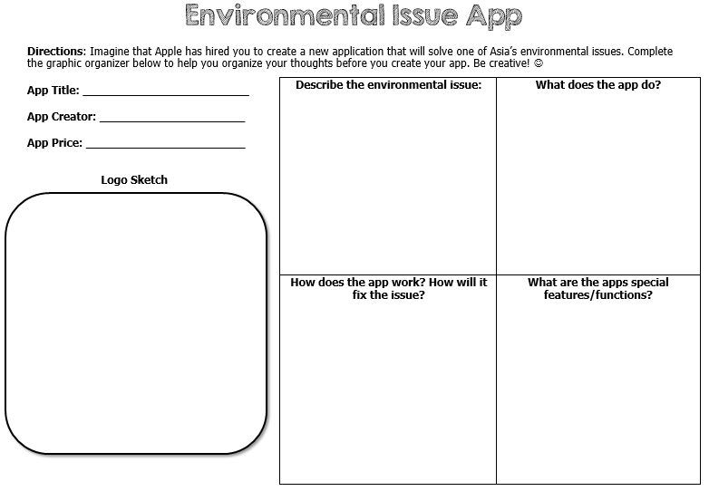

Slide 3
