Slide 1
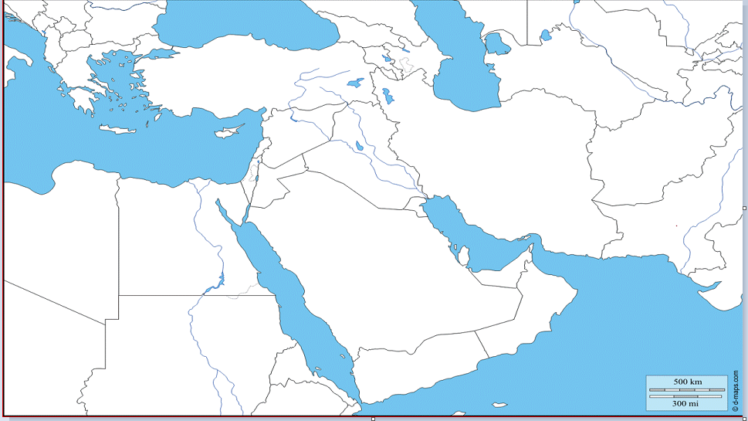
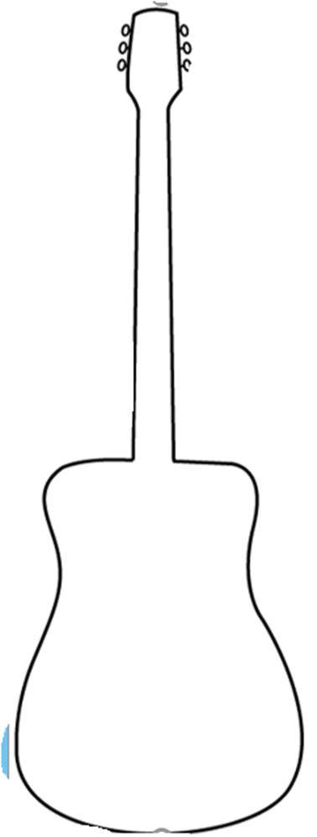
Turkey
Syria
Afghanistan
Iraq
Iran
Israel
Kuwait
Saudi Arabia
UAE
Qatar

