Slide 1
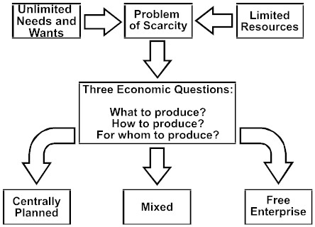
Command Economy
Mixed Economy
Market Economy

Slide 2
Economic System
Explains how a country answers the three questions of economics:
1) What to produce?
2) For whom to produce?
3) How to produce?
Traditional
Market
Command
MIXED

Slide 3
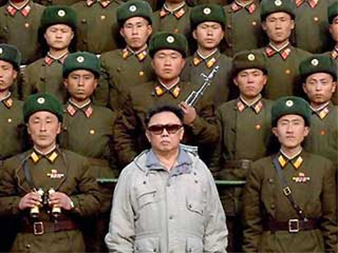
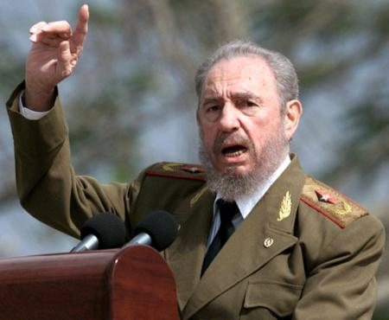
Command Economy
Government decides what is produced, who receives goods and services, and how things are produced
Examples: North Korea and Cuba are close to pure command economies

Slide 4
Market Economy
Consumers and producers determine what’s produced, who receives goods/services, and how things are produced (supply & demand)
Also called “capitalism” or “free market”
Encourages entrepreneurs (creators of new businesses)

Slide 5
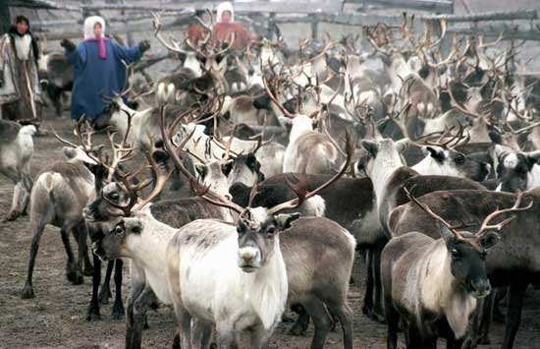
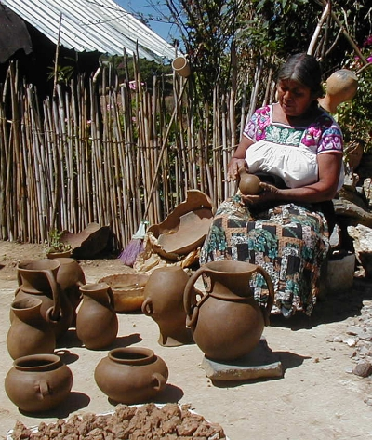
Traditional Economy
Economic decisions are based on a country’s or society’s customs and habits
Old ways of doing things—hunting or farming
Not common

Slide 6
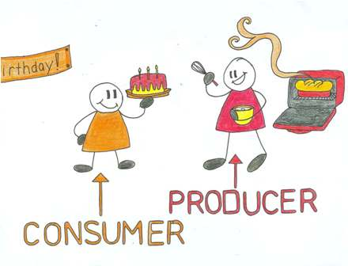
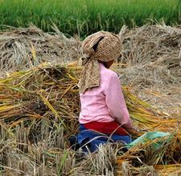
Mixed Economy
When a country combines elements of market and command systems (and sometimes traditional elements as well)
Most societies fall under this category, including ours!

Slide 7
Economic Systems
Pure
Command
Pure
Market
Mixed Economy

Slide 8
Economic Systems
United States
78%
Japan
73%
China
51%
0
100
Pure
Command
Pure
Market
Mixed Economy
Notes:
6th Grade- This information is meant to be used in conjunction with the 6th and 7th grade Teacher Notes. For additional resources, go to GeorgiaStandards.org. (Note: This is not an expectation for students to memorize numbers, but to understand that factors that influence specific countries to move more towards a command or market economy). The numbering system is based on The Heritage Foundation’s Economic Freedom Index 2009 The Heritage Foundation is a conservative organization that has partnered with the Wall Street Journal for over a decade to evaluate each country based on a set of 10 criteria to determine economic freedom. Update information using resources listed in the Teacher Notes.

Slide 9
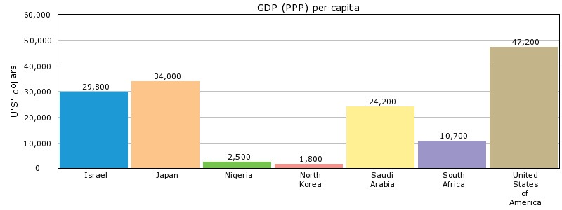
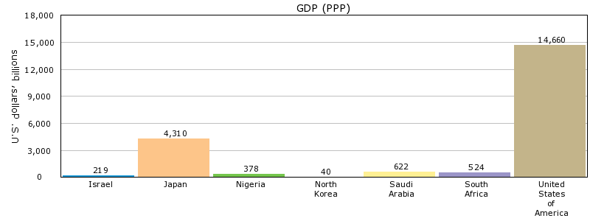
GDP
Gross Domestic Product
Total value of all goods and services produced in a country in a year
Investment in human capital and capital goods usually leads to increased GDP

Slide 10
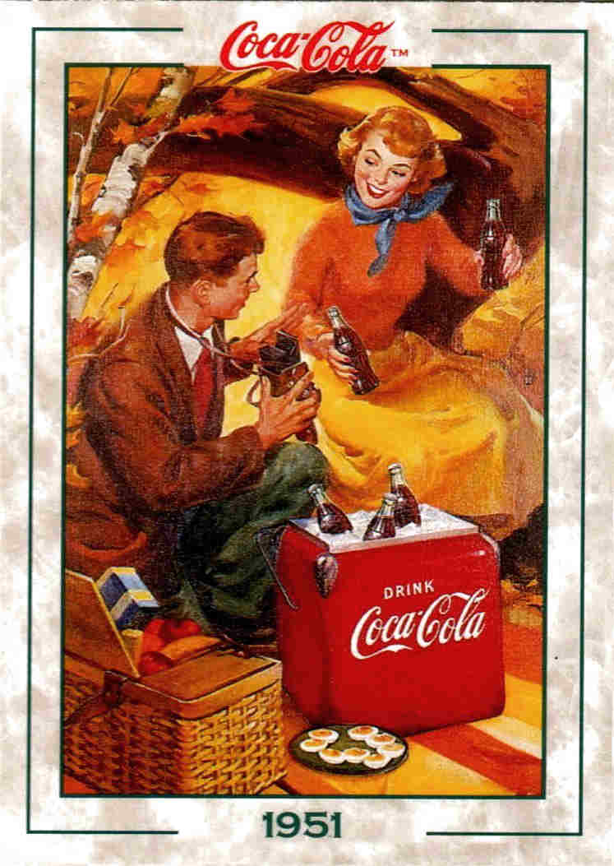
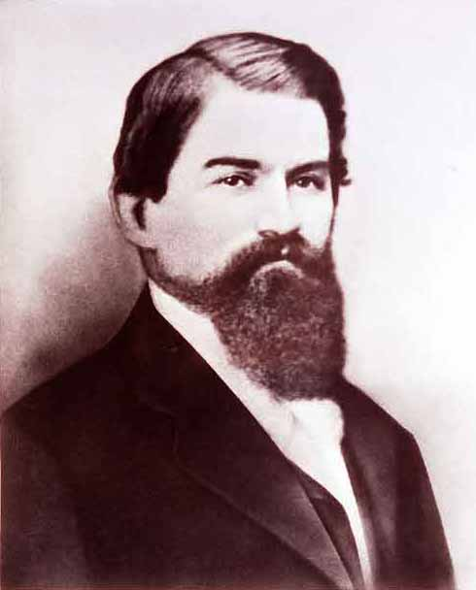
Entrepreneur
A person who combines resources to create new businesses
Entrepreneurs + land, labor, and capital = goods and services
John Pemberton

Slide 11
Trade
Trade = the exchange of goods and services in a market (Domestic—traders inside same country; international—exports and imports)
Exports: Goods produced within one country and sold outside of the country
Imports: Goods/services sold in a country but produced in other countries
Currency = money
Why do we need a system for exchanging currency for international trade?

Slide 12
Trade Barriers
Tariff = a tax on imports or exports
Quota = a restriction or limit on the amount of a good that can be imported (government imposed)
Embargo = a government ban on certain imports for political or economic reasons

