Slide 1
Africa
The standard of living for much of Africa is _____________________ .
Many Africans cannot _____________________ and poverty is widespread.
_____________________ of the world’s poorest countries are located in Africa.
There are many major issues across Africa that affect the people’s quality of life: unstable governments, _____________________ , lack of healthcare, and the threat of famine.
Instability
_____________________ is a major issue that has kept African nations from improving their citizens’ standard of living.
In many parts of Africa, civil wars, _____________________ , and revolutions have caused power to change hands many time.
When a country’s government is unstable, it cannot meet the _____________________ .
Political conflicts keeps many countries from providing _____________________ and finding solutions to the issues of famine, poverty, and disease.
Education
Access to education is an issue that _____________________ face.
Many of these nations have been involved in civil wars and have had _____________________ to invest in an education system.
Because of this, access to education in Africa is _____________________ .
Children who live in _____________________ have greater access to education.
In rural areas, there is a _____________________ , teachers, and school buildings.
Often, families are _____________________ all of their children to school, so some have to work or do chores.
Gender Gap
_____________________ is a huge problem in Africa.
Some African societies believe that girls do not need an education, and instead, they should prepare for marriage by _____________________ .
Because of this, _____________________ are literate than men.
© Brain Wrinkles
Education, Health, & Famine
CLOZE Notes 1

Slide 2
Disease
The governments of many African nations have failed to focus on building _____________________ systems for their citizens.
As a result, there are too few hospitals, not enough doctors, and _____________________ to treat outbreaks of major diseases.
Epidemic
In many instances, African governments have not been effective in _____________________ in emergencies.
Outbreaks of diseases can turn into _____________________ when African governments do not act quickly.
Some epidemics that have _____________________ include malaria, Ebola, and AIDS.
AIDS in Africa
Today, 34 million people worldwide are living with HIV/AIDS, and _____________________ are in sub-Saharan Africa.
About _____________________ across the continent have AIDS, and 1.5 million have died.
These deaths have created over _____________________ .
The situation has gotten even worse as a _____________________ and weak educational and public health services.
The epidemic now places a huge burden on the healthcare systems on countries that barely have enough resources to _____________________ .
Few African countries _____________________ to treat AIDS patients.
Zimbabwe
Zimbabwe has one of the _____________________ of HIV/AIDS in the world.
The country also has _____________________ , civil unrest, and a suspicion of outside help—which has made the situation worse.
Zimbabwe also has a very poor economy, meaning that the _____________________ are impossible for most people to afford.
© Brain Wrinkles
Education, Health, & Famine
CLOZE Notes 2

Slide 3
Botswana
Botswana has maintained a _____________________ since the country gained independence in 1966.
As a result, Botswana _____________________ to help treat AIDS patients.
Botswana’s government has provided education and _____________________ for its citizens.
It was also the first country to offer the _____________________ for free to infected people.
Famine
_____________________ is one of Africa’s biggest problems.
Famine occurs when a region does _____________________ for a long period of time.
In many African countries, famine has taken a strong hold when governments have failed to provide enough resources to _____________________ .
Lack of Food
Many African countries _____________________ because of climate changes.
Repeated drought has plagued Africa _____________________ .
Soil barrenness and erosion have decreased the _____________________ .
AIDS has _____________________ available to farm the land.
Instability
The stability of a country’s government directly impacts the country’s ability to _____________________ to prevent famine.
Civil wars _____________________ for most people, including farmers, which causes food shortages.
Some governments have built armies instead of _____________________ for their people.
Other governments have used food as a weapon by _____________________ to political enemies.
© Brain Wrinkles
Education, Health, & Famine
CLOZE Notes 3

Slide 4
EDUCATION,
HEALTH, & FAMINE
© Brain Wrinkles

Slide 5
STANDARDS:
SS7CG2 Analyze how government instability in Africa impacts standard of living.
a. Describe the impact of government instability on access to education and the distribution of medicine and food to combat diseases and famine across Africa.
© Brain Wrinkles

Slide 6
Africa
The standard of living for much of Africa is very low.
Many Africans cannot meet their basic needs and poverty is widespread.
Three-fourths of the world’s poorest countries are located in Africa.
There are many major issues across Africa that affect the people’s quality of life: unstable governments, access to education, lack of healthcare, and the threat of famine.
© Brain Wrinkles

Slide 7
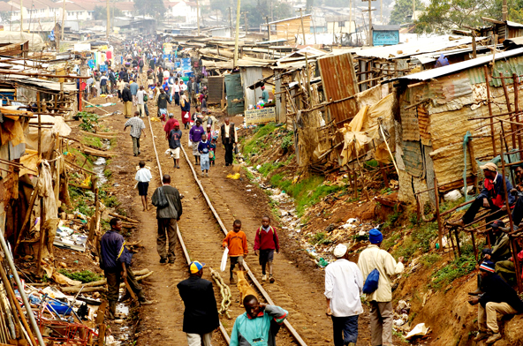
© Brain Wrinkles

Slide 8
Instability
Government instability is a major issue that has kept African nations from improving their citizens’ standard of living.
In many parts of Africa, civil wars, military coups, and revolutions have caused power to change hands many time.
When a country’s government is unstable, it cannot meet the needs of its people.
Political conflicts keeps many countries from providing education opportunities and finding solutions to the issues of famine, poverty, and disease.
© Brain Wrinkles

Slide 9
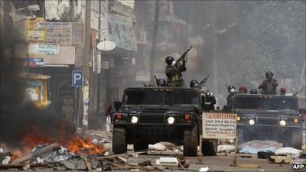
© Brain Wrinkles

Slide 10
Education
Access to education is an issue that many African countries face.
Many of these nations have been involved in civil wars and have had little time or money to invest in an education system.
Because of this, access to education in Africa is often limited.
© Brain Wrinkles

Slide 11
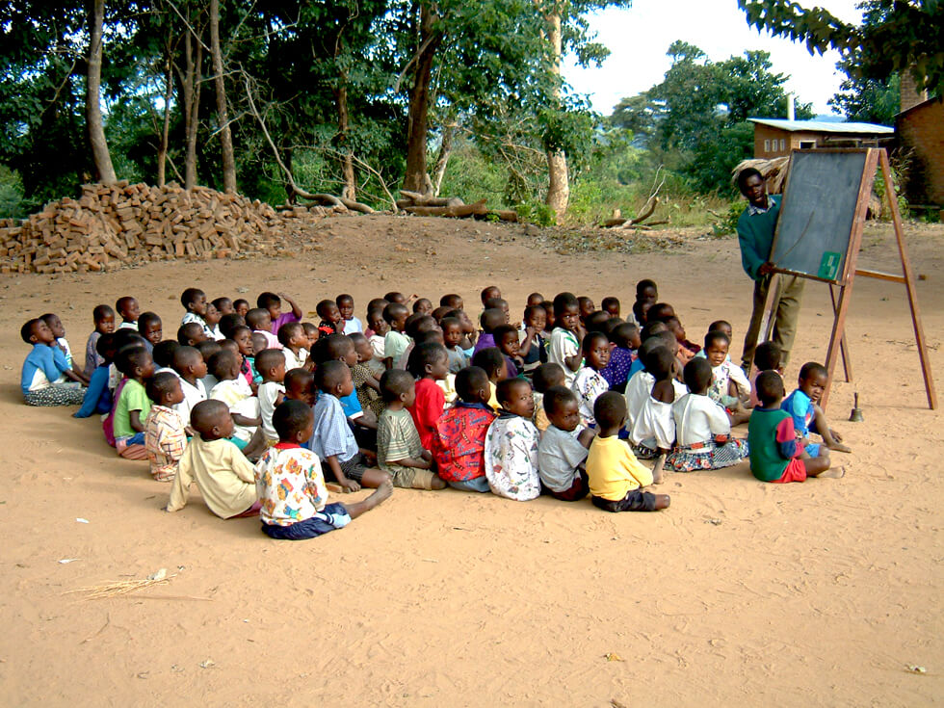
© Brain Wrinkles

Slide 12
Education
Children who live in Africa’s cities have greater access to education.
In rural areas, there is a shortage of money, teachers, and school buildings.
Often, families are too poor to send all of their children to school, so some have to work or do chores.
© Brain Wrinkles

Slide 13
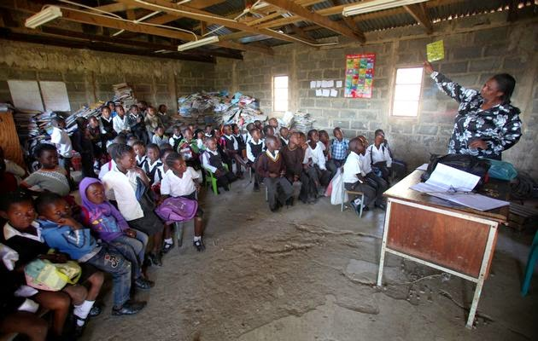
© Brain Wrinkles

Slide 14
Gender Gap
Education for women is a huge problem in Africa.
Some African societies believe that girls do not need an education, and instead, they should prepare for marriage by learning to cook and clean.
Because of this, far less African women are literate than men.
© Brain Wrinkles

Slide 15
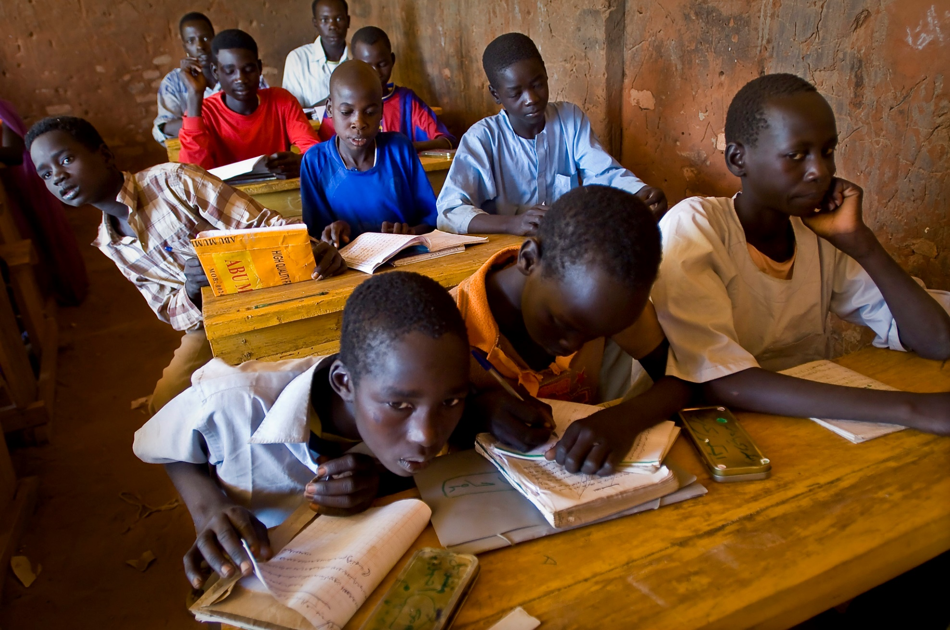
© Brain Wrinkles

Slide 16
Disease
The governments of many African nations have failed to focus on building proper healthcare systems for their citizens.
As a result, there are too few hospitals, not enough doctors, and insufficient supplies to treat outbreaks of major diseases.
© Brain Wrinkles

Slide 17
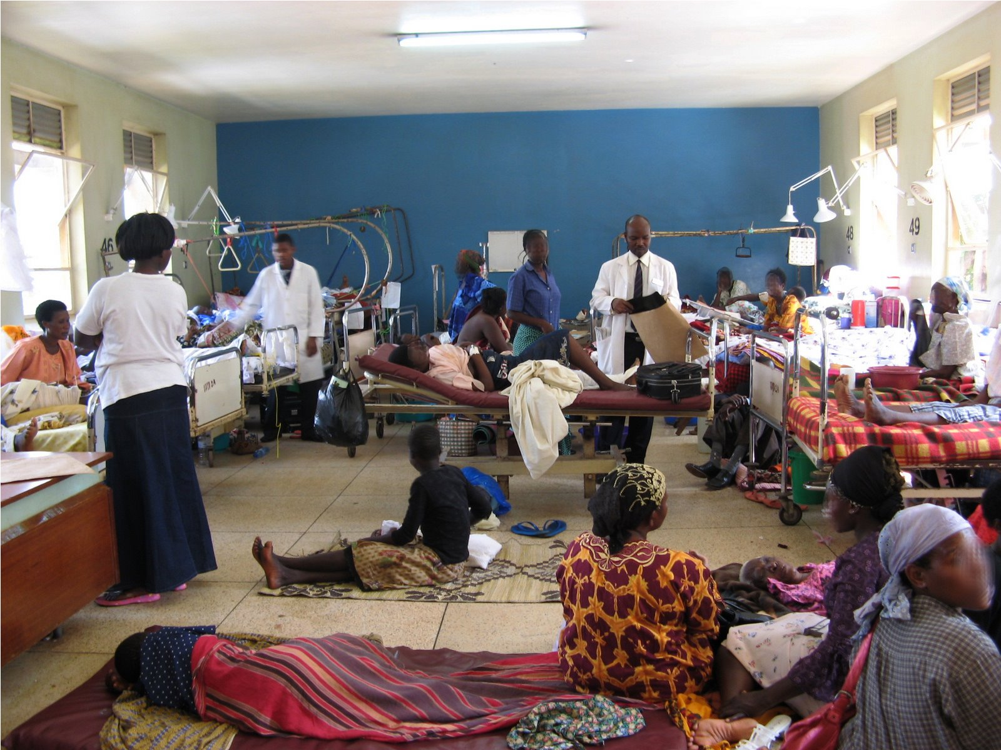
© Brain Wrinkles

Slide 18
Epidemic
In many instances, African governments have not been effective in distributing medicines in emergencies.
Outbreaks of diseases can turn into deadly epidemics when African governments do not act quickly.
Some epidemics that have occurred in Africa include malaria, Ebola, and AIDS.
© Brain Wrinkles

Slide 19
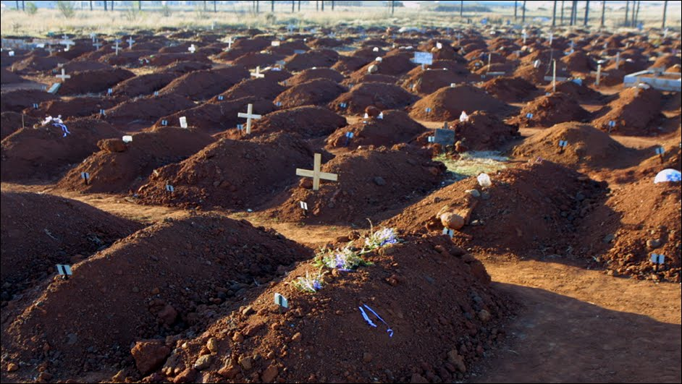
© Brain Wrinkles

Slide 20
AIDS in Africa
Today, 34 million people worldwide are living with HIV/AIDS, and two-thirds of those people are in sub-Saharan Africa.
About 24 million people across the continent have AIDS, and 1.5 million have died.
These deaths have created over 11 million orphans.
© Brain Wrinkles

Slide 21
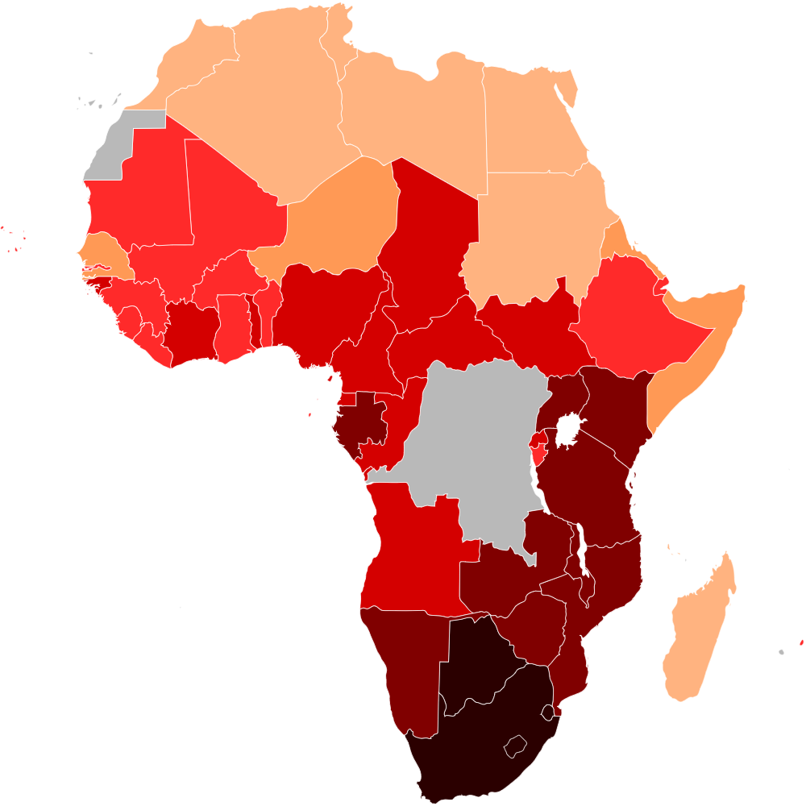
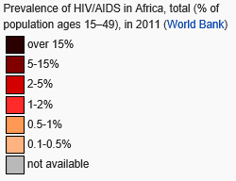
© Brain Wrinkles

Slide 22
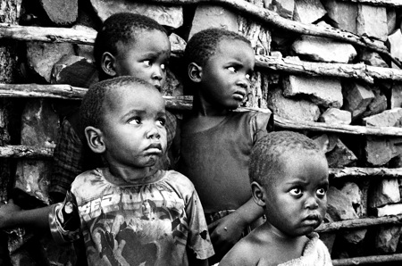
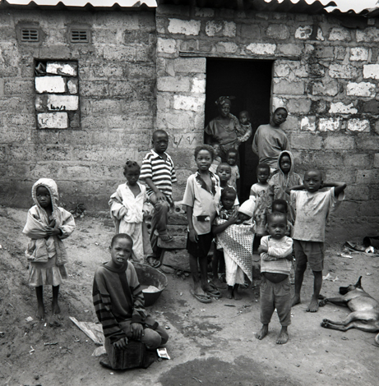
AIDS Orphans,
Swaziland
© Brain Wrinkles

Slide 23
AIDS in Africa
The situation has gotten even worse as a result of poverty and weak educational and public health services.
The epidemic now places a huge burden on the healthcare systems on countries that barely have enough resources to handle basic care.
Few African countries have the resources to treat AIDS patients.
© Brain Wrinkles

Slide 24
© Brain Wrinkles

Slide 25
Zimbabwe
Zimbabwe has one of the highest rates of HIV/AIDS in the world.
The country also has government corruption, civil unrest, and a suspicion of outside help—which has made the situation worse.
Zimbabwe also has a very poor economy, meaning that the expensive medicines are impossible for most people to afford.
© Brain Wrinkles

Slide 26
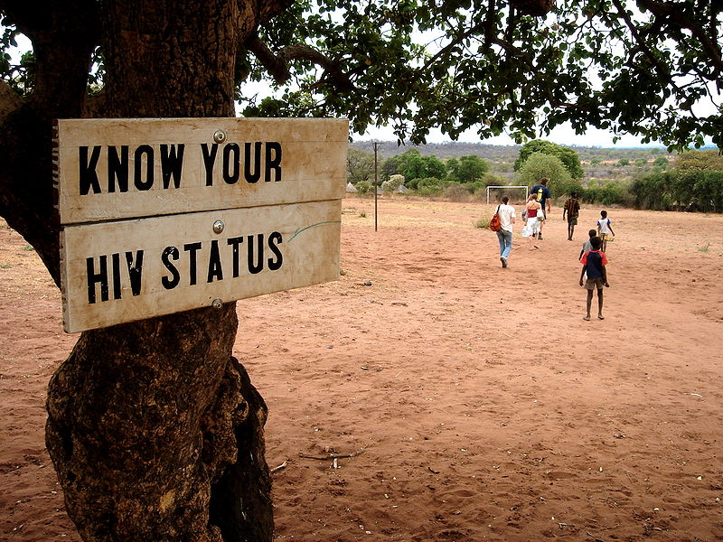
Sign in Zambia
© Brain Wrinkles

Slide 27
Botswana
Botswana has maintained a stable democratic government since the country gained independence in 1966.
As a result, Botswana has the resources to help treat AIDS patients.
Botswana’s government has provided education and prevention training for its citizens.
It was also the first country to offer the necessary drug therapy for free to infected people.
© Brain Wrinkles

Slide 28
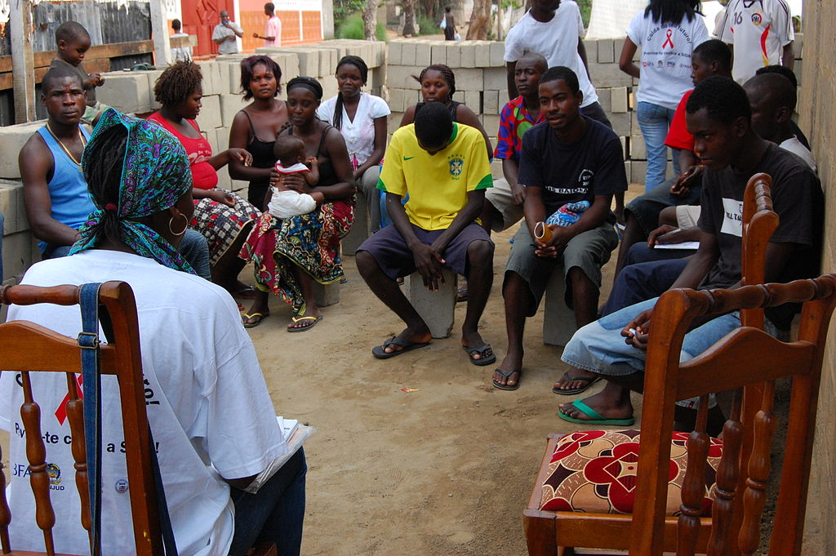
AIDS Education Outreach Event
© Brain Wrinkles

Slide 29
Famine
Famine is one of Africa’s biggest problems.
Famine occurs when a region does not have enough food for a long period of time.
In many African countries, famine has taken a strong hold when governments have failed to provide enough resources to feed their people.
© Brain Wrinkles

Slide 30
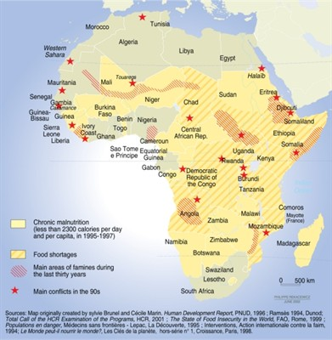
200 million Africans suffer from chronic hunger.
© Brain Wrinkles

Slide 31
Lack of Food
Many African countries face drought because of climate changes.
Repeated drought has plagued Africa since the 1970s.
Soil barrenness and erosion have decreased the amount of crops grown.
AIDS has reduced the workforce available to farm the land.
© Brain Wrinkles

Slide 32
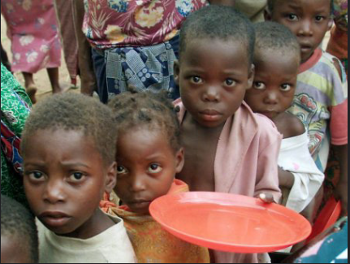
In 2013, over 8,500 African children under the age of 5 died from hunger.
© Brain Wrinkles

Slide 33
Instability
The stability of a country’s government directly impacts the country’s ability to provide enough food to prevent famine.
Civil wars interrupt daily life for most people, including farmers, which causes food shortages.
Some governments have built armies instead of investing in food for their people.
Other governments have used food as a weapon by denying food shipments to political enemies.
© Brain Wrinkles

