Slide 1
Exit # 10
(8/19/19)
What were the names of the 4 children from the film?
Jackson, Zahria, Carlos, & Samuel
Jackson, Sarah, Carmen, and Samuel
Jacob, Zahria, Carla, & Samantha
Jackson, Zahria, Carla, & Samuel
Entry # 10
(8/19/19)
How long does it take Zahria to make it to school every Monday?
1 hour
2 hours
3 hours
4 hours

Slide 2
Exit # 11
(8/20/19)
What is the total amount of time that all 4 children travel to school round trip combined?
14.5 hours
15.5 hours
16.5 hours
17.5 hours
Entry # 11
(8/20/19)
What is the title of the movie we watched?
On the road to school
On the journey to school
On the way to school
On the walk to school

Slide 3
Entry # 12
(8/21/19)
What country does Jackson live in?
Egypt
Europe
Kenya
Kansas
Exit # 12
(8/21/19)
Where does Samuel live?
Brazil
Bay of Bengal
Kenya
Moroco

Slide 4
Entry # 13
(8/22/19)
What is another name for the Southwest Asia area?
Central East
Middle East
North East
Exit # 13
(8/22/19)
What water way borders Turkey to the North?
Red Sea
Mediterranean Sea
Black Sea

Slide 5
Entry # 14
(8/23/19)
What water way borders Turkey to the West?
A. Black Sea
B. Red Sea
C. Mediterranean Sea
Exit # 14
(8/23/19)
What are the 5 countries that border Turkey to the East?
Armenia, Georgia, Iran, Iraq, & Bulgaria
Armenia, Greece, Iran, Iraq, & Bulgaria
Armenia, Georgia, Iran, Iraq, & Syria

Slide 6
Exit # 15
(8/26/19)
What country does the Tigris and the Euphrates River start in?
Georgia
Turkey
Iran
Jordan
Entry # 15
(8/26/19)
What large body of water does the Persian Gulf empties into?
Strait of Hormuz
Red Sea
Arabian Sea
Black Sea

Slide 7
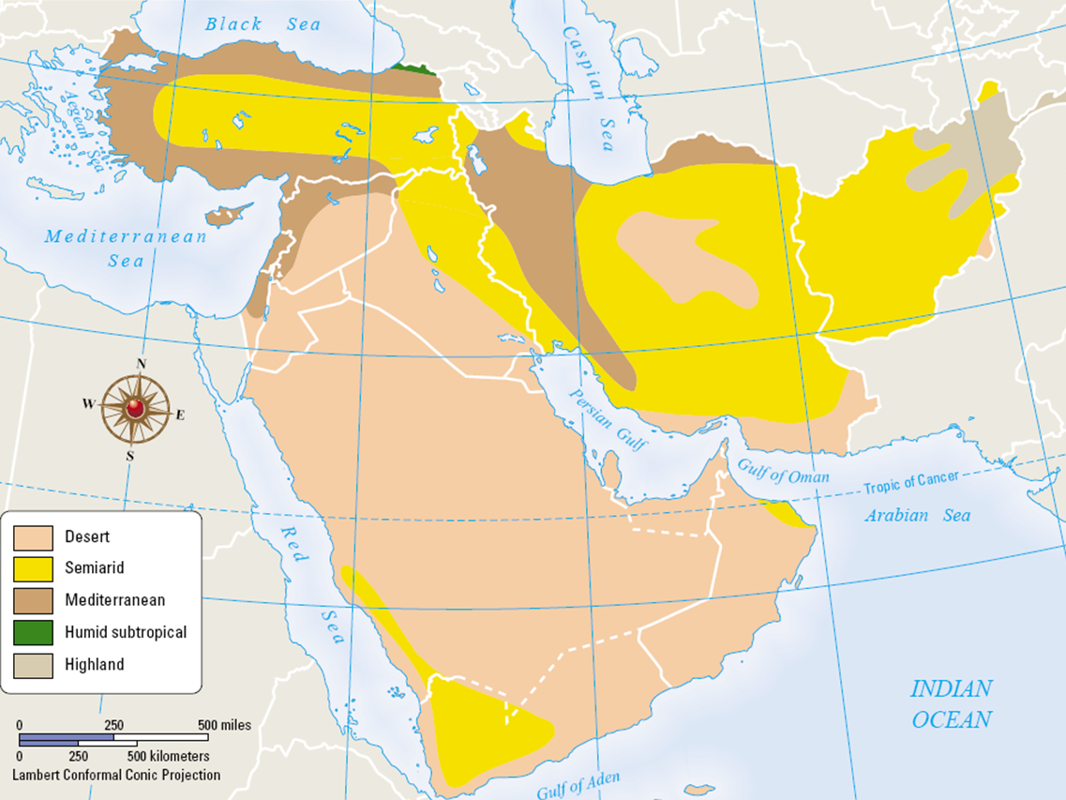
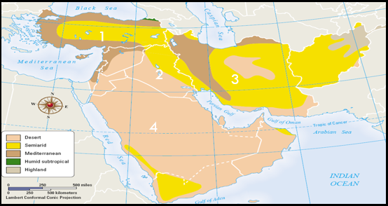
Entry # 16
(8/27/19)
What country is Iran?
1
2
3
4
Exit # 16
(8/27/19)
What country is Turkey?
4
2
1
3
1
2
3
4

Slide 8
Entry # 17
(8/28/19)
Test day no entry
Exit # 17
(8/28/19)
Test day no exit

Slide 9
Entry # 18
(8/29/19)
What is a peninsula?
A. A land mass completely surrounded by water
B. A land mass border by water on two sides
C. A land mass border by water on no sides
D. A land mass border by water on three sides
What is the definition of a bordering country?
A country that touches another country, a sea, or a river that is next to it.
A decorative strip around the edge of something, such as fabric.
A country that does not touches another country, a sea, or a river that is next to it.
A narrow bed of planted ground along the edge of a lawn or walkway
Exit # 18
(8/29/19)
What is scarcity?
Having an abundance of goods/services
Having a shortage of supplies
Having no supplies
What does arid mean?
Wet
Warm
Humid
Dry
What is the main source of drinking water for most countries in the Middle East?
Oceans
Rivers
Lakes
Gulfs

Slide 10
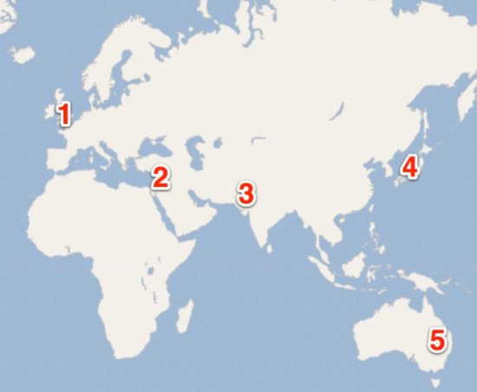
2. Which number on the map represents the country of Afghanistan?
1
2
3
4
Entry # 19
(8/30/19)
6
1. Which number is the CLOSEST to the country of Israel?
1
2
3
4
5
7
5
3. Which number on the map represents the country of Iran?
1
2
3
4
4. Which number on the map represents the physical feature the Persian Gulf?
4
5
6
7

Slide 11
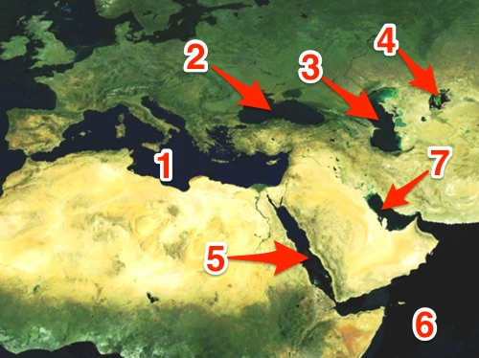
Exit # 19
(8/30/19)
1. Which of these connects the Red Sea and the Mediterranean Sea?
A) Suez Canal
B) Panama Canal
C) Bering Strait
Bosporus Strait
2. In which country is the West Bank & Gaza Strip located?
Saudi Arabia
Iran
Israel
Turkey
3. What body of water does the Jordan River empty into?
Black Sea
Red Sea
Arabian Sea
Dead Sea
4. Identify the Arabian Sea?
A) 1
B) 5
C) 6
7
5. Identify the Red Sea?
A) 3
B) 5
6
7

