Slide 1
Entry/Exit’s for the weeks of Oct. 28-Nov. 8

Slide 2
Entry # 55
(10/28/19)
What was the governing power in the Middle East from 1300s – 1918?
Ottoman Empire
Roman Empire
British Empire
Byzantine Empire
2. The United Nations Partition Plan of 1947 created what?
Arab/Jewish Jordan
Arab/Jewish Palestinian
Arab/Jewish Israel
Arab/Jewish Egypt
Exit # 55
(10/28/19)
This caused the Ottoman Empire to fall.
World War II
The 1967 Arab/Israeli War
The 1948 Arab/Israeli War
World War I
2. What is the major religion of the Palestinians?
Christianity
Judaism
Islam
Hinduism

Slide 3
Entry # 56
(10/29/19)
1. The Torah, which contains the Mosaic Law, is most often used in which religion?
a. Buddhism
b. Christianity
c. Judaism
Islam
2. Which statement describes the Ottomans? They were
a. Turks who followed Judaism
b. Arabs who followed Islam
c. Romans who followed Christianity
d. Turks who followed Islam
Exit # 56
(10/29/19)
1. Which European country ruled the area of Palestine after the breakup of the Ottoman Empire?
a. France
b. Italy
c. Britain
Spain
2. In 1964, The Palestine Liberation Organization (PLO) was formed in order to take Palestine back from whom?
a. Israel
b. Egypt
c. Syria
d. Iraq

Slide 4
Entry # 57
(10/30/19)
What is the US main economic interest in Southwest Asia?
Gold
Water
Diamonds
Oli
2. Why did Iraq invade Kuwait in 1990?
To take control of Kuwait’s water
To take control of Kuwait’s oil
To take control of Kuwait’s religion
To take control of Kuwait’s government
Exit # 57
(10/30/19)
1.Why did the US go to war against Iraq in 2003?
Believed they had WMD’s
Believed they were going to bomb US
Believed they were going to attack Kuwait again
Believed that they had an unstable government
2. Which of the following has been a success of the US War in Afghanistan?
A. the death of Saddam Hussein
B. the complete destruction of all terrorist groups
C. the discovery of weapons of mass destruction
D. the discovery and death of Osama bin Laden

Slide 5
Entry # 58
(10/31/19)
What is major environmental issue due to Iraq burning Kuwait's oil fields.
A. Pollution of the Persian Gulf due to oil spills.
B. Pollution of the air due to the Arabian Brown cloud created by industrial pollution.
C. Pollution of the fertile delta of the Jordan River valley due to agricultural runoff and industrial waste.
D. Pollution of the Jordan River due to oil spills.
Exit # 58
(10/31/19)
How long did the Persian Gulf war last after the US got involved.
1 week
3 weeks
6 weeks
10 weeks

Slide 6
Entry # 59
(11/1/19)
How long did Kuwait’s oil fields burn?
4 months
6 months
8 months
10 months
2. How many countries helped get Iraq out of Kuwait?
50
44
38
28
Exit # 59
(11/1/19)
What are WMD’s?
Weapons of Major Doom
War of Mass Destruction
Weapons of Mass Destruction
War of Major Deployment
What is the name of the terrorist group that attacked US on 9/11?
Mass Jid
Taliban
Al-Talma
Al-Quaker

Slide 7
Entry # 60
(11/4/19)
1. What country was Saddam Hussein the ruler of?
Kuwait
Iran
Iraq
Afghanistan
2. What is an embargo?
A. A refusal to allow trade to happen
B. An approval for trade
C. A ceasefire for war
D. A trading company
Exit # 60
(11/4/19)
1. When the Ottoman Empire ended and new countries were created, what problems did the new boundaries cause as people found themselves living in newly created countries?
A. All of the new countries were very poor
B. People in the new countries were no longer allowed to practice their religion.
C. Most of the new countries were all desert and people could not make a living.
D. The new countries often included ethnic groups who did not have very much in common.
2. What was the outcome of the 1948 War between the new state of Israel and the Arabs living in and around Palestine?
A. The conflict ended, and all Palestinian Arabs became citizens in the new State of Israel.
B. Israel won the war and the new State of Israel was even larger than originally planned.
C. Almost no Jewish people were willing to go to Israel because of the country's Arab neighbors.
D. The United Nations decided to withdraw the proposal to create a State of Israel because of all the problems it caused in the area.

Slide 8
Entry # 61
(11/5/19)
1. No School
Exit # 61
(11/5/19)
1. No School

Slide 9
Entry # 62
(11/6/19)
1. Why did Iraq invade Kuwait?
A. To gain control of oil fields and Persian Gulf
B. To stop Kuwait from building nuclear weapons
C. To protect the Arab culture
D. To overthrow Kuwait’s harsh dictator
2. How did the Arabs living in Palestine in 1948 feel about the creation of the new state of Israel?
A. They supported it fully.
B. They rejected it as unfair to them.
C. The Arab population in Palestine was largely unaffected by the new state.
D. They agreed to try to work it out although they were unhappy about the decision.
Exit # 62
(11/6/19)
What is a government by a small group of people?
Democracy
Oligarchy
Theocracy
Parliamentary Democracy
2. What is a form of government in which the supreme power is vested in the people and exercised by them directly or indirectly?
Parliamentary Democracy
Oligarchy
Democracy
Theocracy

Slide 10
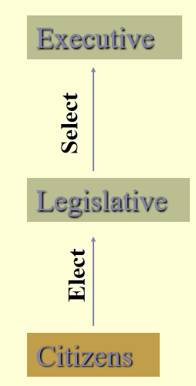
Entry # 63
(11/7/19)
What are the 2 types of Autocracy?
Dictatorship/Presidential
Monarchy/Parliamentary
Parliamentary/Presidential
Dictatorship/Monarchy
2. A government ruled by one person who has unlimited control?
Oligarchy
Democracy
Autocracy
Theocracy
Exit # 63
(11/7/19)
A government ruled by religious leaders who claim God’s authority?
Autocracy
Theocracy
Oligarchy
Democracy
2. What form of government
Is represented by the image?
Presidential Democracy
Autocracy
Parliamentary Democracy
Democracy

Slide 11
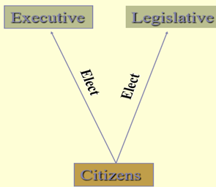
Entry # 64
(11/8/19)
What type of government is represented by the image below?
Exit # 64
(11/8/19)
1. What type of government is represented by the image below?
Autocracy
Theocracy
Oligarchy
Democracy
Presidential Democracy
Autocracy
Parliamentary Democracy
Democracy

