Slide 1
Entry # 20
(9/2/19)
No School
Exit # 20
(9/2/19)
No School

Slide 2
Entry # 21
(9/3/19)
1. Animals are the leading cause of water pollution in SWA.
True
False
2. What percentage of the worlds fresh drinking water is available to the inhabitants of SWA?
7%
5%
3%
1%
Exit # 21
(9/3/19)
1. What SWA country has a “water advantage”?
Israel
Syria
Turkey
Iran
2. How much less water does Syria get because of dams along the Euphrates?
30%
40%
50%
60%

Slide 3
Entry # 22
(9/4/19)
1. How much less water does Iraq now receive because of dams?
40%
60%
80%
100%
2. What two countries effect how much water Iraq receives?
Iran & Syria
Saudi Arabia & Turkey
Turkey & Syria
Jordan & Israel
Exit # 22
(9/4/19)
1. How many days a week can citizens in Jordan get water?
7 days
6 days
3 days
2 days
2. What type of climate does Saudi Arabia have?
Desert
Tropical
Mild
Humid

Slide 4
Entry # 23
(9/5/19)
In what year was Israel created?
1918
1928
1938
1948
2. Jordan’s major surface water sources are shared with what two countries?
Iran & Syria
Israel & Syria
Saudi Arabia & Turkey
Iraq & Israel
Exit # 23
(9/5/19)
Why is the little water that is available in Saudi Arabia of poor quality?
It’s polluted with trash
It’s has oil in it
It has salt water intrusion
It’s polluted with chemicals
2. What is desertification?
Turning desert into farmland
Turning farmland into desert
Taking salt out of sea water
Taking salt out of fresh water

Slide 5
Entry # 24
(9/6/19)
1. How many decades of warfare have caused damage to Iraq’s water treatment plants?
7
5
3
1
2. What has allowed Israel to turn once-barren desert land into farmland?
Money from oil
New farming technology
Advancement in computer tech
An abundance of rain water
Exit # 24
(9/6/19)
1. Because rainfall is down where does Israel get its water?
Aquifers
Dams
Lakes
Oceans
2. Jordan is one of the ____ most water scarce countries in the world?
7
8
9
10

Slide 6
Entry # 25
(9/9/19)
1. What large body of water is also causing water pollution for Turkey because also oil spills?
Red Sea
Mediterranean Sea
Dead Sea
Black Sea
2. Syria has a hard time watering the land which causes a shortage in?
Water
Food
Rivers
Oceans
Exit # 25
(9/9/19)
1.In Iraq what food production has decreased because of dams?
Potatoes & Rice
Wheat & Corn
Wheat & Rice
Rice & Rye
2. What country has the world’s largest desalination plant?
Iraq
Saudi Arabia
Afghanistan
Syria

Slide 7
Exit # 26
(9/10/19)
1. What does it mean if something is hijacked?
It is borrowed and then returned
It is set on fire
C. It is won by election
D. It is forcefully taken over
2. After the attack on Pearl Harbor, the U.S. entered WWII. After the attack on 9/11, a War on Terror was announced. What do both attacks have in common?
A. Both attacks were on American soil and caused public outrage
B. Both attacks were on foreign soil and caused public outrage
C. Both attacks involved hijacked planes, which destroyed buildings and lives
D. Both attacks were directed against military targets, not civilian targets
Entry # 26
(9/10/19)
What is the date for the collapse of the twin towers.
Sep. 11, 1999
Sep. 11, 2000
Sep. 11, 2001
Sep. 11, 2002
2. America did declare war on Afghanistan after the 9/11 attacks.
True
False

Slide 8
Entry # 27
(9/11/19)
1. What country was the al Qaeda terrorist from?
Iran
Afghanistan
Iraq
Kuwait
2. Which person was ultimately responsible for the terrorist attacks against America on 9/11?
A. Saddam Hussein
B. Osama bin Laden
C. Yasser Arafat
D. Mahmoud Ahmedinejad
Exit # 27
(9/11/19)
1. What inference has been made about the fourth hijacked plane from 9/11?
A. The passengers took the plane over from the hijackers.
B. The hijackers planned to crash the plane in a field.
C. The plane suffered from a mechanical failure.
D. The hijackers did not know how to properly fly the plane
2. Which phrase best describes al Qaeda?
A. Regimented army
B. Enemy state
C. Criminal network
D. Fascist dictatorship

Slide 9
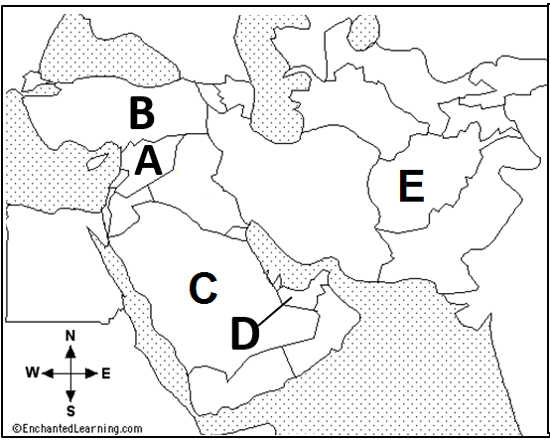
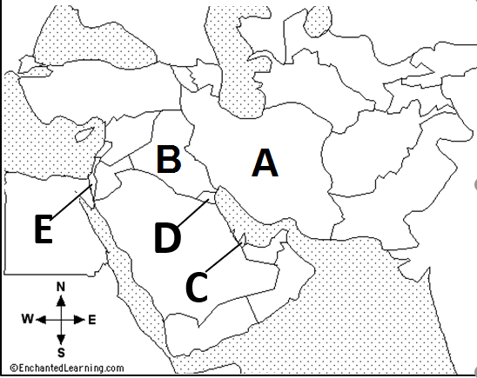
Entry # 28
(9/12/19)
Exit # 28
(9/12/19)
1. Afghanistan_____
2. Saudi Arabia_____
3. Syria____
4. Turkey____
5. UAE_____
1. Kuwait____
2. Iran___
3. Israel____
4. Qatar____
5. Iraq___

Slide 10
Exit # 29
(9/13/19)
1. Lack of water and water rights have lead to __ in SWA?
Abundance of food
Natural disasters
Water wars
Plentiful fertile land
2. Syria has enough water and food to sustain its people?
True
False
Entry # 29
(9/13/19)
1. What is a drawback of desalination?
You can’t get all the salt out of the water
It is very expensive & requires complex technology.
It is only available to one country
Many countries do not know how to use it.
2. What is hydroelectric power?
A. electricity produced from energy of slow moving water
B. electricity produced from energy of rapid moving water
C. electricity produced from wind energy
D. electricity produced from solar energy

