Slide 1
Southwest Asia’s
Environmental
Issues
Water Pollution & Unequal Distribution
© Brain Wrinkles

Slide 2
Pollution
Many countries in Southwest Asia are experiencing the increasing problem of water pollution.
Per-capita availability of safe drinking water here is the worst of any region in the world.
Contaminated water sources have greatly reduced the amount of clean water available for drinking.
© Brain Wrinkles

Slide 3
Causes
Southwest Asia’s biggest pollution problems come from human sewage, agricultural runoff, and industrial waste.
Rapid growth of industry in cities and towns has caused garbage and sewage to build up in rivers and streams.
Towns without proper sewer systems dump untreated human waste directly into rivers.
Pesticides used in farming are washed into rivers or seep into groundwater.
© Brain Wrinkles

Slide 4
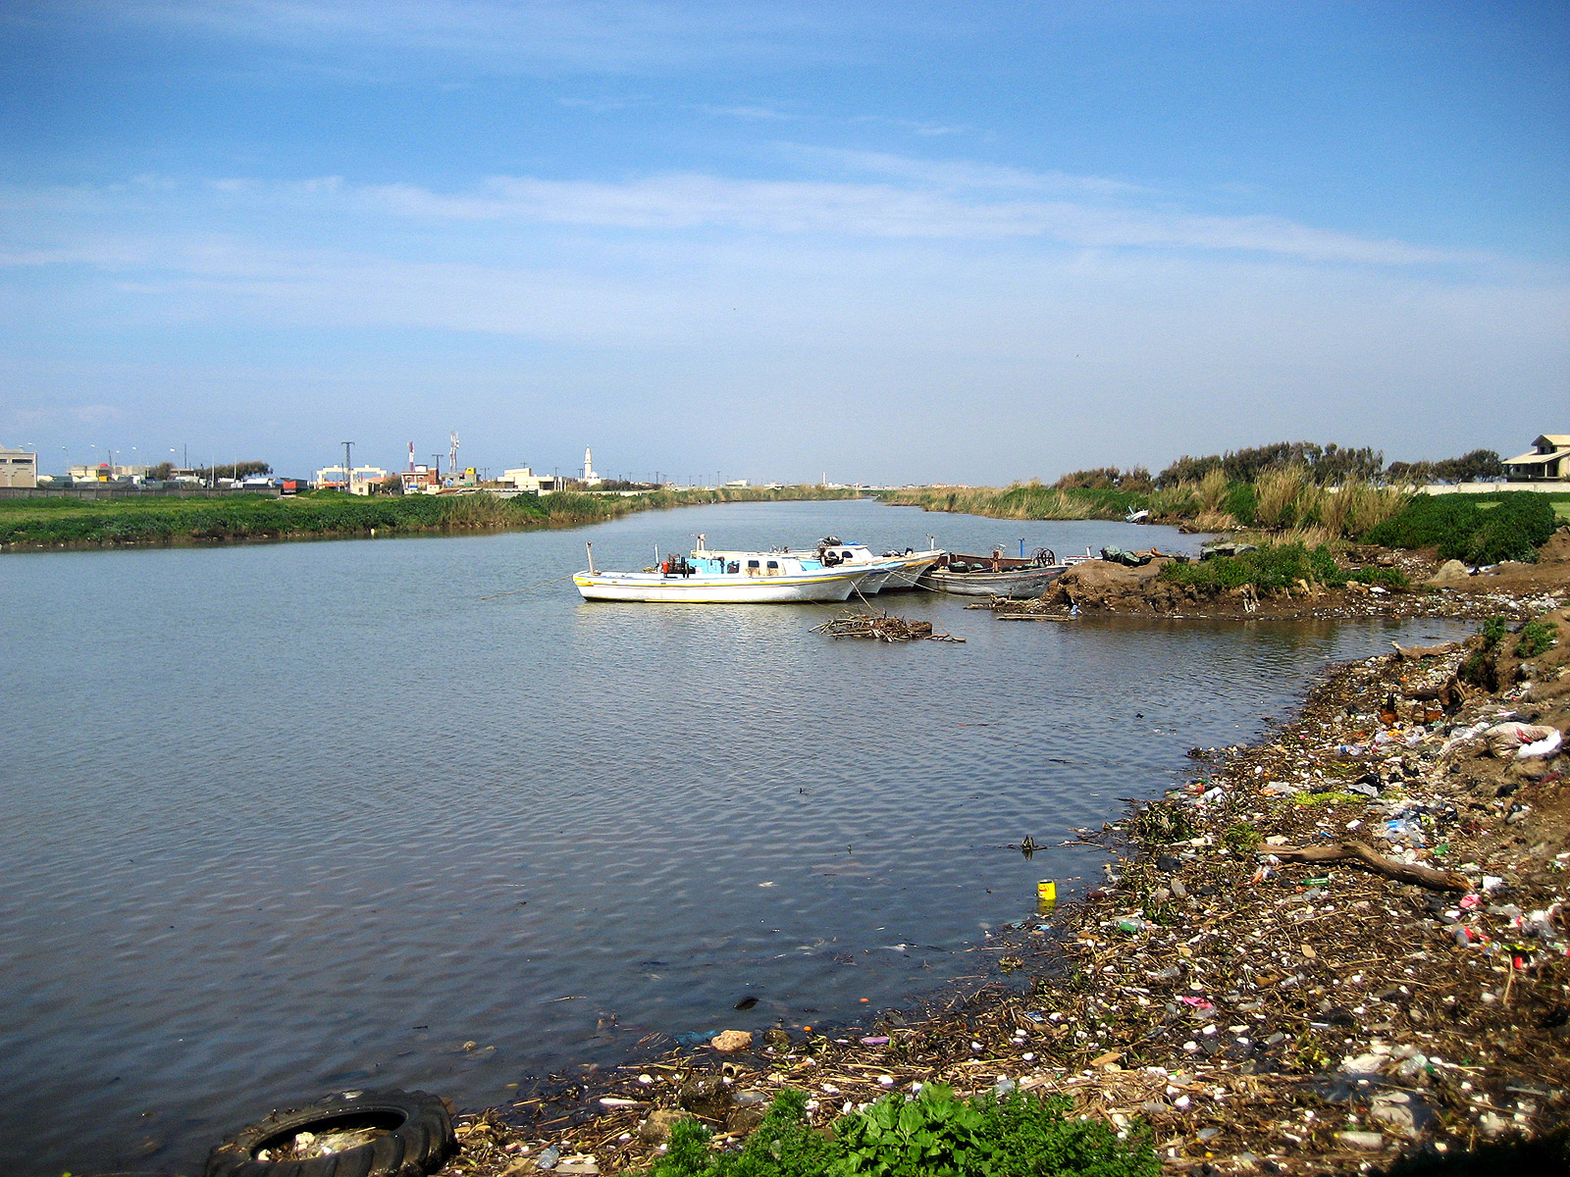
Tigris River Pollution
© Brain Wrinkles

Slide 5
Water?
Water availability is also a major concern in Southwest Asia.
Less than 1% of the world’s fresh water is available to the area’s inhabitants (5% of the world’s population).
© Brain Wrinkles

Slide 6
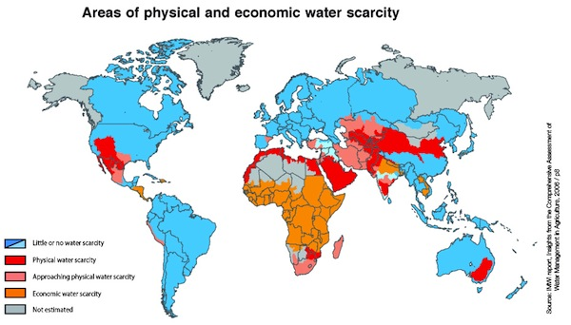
© Brain Wrinkles

Slide 7
Scarcity
Water is a precious resource and there is simply not enough available to meet the population’s needs.
Middle Eastern countries are constantly in conflict over these water problems.
Let’s take a look at how water is distributed in several of these countries.
© Brain Wrinkles

Slide 8
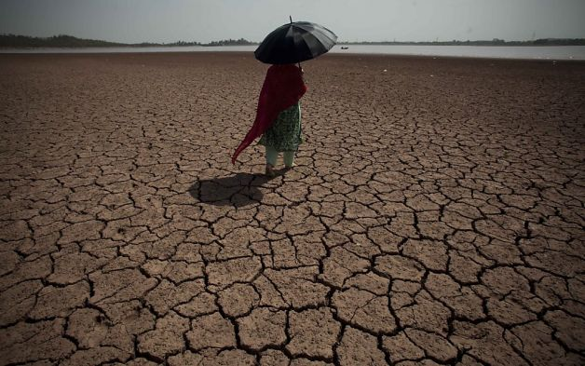
© Brain Wrinkles

Slide 9
Turkey
Turkey has a “water advantage” over other Middle Eastern countries because the Tigris and Euphrates rivers form here.
Turkey has developed the Southeastern Anatolia Project, which consists of 22 dams and 19 hydroelectric plants along the Euphrates River.
This project has greatly improved the standard of living for Turkey’s citizens.
© Brain Wrinkles

Slide 10
Turkey’s Ataturk Dam
© Brain Wrinkles

Slide 11
Turkey
Unfortunately, the country has had to deal with the increasing problem of water pollution.
Chemical fertilizers from agriculture and industrial wastes from industries pollute the rivers.
Pollution also comes from oil spills in the Black Sea.
© Brain Wrinkles

Slide 12
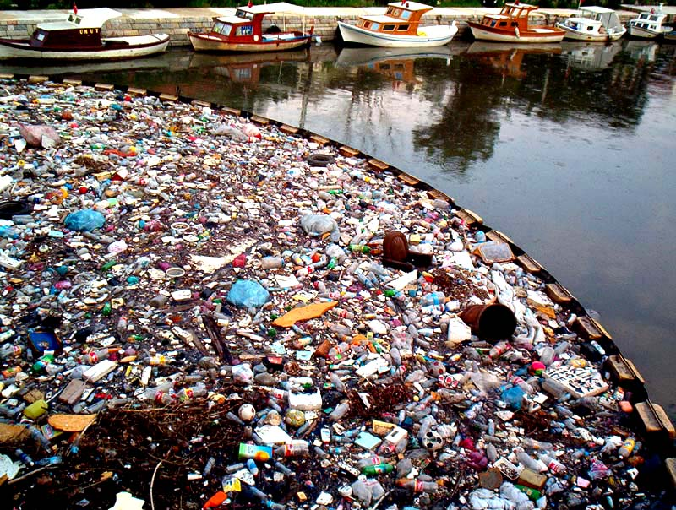
Water Pollution in Istanbul
© Brain Wrinkles

Slide 13
Syria
The dams that Turkey built along the Euphrates have greatly reduced the amount of water reaching Syria (40% less).
Syria already suffers from food shortages, and irrigating new land is extremely difficult with the diminished water supply from the Euphrates.
© Brain Wrinkles

Slide 14
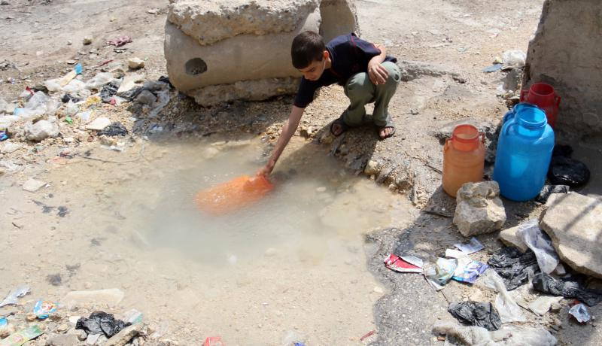
© Brain Wrinkles

Slide 15
Syria
In order to keep some water in the country, Syria has also built dams along the river.
This has reduced the river’s flow into Iraq, thus causing more conflict.
© Brain Wrinkles

Slide 16
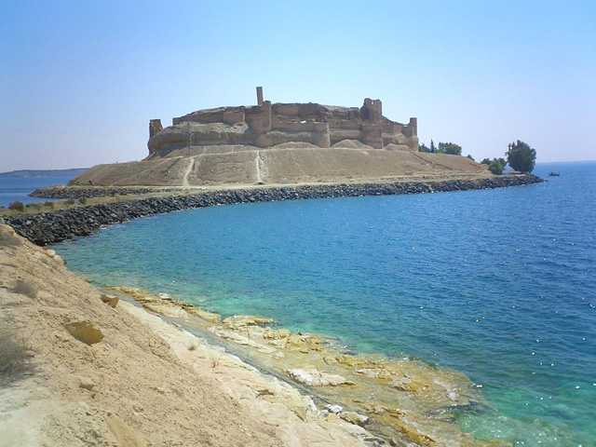
Lake Assad – Syria’s largest reservoir was created in 1974
© Brain Wrinkles

Slide 17
Iraq
The dams that Turkey & Syria built along the Euphrates have also greatly reduced the amount of water reaching Iraq (80% less).
This has negatively impacted the country’s food supply.
Wheat and rice production has decreased dramatically, and many farmers are now without jobs.
© Brain Wrinkles

Slide 18
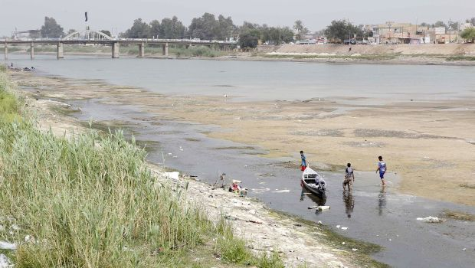
© Brain Wrinkles

Slide 19
Iraq
Iraq also faces water pollution problems as a result of industry and petroleum drilling equipment.
Also, three decades of warfare have caused damage to Iraq’s water treatment plants.
© Brain Wrinkles

Slide 20
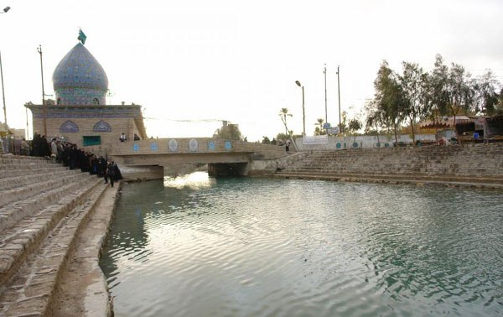
The Glory Canal (built by Suddam Hussein in 1993) was a disastrous project that diverted natural water flow from the country’s marshes and converted wetlands into desert.
© Brain Wrinkles

Slide 21
Israel
Since its creation in 1948, Israel has developed new technology and advanced farming techniques that have turned the once-barren desert land into farmland.
Because rainfall is down, Israel has to rely on drawing water from its aquifers (underground layer of rock and sand that contains water).
Unfortunately, the aquifers are in jeopardy because more water is taken out than is replenished by rain.
© Brain Wrinkles

Slide 22
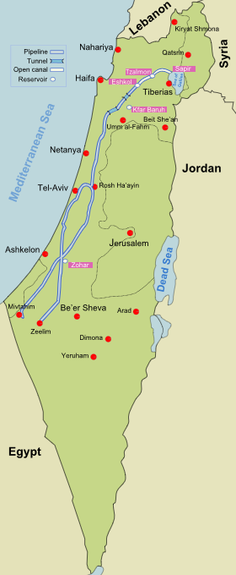
National Water Carrier of Israel –
A pipeline that transfers water from the Sea of Galilee to the highly populated center and arid south.
© Brain Wrinkles

Slide 23
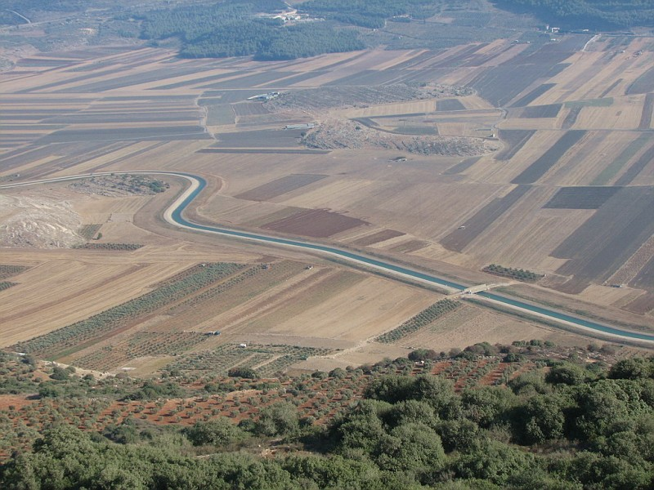
© Brain Wrinkles

Slide 24
Israel
Israel has been involved in many conflicts over water rights to the Jordan River with Syria, Jordan, and Palestine.
© Brain Wrinkles

Slide 25
Jordan
Jordan is one of the ten most water scarce countries in the world.
Jordan cannot meet the basic needs of its people and has to ration the water supply.
Citizens can only get water two days a week.
The country’s major surface water sources are shared with Israel and Syria, who leave only a small amount for Jordan.
© Brain Wrinkles

Slide 26
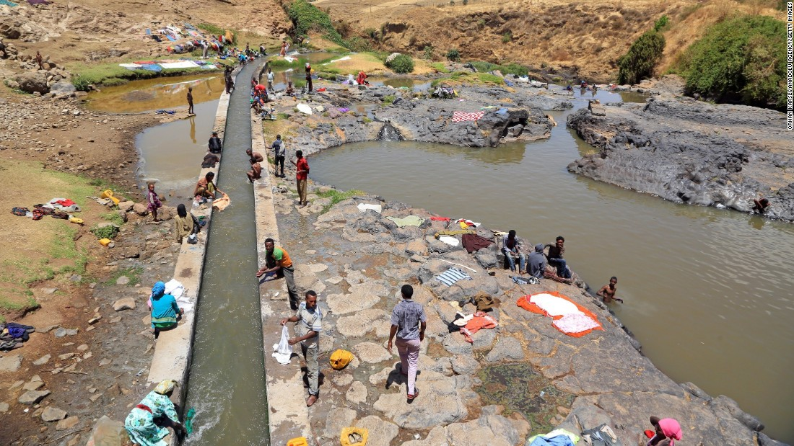
© Brain Wrinkles

Slide 27
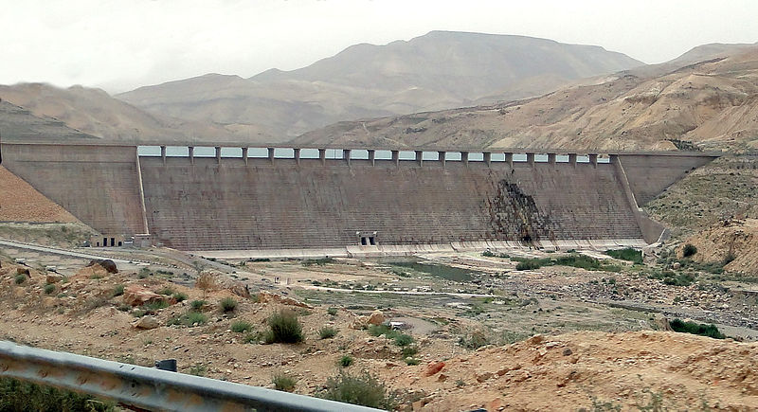
Mujib Dam, Jordan –
Desalinates brackish water from the Dead Sea
© Brain Wrinkles

Slide 28
Jordan
Israel has built pipelines that redirect the river’s water away from Jordan and into its own lands.
Jordan & Israel have been involved in military battles over water rights.
© Brain Wrinkles

Slide 29
Saudi Arabia
Saudi Arabia has a desert climate and has struggled to meet the water needs of its growing population.
Water is scarce in the country, and what little water that is available is of poor quality because of salt water intrusion.
© Brain Wrinkles

Slide 30
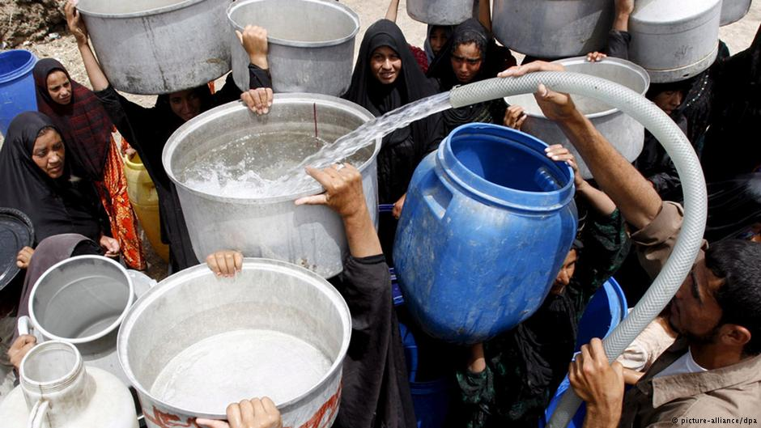
© Brain Wrinkles

Slide 31
Saudi Arabia
The country has built a number of desalination plants that provide most of the country’s drinking water.
Desalination is the process of taking salt out of seawater and using it for drinking water.
© Brain Wrinkles

Slide 32
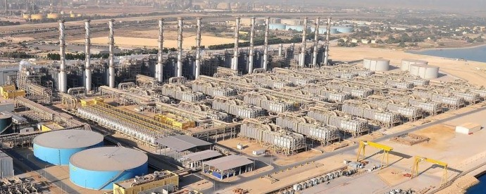
World’s Largest Desalination Plant – Jubail Industrial City, Saudi Arabia
© Brain Wrinkles

