Slide 1
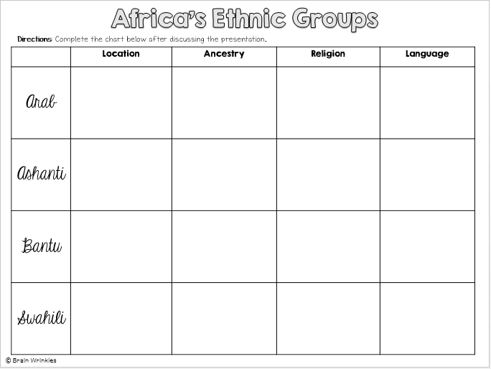
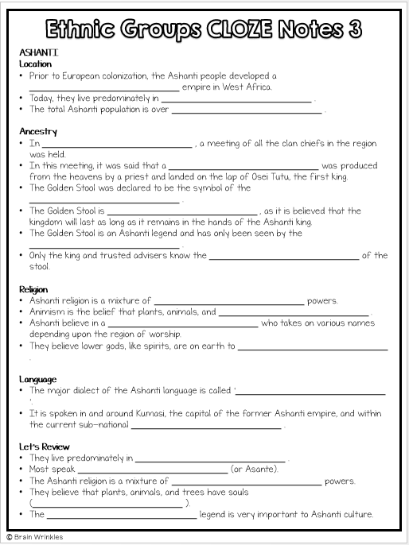
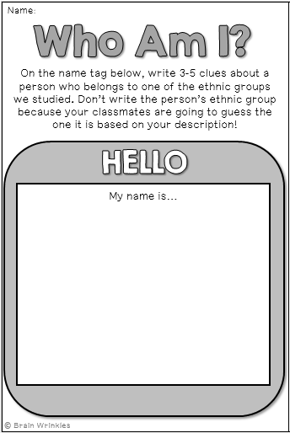
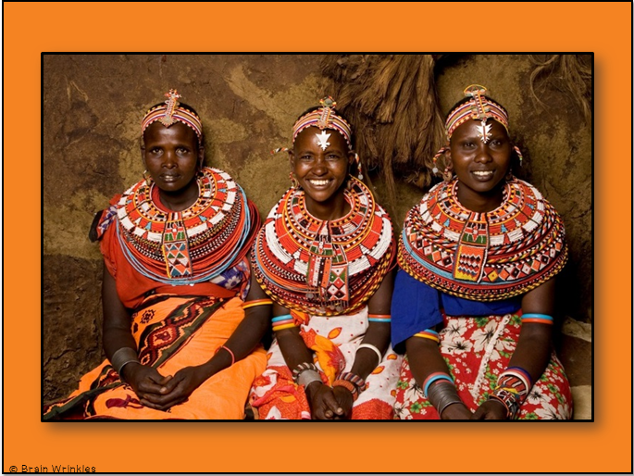
Africa’s
ETHNIC
GROUPS
Presentation, Graphic Organizers, & Activities

Slide 2
STANDARDS:
SS7G4 Analyze the diverse cultural characteristics of the people who live in Africa.
a. Explain the differences between an ethnic group and a religious group.
b. Describe the diversity of religions within African ethnic groups.
© Brain Wrinkles

Slide 3
TEACHER INFO: CLOZE Notes
The next pages are handouts for the students to use for note-taking during the presentation. (Print front to back to save paper and ink.)
Check the answers as a class after the presentation.
© Brain Wrinkles

Slide 4
Ethnic Group
This is a group of people who share a _____________________________ .
They are identified on the basis of religion, race, or _____________________________ .
Ethnic groups can have _____________________________ in common:
Shared history, common ancestry, language, religion, _____________________________ , beliefs, holidays, food, etc.
These characteristics have been part of their _____________________________ .
All of these things make up a common culture that is _____________________________ of the ethnic group.
There are _____________________________ ethnic groups in Africa, but some of the main ones are the Arabs, Ashanti, Bantu, and Swahili.
Religious Group
This is a group of people who share a _____________________________ .
A religious group is identified based on _____________________________ and practices.
They believe in the _____________________________ (or gods) and have a common sacred text with a specific set of rules about how to live.
Religious groups have many things in common:
God(s), prophets, prayers, history, _____________________________ , religious laws, holy days, etc.
People from different ethnic groups may share the same religion; however, they may be from _____________________________ .
Traditional African Religions
Religion is part of _____________________________ in Africa, not separate from it.
Most Africans today are either _____________________________ , but traditional religions and customs still play a role in African culture.
Elements of _____________________________ are often woven into Muslim and Christian practices.
© Brain Wrinkles
Ethnic Groups CLOZE Notes 1

Slide 5
ARABS
Location
Most of Africa’s Arab population is found in the countries of _____________________________ .
While the majority of Arabs are in North Africa, the gold and salt trade _____________________________ beyond the Sahara into the Sahel region and beyond.
Ancestry
Arab people began to spread into North Africa in the _____________________________ , when the first Muslim armies arrived in Egypt.
_____________________________, traders, and scholars soon spread across northern Africa all the way to Morocco.
Wherever the Arabs went, they took Islam and the _____________________________ with them.
Arabic was necessary to be able to _____________________________ , Islam’s holy book.
The Arabic language, the _____________________________ , and many other aspects of Muslim culture became part of Africa.
Religion
Most _____________________________ , while small numbers of Arabs practice other religions.
Not all Arabs are Muslims, and _____________________________ are Arabs.
Islam consists mostly of _____________________________ .
The majority of Muslims practice _____________________________ , and most others practice Shi’a Islam.
Sunnis and Shi’a disagree about _____________________________ of the Muslim world.
Sunni Islam dominates in most Arab areas, especially in _____________________________ .
_____________________________ is dominant among the Arab population in most of Southwest Asia.
Language
The term “Arab” refers to an ethnic group made up of people who speak the _____________________________ .
Most Arabs, whether they are Muslim or Christian, _____________________________ .
Let’s Review
The majority of Arab people are found in Southwest Asia and _____________________________ .
The language of the Arab people is _____________________________ .
Most Arabs, but not all, _____________________________ .
© Brain Wrinkles
Ethnic Groups CLOZE Notes 2

Slide 6
ASHANTI Location
Prior to European colonization, the Ashanti people developed a _____________________________ empire in West Africa.
Today, they live predominately in _____________________________ .
The total Ashanti population is over _____________________________ .
Ancestry
In _____________________________ , a meeting of all the clan chiefs in the region was held.
In this meeting, it was said that a _____________________________ was produced from the heavens by a priest and landed on the lap of Osei Tutu, the first king.
The Golden Stool was declared to be the symbol of the _____________________________ .
The Golden Stool is _____________________________ , as it is believed that the kingdom will last as long as it remains in the hands of the Ashanti king.
The Golden Stool is an Ashanti legend and has only been seen by the _____________________________ .
Only the king and trusted advisers know the _____________________________ of the stool.
Religion
Ashanti religion is a mixture of _____________________________ powers.
Animism is the belief that plants, animals, and _____________________________ .
Ashanti believe in a _____________________________ who takes on various names depending upon the region of worship.
They believe lower gods, like spirits, are on earth to _____________________________ .
Language
The major dialect of the Ashanti language is called ‘_____________________________ ’.
It is spoken in and around Kumasi, the capital of the former Ashanti empire, and within the current sub-national _____________________________ .
Let’s Review
They live predominately in _____________________________ .
Most speak _____________________________ (or Asante).
The Ashanti religion is a mixture of _____________________________ powers.
They believe that plants, animals, and trees have souls (_____________________________ ).
The _____________________________ legend is very important to Ashanti culture.
© Brain Wrinkles
Ethnic Groups CLOZE Notes 3

Slide 7
BANTU Location
Bantu generally refers to nearly _____________________________ in Africa who speak Bantu languages.
The Bantu people are distributed throughout _____________________________ parts of the continent.
Bantu make up _____________________________ of Africa’s population and cover the southern half of the continent.
The word “bantu” means “_____________________________ ”.
Ancestry
In Angola, archeologists have uncovered scratches on rock, massive stone pillars, and tools that place the Bantu people there about _____________________________ .
From there, they evolved and spread _____________________________ .
As they spread across the continent, they met many new people, learned new skills, and _____________________________ and beliefs.
They intermarried with the people, accepting new traditions and _____________________________ with Bantu culture.
Bantu-speaking people settled as far south as the _____________________________ .
The Bantu migration was one of the _____________________________ of people in Africa’s history.
Religion
Many Bantu people settled in areas where there was a _____________________________ and are now Muslim.
Other Bantu people were influenced by _____________________________ in Africa and are now Christian.
Whether Muslim or Christian, many Bantu _____________________________ that precede both those religions.
They believe in the power of _____________________________ .
Language
There are _____________________________ different Bantu languages and dialects.
Today, close to _____________________________ across the southern half of Africa speak Bantu-based languages and share some part of Bantu culture.
Let’s Review
The Bantu people are found throughout _____________________________ .
Bantu is a mixture of nearly _____________________________ combined.
There are _____________________________ different Bantu languages and dialects.
Bantu practice Islam, Christianity, & _____________________________ religions.
© Brain Wrinkles
Ethnic Groups CLOZE Notes 4

Slide 8
SWAHILI Location
The Swahili people mostly inhabit a narrow strip of land along the southern coast of _____________________________ (in Kenya, Tanzania, & Mozambique).
Members also live on _____________________________ in the Indian Ocean, including Zanzibar.
The total population is _____________________________ .
Ancestry
The Swahili community developed along the coast of East Africa when _____________________________ began to settle there and intermarry with the local Bantu-speaking population.
The group’s name comes from the Arabic word “Swahili,” which means “one who _____________________________ ”.
Religion
Islam established its presence in the region during the _____________________________ , when Arab traders made contact with the Bantu people.
The Swahili _____________________________ and Islam has been one of the factors that helped create a common identity for such a diverse group of people.
Since _____________________________ , and religious holidays are very important, the Arab culture is a vital part of Swahili culture.
Language
The Swahili speak the _____________________________ as their native tongue.
While the Swahili language is considered a ____________________________ , there are many Arabic words and phrases included as a result of interactions with early Arab traders.
Many also _____________________________ .
Let’s Review
The Swahili people are found in _____________________________ (Kenya, Tanzania, & Mozambique).
The language they speak is Swahili, which reflects _____________________________ .
The majority _____________________________ .
© Brain Wrinkles
Ethnic Groups CLOZE Notes 5

Slide 9
African
Ethnic
Groups
Arab, Ashanti, Bantu, & Swahili
© Brain Wrinkles

Slide 10
Ethnic Group
This is a group of people who share a common culture.
They are identified on the basis of religion, race, and/or national origin.
Ethnic groups can have many things in common:
Shared history, common ancestry, language, religion, traditions, beliefs, holidays, food, etc.
© Brain Wrinkles

Slide 11
Ethnic Group
These characteristics have been part of their community for generations. (by blood – ancestry)
All of these things make up a common culture that is shared by the members of the ethnic group.
There are several thousand ethnic groups in Africa, but some of the main ones are the Arabs, Ashanti, Bantu, and Swahili.
© Brain Wrinkles

Slide 12
Religious Group
This is a group of people who share a belief system.
A religious group is identified based on common religious beliefs and practices.
They believe in the same god (or gods) and have a common sacred text with a specific set of rules about how to live.
© Brain Wrinkles

Slide 13
Religious Group
Religious groups have many things in common:
God(s), prophets, prayers, history, sacred text, religious laws, holy days, etc.
People from different ethnic groups may share the same religion; however, they may be from different cultures.
© Brain Wrinkles

Slide 14
Traditional African
Religions
Religion is part of everyday life in Africa, not separate from it.
Most Africans today are either Muslim or Christian, but traditional religions and customs still play a role in African culture.
Elements of traditional African beliefs are often woven into Muslim and Christian practices.
© Brain Wrinkles

Slide 15
ARABS
© Brain Wrinkles

Slide 16
Location
Most of Africa’s Arab population is found in the countries of Northern Africa.
While the majority of Arabs are in North Africa, the gold and salt trade spread the Arab culture beyond the Sahara into the Sahel region and beyond.
© Brain Wrinkles

Slide 17
© Brain Wrinkles

Slide 18
Ancestry
Arab people began to spread into North Africa in the late 600s, when the first Muslim armies arrived in Egypt.
Arab armies, traders, and scholars soon spread across northern Africa all the way to Morocco.
Wherever the Arabs went, they took Islam and the Arabic language with them.
© Brain Wrinkles

Slide 19
Ancestry
Arabic was necessary to be able to read the Quran, Islam’s holy book.
The Arabic language, the religion of Islam, and many other aspects of Muslim culture became part of Africa.
© Brain Wrinkles

Slide 20
Religion
Most Arabs practice Islam, while small numbers of Arabs practice other religions.
Not all Arabs are Muslims, and not all Muslims are Arabs.
Islam consists mostly of two different groups.
The majority of Muslims practice Sunni Islam, and most others practice Shi’a Islam.
Sunnis and Shi’a disagree about who is in charge of the Muslim world.
© Brain Wrinkles

Slide 21
Religion
Sunni Islam dominates in most Arab areas, especially in North Africa.
Sunni Islam is dominant among the Arab population in most of Southwest Asia.
© Brain Wrinkles

Slide 22
Language
The term “Arab” refers to an ethnic group made up of people who speak the Arabic language.
Most Arabs, whether they are Muslim or Christian, speak Arabic.
© Brain Wrinkles

Slide 23
© Brain Wrinkles

Slide 24
Let’s Review
The majority of Arab people are found in Southwest Asia and northern Africa.
The language of the Arab people is Arabic.
Most Arabs, but not all, practice Islam.
© Brain Wrinkles

Slide 25
ASHANTI
© Brain Wrinkles

Slide 26
Location
Prior to European colonization, the Ashanti people developed a large and influential empire in West Africa.
Today, they live predominately in Ghana and Ivory Coast.
The total Ashanti population is over 7 million.
© Brain Wrinkles

Slide 27
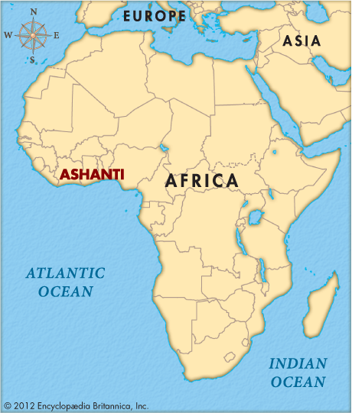
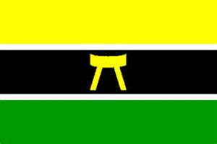
© Brain Wrinkles

Slide 28
Ancestry
In 1701, a meeting of all the clan chiefs in the region was held.
In this meeting, it was said that a Golden Stool was produced from the heavens by a priest and landed on the lap of Osei Tutu, the first king.
The Golden Stool was declared to be the symbol of the new Ashanti kingdom.
© Brain Wrinkles

Slide 29
Ancestry
The Golden Stool is sacred to the Ashanti, as it is believed that the kingdom will last as long as it remains in the hands of the Ashanti king.
The Golden Stool is an Ashanti legend and has only been seen by the tribe's royalty.
Only the king and trusted advisers know the hiding place of the stool.
© Brain Wrinkles

Slide 30
Religion
Ashanti religion is a mixture of supernatural and animist powers.
Animism is the belief that plants, animals, and trees have souls.
Ashanti believe in a supreme god who takes on various names depending upon the region of worship.
They believe lower gods, like spirits, are on earth to assist humans.
ADD: Some Ashanti also practice Christianity or a blend of Christianity and traditional beliefs/animism
© Brain Wrinkles

Slide 31
Language
The major dialect of the Ashanti language is called ‘Asante’, or ‘Twi’ (pronounced “tree”).
It is spoken in and around Kumasi, the capital of the former Ashanti empire, and within the current sub-national Asante Kingdom in Ghana.
© Brain Wrinkles

Slide 32
Let’s Review
They live predominately in Ghana and Ivory Coast.
Most speak Twi (or Asante).
The Ashanti religion is a mixture of spiritual and supernatural powers. (ADD: Some are also Christian, or they blend Christianity and traditional beliefs.)
They believe that plants, animals, and trees have souls (animism).
The Golden Stool legend is very important to Ashanti culture.
© Brain Wrinkles

Slide 33
BANTU
© Brain Wrinkles

Slide 34
Location
Bantu generally refers to nearly 600 ethnic groups in Africa who speak Bantu languages.
The Bantu people are distributed throughout central and southern parts of the continent.
Bantu make up about two-thirds of Africa’s population and cover the southern half of the continent.
The word “bantu” means “the people”.
© Brain Wrinkles

Slide 35
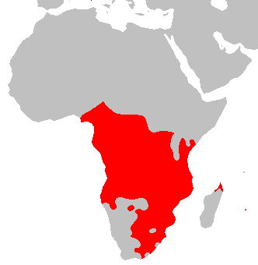
© Brain Wrinkles

Slide 36
Ancestry
In Angola, archeologists have uncovered scratches on rock, massive stone pillars, and tools that place the Bantu people there about 50,000 BCE.
From there, they evolved and spread eastward and southward.
As they spread across the continent, they met many new people, learned new skills, and shared their customs and beliefs.
© Brain Wrinkles

Slide 37
Ancestry
They intermarried with the people, accepting new traditions and blending them with Bantu culture.
Bantu-speaking people settled as far south as the southern tip of Africa.
The Bantu migration was one of the largest movements of people in Africa’s history.
© Brain Wrinkles

Slide 38
Religion
Many Bantu people settled in areas where there was a strong Arab presence and are now Muslim.
Other Bantu people were influenced by missionary efforts in Africa and are now Christian.
Whether Muslim or Christian, many Bantu retain their beliefs that precede both those religions.
They believe in the power of curses and magic (ADD: and ancestors).
© Brain Wrinkles

Slide 39
Language
There are over 650 different Bantu languages and dialects.
Today, close to 70 million people across the southern half of Africa speak Bantu-based languages and share some part of Bantu culture.
© Brain Wrinkles

Slide 40
Let’s Review
The Bantu people are found throughout Sub-Saharan Africa.
Bantu is a mixture of nearly 600 different ethnic groups combined.
There are over 650 different Bantu languages and dialects.
Bantu practice Islam, Christianity, & traditional African religions.
© Brain Wrinkles

Slide 41
SWAHILI
© Brain Wrinkles

Slide 42
Location
The Swahili people mostly inhabit a narrow strip of land along the southern coast of East Africa (in Kenya, Tanzania, & Mozambique).
Members also live on several nearby islands in the Indian Ocean, including Zanzibar.
The total population is 1,328,000.
© Brain Wrinkles

Slide 43
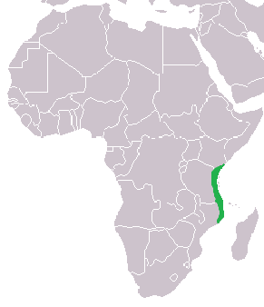
© Brain Wrinkles

Slide 44
Ancestry
The Swahili community developed along the coast of East Africa when Arab traders began to settle there and intermarry with the local Bantu-speaking population.
The group’s name comes from the Arabic word “Swahili,” which means “one who lives on the coast”.
© Brain Wrinkles

Slide 45
Religion
Islam established its presence in the region during the 9th century, when Arab traders made contact with the Bantu people.
The Swahili are (CHANGE “all” to “mainly”) Muslims, and Islam has been one of the factors that helped create a common identity for such a diverse group of people.
Since Islam is a way of life, and religious holidays are very important, the Arab culture is a vital part of Swahili culture.
ADD: Some blend Islam with traditional beliefs.
© Brain Wrinkles

Slide 46
Language
The Swahili speak the Swahili language as their native tongue.
While the Swahili language is considered a Bantu language, there are many Arabic words and phrases included as a result of interactions with early Arab traders.
Many also speak English and Kiswahili
© Brain Wrinkles

Slide 47
Let’s Review
The Swahili people are found in eastern Africa (Kenya, Tanzania, & Mozambique).
The language they speak is Swahili, which reflects Bantu and Arab roots (a mixture of the two).
The majority practice Islam. (and some blend traditional beliefs with Islam)
© Brain Wrinkles

