Slide 1
Why Africa?
Europeans first became interested in Africa for __________________________ purposes.
They were looking for ways to __________________________ of the Arab and Ottoman empires in Southwest Asia.
Sailing around Africa was a long voyage and could not be completed __________________________ along the way.
Europeans created ports in southern and eastern Africa so traders could __________________________ before heading home.
Slave Trade
During the 16th century, Portuguese explorers became engaged in the __________________________ .
They kidnapped Africans and forced them to work on __________________________ in their colonies in the New World.
Other European countries __________________________ in the slave trade as well.
The trans-Atlantic slave trade lasted from the __________________________ .
Even after the slave trade had ended, European interest in Africa was __________________________ .
European countries saw that Africa was a continent full of __________________________ and mineral wealth.
Imperialism
The end of the 19th century is called the “Age of Imperialism” because that is when European countries __________________________ throughout Asia and Africa.
Imperialism is a system were a __________________________ and raw materials from another country.
A “strong” country was supposed to have __________________________ to increase its wealth and importance around the world.
Geographic Reasons
During this time, many European countries __________________________ by aggressively establishing colonies in Africa.
They wanted to __________________________ Africa’s resources (rubber, timber, diamonds, gold, etc.).
Europeans also wanted to protect their __________________________ .
© Brain Wrinkles
Partitioning Across Africa CLOZE Notes 1

Slide 2
Economic Reasons
__________________________ played a large part in the colonization of Africa.
The 19th century was a time of __________________________ in Europe (Industrial Revolution).
Factories __________________________ that could be manufactured into marketable products.
When Europeans returned to Africa for more resources, they brought back the manufactured goods and __________________________ .
Africa became a __________________________ for Europe to sell goods.
Political Reasons
__________________________ also led to the colonization of Africa.
Nationalism, a strong __________________________ in one's nation, resulted in competition between European nations.
No major nation wanted to be without colonies, which led to this __________________________
The competition was particularly fierce between Great Britain, France, and Germany, the __________________________ in the 1800s.
Religious Reasons
__________________________ gained strength during the 1800s as European countries were becoming more involved in Africa.
The idea of “Christianizing” Africa also made many Europeans __________________________ on the colonization of the continent.
Berlin Conference
By the 1880s, Great Britain, France, Germany, Belgium, Spain, and Portugal all wanted __________________________ .
To __________________________ over Africa, leaders from fourteen European governments and from the United States met in Berlin, Germany, in 1884.
__________________________ attended the meeting.
At the meeting, the European leaders discussed Africa’s land and how it __________________________ .
Going into the meeting, __________________________ of Africa was under European colonial rule.
By the end of the meeting, European powers __________________________ and drew boundary lines that remained until 1914.
__________________________ the most land in Africa and was “given” Nigeria, Egypt, Sudan, Kenya, and South Africa after defeating the Dutch Settlers and Zulu Nation.
The agreements made in Berlin still __________________________ of African countries today.
© Brain Wrinkles
Partitioning Across Africa CLOZE Notes 2

Slide 3
Artificial Boundaries
European powers organized Africa’s population in ways to make the _______________ , ignoring the natives’ cultural groups or existing political leadership.
Sometimes they __________________________ people who had never been united before.
Sometimes they __________________________ of people.
The creation of these borders had a negative impact on Africa’s __________________ by either dividing groups that wanted to be together or combining ethnic groups that were enemies.
European Control
Europeans placed colonies into __________________________ and forced the Africans to go along with their demands.
Europeans also tried to __________________________ by forcing them to give up their own African customs and adopt European ones.
Protests and revolts were common and __________________________ became widespread.
Europeans took the __________________________ .
African farmers were forced to grow cash crops like cocoa and coffee, causing there to be a __________________________ in many areas of Africa.
Africans were forced to work under __________________________ on plantations, railways, and logging.
Lasting Effects
In order to gain power, Europeans encouraged Africans to ______________________ .
New political boundaries caused __________________________ .
This has led to ethnic and political __________________________ .
There have been over __________________________ in Africa since WWII as a result of the colonial lines drawn by Europeans.
African Unrest
By the mid-twentieth century, Africans began to __________________________ European control of their countries.
It was obvious that colonialism __________________________ , as it only benefitted the Europeans.
Africans were tired of being treated like __________________________ on their own land.
They soon begin to __________________________ for themselves and the desire for independence spread across Africa.
© Brain Wrinkles
Partitioning Across Africa CLOZE Notes 3

Slide 4
European Partitioning across
AFRICA
© Brain Wrinkles

Slide 5
Why Africa?
Europeans first became interested in Africa for trade route purposes.
They were looking for ways to avoid the taxes of the Arab and Ottoman empires in Southwest Asia.
Sailing around Africa was a long voyage and could not be completed without “pit stops” along the way.
Europeans created ports in southern and eastern Africa so traders could restock supplies before heading home.
© Brain Wrinkles

Slide 6
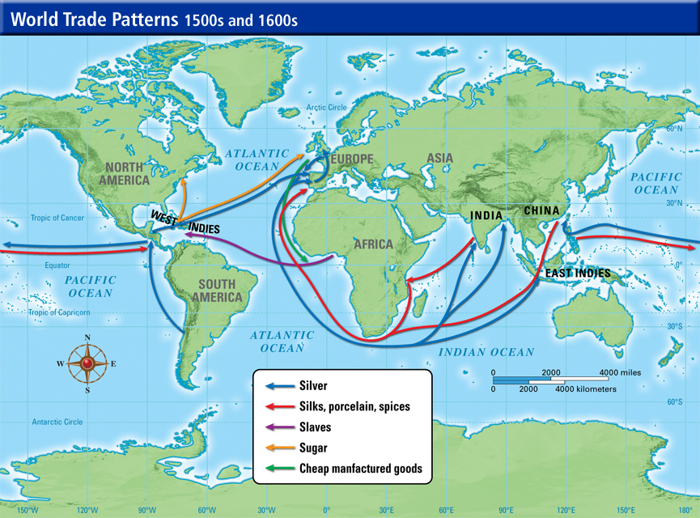
© Brain Wrinkles

Slide 7
Slave Trade
During the 16th century, Portuguese explorers became engaged in the African slave trade.
They kidnapped Africans and forced them to work on plantations and mines in their colonies in the New World.
Other European countries soon participated in the slave trade as well.
© Brain Wrinkles

Slide 8
Slave Trade
The trans-Atlantic slave trade lasted from the 1500s to the mid-1800s.
Even after the slave trade had ended, European interest in Africa was still going strong.
European countries saw that Africa was a continent full of vast natural resources and mineral wealth.
© Brain Wrinkles

Slide 9
Imperialism
The end of the 19th century is called the “Age of Imperialism” because that is when European countries competed for land and power throughout Asia and Africa.
Imperialism is a system where a strong country takes wealth and raw materials from another country.
A “strong” country was supposed to have many colonies to increase its wealth and importance around the world.
© Brain Wrinkles

Slide 10
Geographic
Reasons
During this time, many European countries expanded their empires by aggressively establishing colonies in Africa.
They wanted to exploit and export Africa’s resources (rubber, timber, diamonds, gold, etc.).
Europeans also wanted to protect their trade routes.
© Brain Wrinkles

Slide 11
Economic Reasons
Economic motivation played a large part in the colonization of Africa.
The 19th century was a time of great industrialization in Europe (Industrial Revolution).
Factories required raw materials that could be manufactured into marketable products.
© Brain Wrinkles

Slide 12
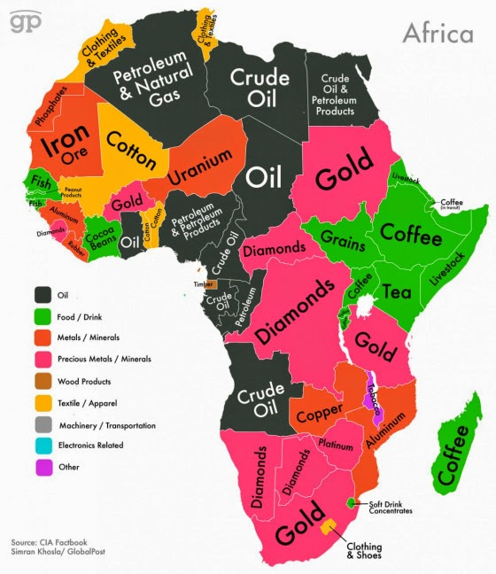
© Brain Wrinkles

Slide 13
Economic Reasons
When Europeans returned to Africa for more resources, they brought back the manufactured goods and sold them to Africans.
Africa became a new market for Europe to sell goods. (ADD: not most important) TAKE OUT OF YOUR NOTES
© Brain Wrinkles

Slide 14
Political
Reasons
Politics in Europe also led to the colonization of Africa.
Nationalism, a strong sense of pride in one's nation, resulted in competition between European nations.
**NATIONALISM: a desire of a group of people to have their own country
No major nation wanted to be without colonies, which led to this “Scramble for Africa”.
The competition was particularly fierce between Great Britain, France, and Germany, the strongest European nations in the 1800s.
© Brain Wrinkles

Slide 15
Religious
Reasons
Christian missionary work gained strength during the 1800s as European countries were becoming more involved in Africa.
The idea of “Christianizing” Africa also made many Europeans look favorably on the colonization of the continent.
© Brain Wrinkles

Slide 16
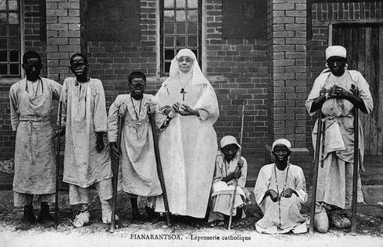
© Brain Wrinkles

Slide 17
Berlin
Conference
By the 1880s, Great Britain, France, Germany, Belgium, Spain, and Portugal all wanted part of Africa.
To prevent a European war over Africa, leaders from fourteen European governments and from the United States met in Berlin, Germany, in 1884.
No Africans attended the meeting.
At the meeting, the European leaders discussed Africa’s land and how it should be divided.
© Brain Wrinkles

Slide 18
Berlin
Conference
Going into the meeting, roughly 10% of Africa was under European colonial rule.
By the end of the meeting, European powers “owned” most of Africa and drew boundary lines that remained until 1914.
Great Britain won the most land in Africa and was “given” Nigeria, Egypt, Sudan, Kenya, and South Africa after defeating the Dutch Settlers and Zulu Nation.
The agreements made in Berlin still affect the boundaries of African countries today.
© Brain Wrinkles

Slide 19
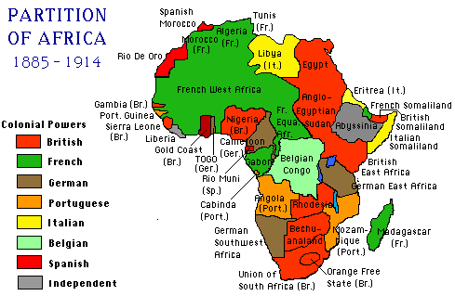
Political Boundaries after the Berlin Conference
© Brain Wrinkles

Slide 20
Artificial
Boundaries
European powers organized Africa’s population in ways to make the most efficient workforce, ignoring the native peoples’ cultural groups or existing political leadership ADD – ethnic group divisions.
Sometimes they grouped together people who had never been united before.
Sometimes they divided existing groups of people.
The creation of these borders had a negative impact on Africa’s political and social structures by either dividing groups that wanted to be together or combining ethnic groups that were enemies.
© Brain Wrinkles

Slide 21
European
Control
Europeans placed colonies into administrative districts and forced the Africans to go along with their demands.
Europeans also tried to assimilate Africans by forcing them to give up their own African customs and adopt European ones.
Protests and revolts were common and starvation and disease became widespread.
© Brain Wrinkles

Slide 22
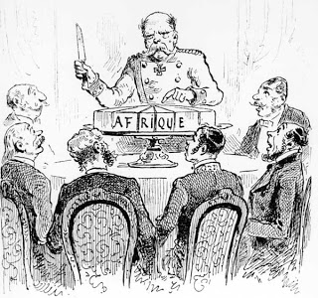
© Brain Wrinkles

Slide 23
European
Control
Europeans took the best land by force.
African farmers were forced to grow cash crops like cocoa and coffee, causing there to be a shortage of food in many areas of Africa.
Africans were forced to work under terrible conditions on plantations, railways, and logging.
© Brain Wrinkles

Slide 24
Lasting
Effects
In order to gain power, Europeans encouraged Africans to fight against each other.
New political boundaries caused ethnic groups to clash.
This has led to ethnic and political unrest in Africa today.
There have been over 50 ethnic conflicts in Africa since WWII as a result of the colonial lines drawn by Europeans.
ADD: Sometimes caused civil war
© Brain Wrinkles

Slide 25
African
Unrest
By the mid-twentieth century, Africans began to openly oppose European control of their countries.
It was obvious that colonialism was not fair, as it only benefitted the Europeans.
Africans were tired of being treated like second-class citizens on their own land.
They soon begin to demand freedom for themselves and the desire for independence spread across Africa.
© Brain Wrinkles

