Slide 1
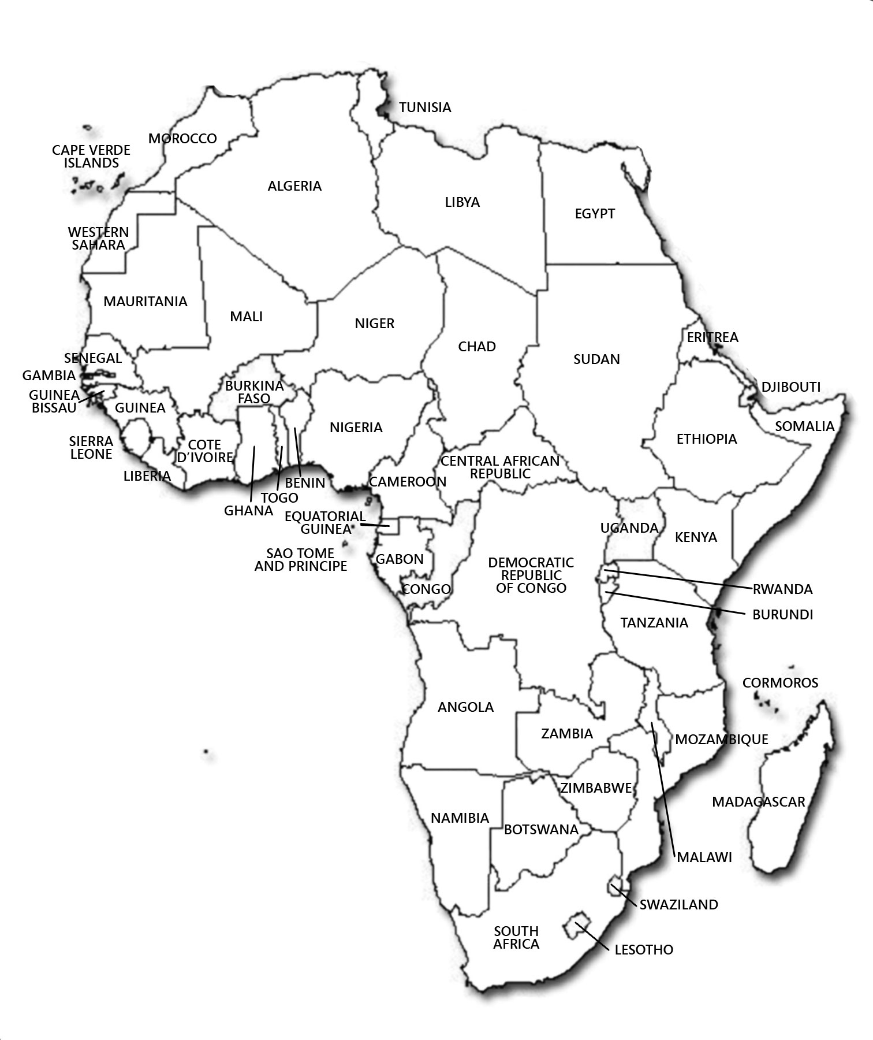
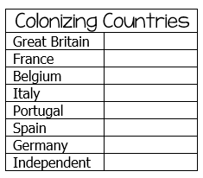
© Brain Wrinkles
Map Key
Directions: Create a color-coded key for the Colonizing Countries. Next, color the countries below to correspond with the countries that colonized them.
European Partitioning
Across Africa

