Slide 1
Southwest Asia Today
Dubai, UAE

Slide 2
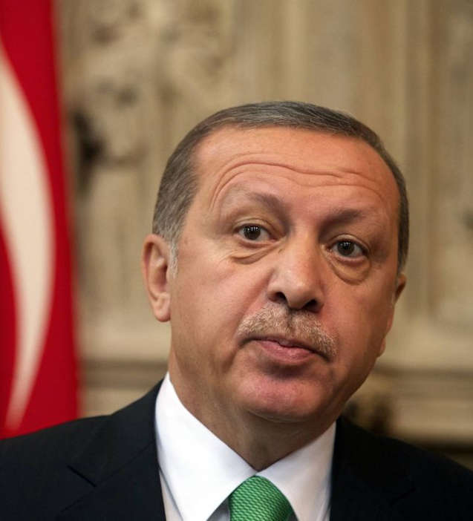
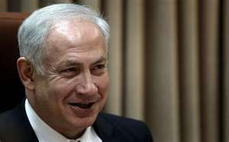
Governments of Middle East
Let’s review the different types of governments
Absolute/Autocratic Monarchy
Dictatorship
Autocracy
Oligarchy
Democracy
Parliamentary
Presidential
Theocracy
King Salman (SA)
President Erdogan (T)
Benjamin Netanyahu (Is.)

Slide 3
SS7CG3 Compare and contrast various forms of government.
a. Explain citizen participation in autocratic and democratic governments [i.e., the role of citizens in choosing the leaders of Israel (parliamentary democracy), Saudi Arabia (autocratic monarchy), and Turkey (parliamentary democracy)].
b. Describe the two predominant forms of democratic governments: parliamentary and presidential.

Slide 4
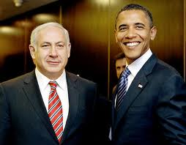
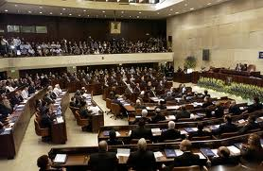
Israel
Parliamentary Democracy
Prime Minister and Parliament are elected by the people (exception to the rule)
Parliament is known as Knesset (120 members, 4 yr. terms)
Coalition government of many parties.
Prime Minister is Benjamin Netanyahu
President (Reuven Rivlin) is a ceremonial role, not part of three branches
Major issue is security.
All citizens can vote and speak freely.

Slide 5
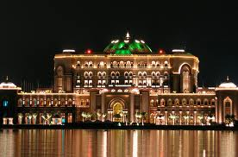
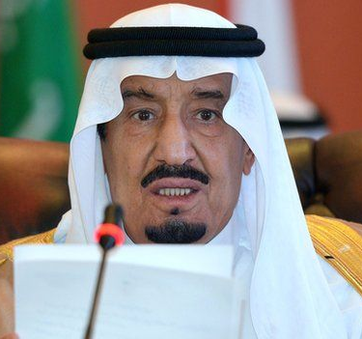
Saudi Arabia
Islamic absolute/autocratic monarchy (Al-Saud dynasty)
The king inherits his position
Qur’an is the constitution of the country, which is governed on the basis of Islamic law (Shari’a).
No political parties and no national elections
Cabinet is appointed by king (many are royal family members)
Citizens (Women – first voted in 2015) elect local council members.
The King of Saudi Arabia is both chief of state and the head of government
King Salman inherited throne in Jan. 2015 when half-brother, King Abdullah, died (who had ruled since 2005).
http://www.bbc.com/news/world-middle-east-14703478

Slide 6
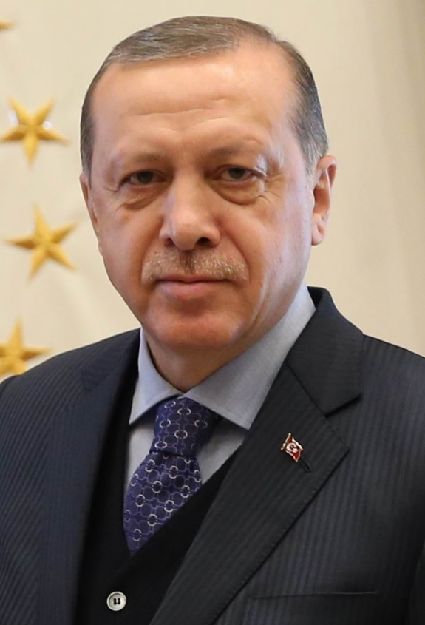
Turkey-
Presidential Democracy
Unicameral legislature – Parliament
Grand National Assembly of Turkey
600 directly-elected representatives
Head of Government: President elected by people for five-year term
President Erdogan (2018) (Took more powers than he was supposed to, and citizens voted in April 2017 to grant sweeping powers to the President.) – re-elected again in June 2018
Has limited freedom of speech – arrests of journalists, changed Turkey’s constitution
Survived a coup in 2016
Accusations of corrupt elections
18 and over voting rights

Slide 7
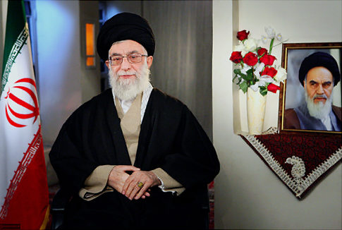
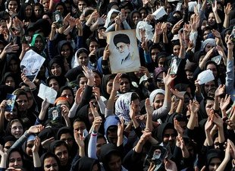
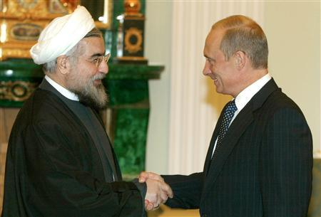
Iran
Ayatollah Ali Khamenei is the Head of Government(1989-present)
Religious leader – theocracy
“Supreme Leader” according to Qur’an
Appointed by special committee for life
Election of president in June 2013
Citizens 18 and over can vote.
President Hasan Ruhani:
“My government will be one of prudence and hope and my message is about saving the economy, reviving ethics and interaction with the world.”

