Slide 1
Religions of the Middle East

Slide 2
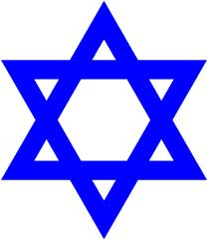
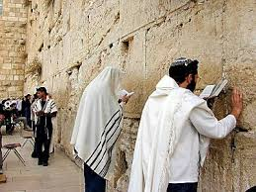
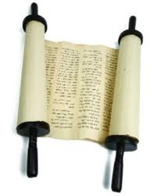
Judaism
Holy city ----- Jerusalem
Holy book ----- Torah
written in Hebrew (sacred language)
part of the TeNaKh
God ----- God of Abraham; called Adonai in Hebrew (one of the names)

Slide 3
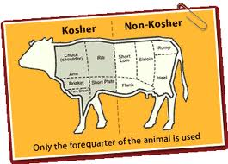
Most important figure ----- Moses
Practices and Rituals -----
Live a good life according to the laws of the Torah
Pass on Jewish traditions to their families
Rest and pray on the Sabbath
Fast during Yom Kippur (day of atonement)
Give to the needy
Eat only kosher foods (diet restrictions including no pork)

Slide 4
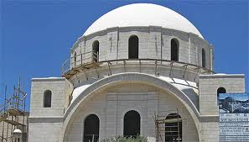
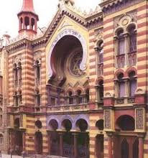
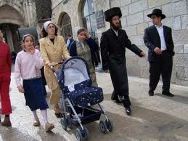
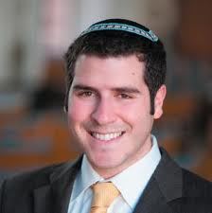
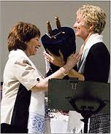
Worship Services -----
Place: Synagogue
Sabbath: Saturday (Friday evening to Saturday evening)
Leader: Rabbi
Sects -----
Orthodox
Conservative
Reformed

Slide 5
Key beliefs -----
God gave the Torah to Moses
Laws continued to be revealed in every generation
God made an agreement with Abraham that said his descendants would be God’s chosen people in return for their faith and obedience.

Slide 6
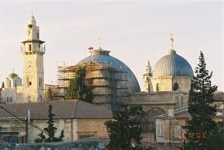
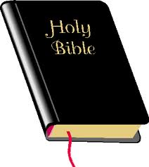
Christianity
Holy city ----- Jerusalem
Holy book ----- Bible
Old Testament
New Testament (Jesus’s life and after)
no sacred language
God ----- God of Abraham
Most important figure----- Jesus

Slide 7
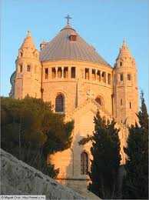
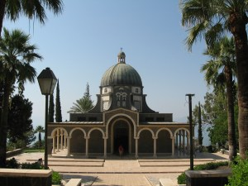
Practices and Rituals -----
follow Jesus and the Bible
participate in sacraments (such as baptism and communion)
Worship Services -----
Place: Church
Sabbath: Sunday
Leader: Pastor, Priest, Minister, Preacher
Sects ----- Roman Catholic, Protestant, Orthodox

Slide 8
Key beliefs -----
Trinity: Father, Son, Holy Spirit
Based on teachings of Jesus
Jesus is a part of God and seen as Savior
God made an agreement with Abraham that said his descendants would be God’s chosen people in return for their faith and obedience – expanded to all who believe in Jesus

Slide 9
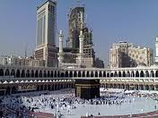
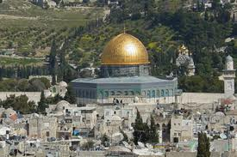
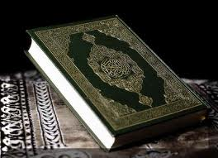
Islam
Holy Cities -----
Mecca (most important)
Jerusalem
Holy Book ----- Qur'an (or Koran)
Written in Arabic (sacred language)
God ----- God of Abraham; called “Allah” in Arabic

Slide 10
Most important figure ----- Muhammad
Think Jesus and Moses were prophets too
Practices and Rituals -----
Five Pillars of Islam
Public declaration of faith (there is one true god)
Prayer 5 times a day
Giving to the needy
Fasting during Ramadan
Journey to Mecca once in lifetime

Slide 11
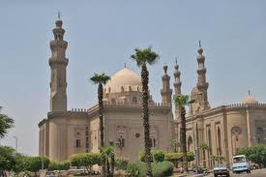
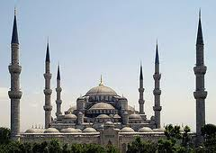
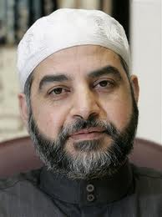
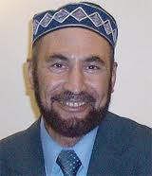
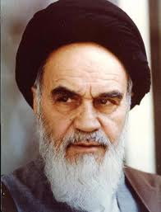
Worship services -----
Place: Mosque
Sabbath: Friday
Most important prayer is at noon
Leader: Imam
Sects----- Sunni, Shi’a (or Shi’i)

Slide 12
Key beliefs -----
Jews descended from Isaac, Muslims descended from Ishmael
Allah revealed his message to Muhammad for 23 years (Qur’an)
Allah made an agreement with Abraham that said his descendants would be Allah’s chosen people in return for their faith and obedience

Slide 13
All Three
Belief in one god (monotheism)
God of Abraham (but believed in different ways)
Importance of prophets
Jerusalem
Originated in Middle East
Holy book

Slide 14
Islam & Judaism
Sacred language
Dietary laws
Required to give to the needy
Fasting during certain holidays

Slide 15
Judaism & Christianity
Orthodox is a strict sect
Service leaders are ordained
The old testament

Slide 16
Islam & Christianity
Jesus was/is more than just a man

Slide 17
Judaism
Moses is most important prophet
Torah
Saturday worship service
Synagogue
Rabbi
Adonai (one of the names)

Slide 18
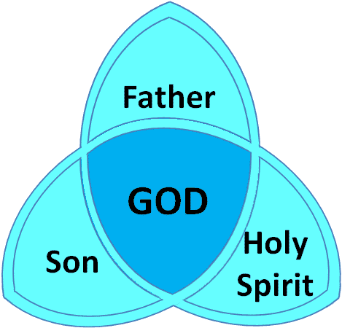
Christianity
Trinity( God, the son, & holy spirit)
Sacraments
Bible
Sunday
Church
Jesus is divine
minister

Slide 19
Islam
Mecca
Muhammad is final prophet
Qur’an
Mosque
Friday (noon prayer)
Imam
5 Pillars

Slide 20
The Split of Islam
Islam was founded by Muhammad in 610 AD in Mecca
Muhammad’s followers spread his teachings across the Arabian peninsula and its neighbors
When Muhammad died in 632 AD, disagreements began over who would take his place.
Islam split into two major sects: Sunni and Shi’a
Today differences are political as well as religious

Slide 21
Sunni and Shi’a
Sunni
85% of the world’s Muslims
Same basic beliefs and practices as Shi’a
Believed a well-respected, knowledgeable Muslim could take Muhammad’s place as caliph (leader)
Abu Bakr was chosen
Imams are respected within the community and knowledgeable of the Qur’an
Shi’a
15% of the world’s Muslims
Same basic beliefs and practices as Sunnis
Believed relatives of Muhammad should take his place as caliph (leader)
Son-in-law Ali was chosen
Imams are members of an organized clergy, believed to be descendants of Ali
Iran is the only country with Shia political control

