Slide 1
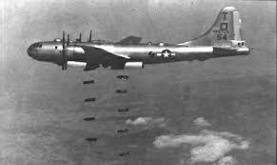
New south-ww2 review

Slide 2
In what 3 ways did Georgia contribute to the Allies during World War II? .
1. Six-hundred bomber airplanes (Bell Bomber) were built in Marietta and used in WWII. 2. Ships were built in both Savannah and Brunswick, which were used in WWII. 3. Carl Vinson and Richard Russell had several military bases built in Georgia during WWII

Slide 3
The systematic killing of 6 million Jewish people by the Nazis was known as the
Holocaust.

Slide 4
President Franklin Delano Roosevelt’s Little White House was in Warm Springs, Georgia. Why did the president often travel to Georgia?
President Roosevelt suffered from polio and swam in the healing water of Warm Springs.

Slide 5
A ruler with total power over a country who has typically obtained power by force.
Dictator

Slide 6
The national policy of abstaining (sitting out) from political or economic relations with other countries.
Isolationism

Slide 7
Who replaced Tom Watson in Congress after he died while still serving his term?
Rebecca Latimer Felton

Slide 8
The cause of the 1906 Race Riot in Atlanta was caused by
A series of articles in the newspaper about black violence against white women

Slide 9
Who was accused of killing Mary Phagan at the pencil factory on April 26, 1913?
Leo Frank

Slide 10
How did the county unit system affect voting and politics in Georgia in the early 1900’s?
It gave rural areas more political power.

Slide 11
How did the Bourbon Triumvirate describe the New South Period?
A blending of the new and the old, keeping old southern traditions while building new traditions around industries to rival the North.

Slide 12
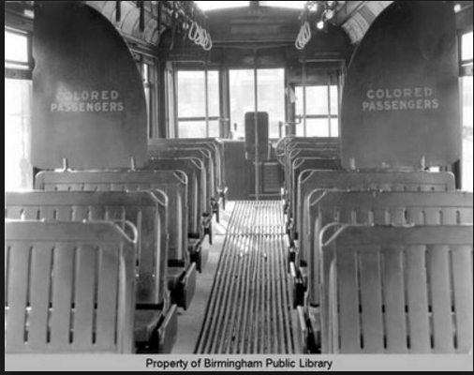
What court case ruling made this act legal?
Plessy v. Ferguson

Slide 13
Why was Henry Grady known as the “voice of The New South”?
In his articles, he said that GA needed to move from agriculture toward industries.

Slide 14
What was the result of the passage of “Jim Crow” laws?
Separate restrooms, water fountains, railroad cars, dining areas and schools

Slide 15
What was the main purpose of the International Cotton Exposition?
To showcase the industries in the New South.

Slide 16
What GA leader based his career on supporting poor farmers, on a platform of lower taxes?
Tom Watson

Slide 17
Who was selected as the first black president of both Morehouse and Atlanta University?
John Hope

Slide 18
What organization did Lugenia Burns Hope establish?
Neighborhood Union

Slide 19
What business made Alonzo Herndon a successful businessman?
Atlanta Mutual Insurance Company

Slide 20
What 3 things led to the decision for the United States to enter World War I?
The sinking of the Lusitania, Zimmerman telegram & submarine attacks on US ships

Slide 21
World War I begins with the ________________ and ends with the signing of____________.
Assassination of Archduke Franz Ferdinand and Treaty of Versailles

Slide 22
. Why was Georgia important to the World War 1 effort?
Many US Soldiers trained in Georgia training camps.

Slide 23
What caused cotton production to drop from 1.75 million bales in 1914 to 588,000 bales in 1923?
A small long-snouted beetle called the boll weevil destroyed cotton in the field

Slide 24
This insect caused cotton production to drop and on the hills of that GA suffered a severe _______________ that made farmers pack up and move.
Drought

Slide 25
Which U.S. President believed in the practice of laissez-fair policies that helped bring about the depression in the 30s?
Herbert Hoover

Slide 26
Whose rights did Tom Watson and the Populists fight for?
Rural Farmers

Slide 27
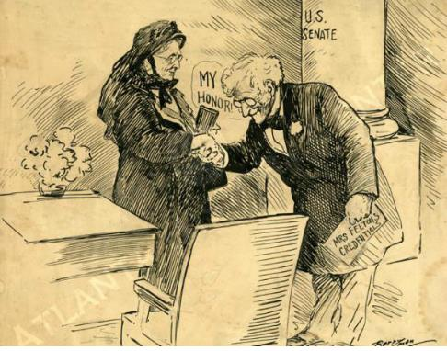
What is the subject of the political cartoon?
Rebecca Latimer Felton serving as a United States senator

Slide 28
Due to the lack of enforcement by the federal government, southern states established many laws that prevented blacks, and poor whites from voting. This is called
Disenfranchisement

Slide 29
What Constitutional amendment(s) was violated by Jim Crow legislation?
14th & 15th Amendment

Slide 30
In 1920, the Nineteenth Amendment to the U.S. Constitution was ratified. How did this amendment change the make-up of those who could vote in Georgia?
It allowed all women to vote

Slide 31
What did Booker T. Washington believe about social equality among blacks and whites of his day?
He accepted social separation and felt that African Americans could advance faster through hard work than by demanding equal rights.

Slide 32
What did DuBois believe about social equality among blacks and whites of his day
He felt that African Americans should speak out against discrimination and that college-educated African Americans should lead the fight against it.

Slide 33
* Borrowing more money than could be repaid * Speculating in the Stock Market * Overproducing farm products These events led to_______?
The Great Depression

Slide 34
What programs were apart of Roosevelt's "New Deal"?
Agricultural Adjustment Act (AAA) Civilian Conservation Corps (CCC) Social Security Act (SSA) Rural Electrification Authority (REA)

Slide 35
Place the following events in the correct chronological order they occurred: 1. Sharp economic growth 2. Drought and Dust Bowl 3. Black Tuesday 4. World War 1
4, 1, 3, 2

Slide 36
Eugene Talmadge became governor of Georgia in 1933. He disliked relief efforts, public welfare and debts. As a result of these beliefs, Governor Talmadge
Tried to get rid of all of the New Deal programs in Georgia.

Slide 37
The Civilian Conservation Corps (CCC) was a popular New Deal program because it put unemployed people to work during the Depression. What was a result of the CCC?
Many men across Georgia and the U.S. built public facilities, many of which exist to this day.

Slide 38
What was the name of the federal assistance program designed to bring economic relief during the Great Depression?
The New Deal

Slide 39
What president was responsible for creating the programs that would bring economic relief during the Great Depression?
Franklin D. Roosevelt

Slide 40
What program loaned money to farmer's cooperatives to help them build power lines and purchase power wholesale?
Rural Electrification Administration

Slide 41
What New Deal program restricted agricultural production by paying farmers to grow fewer crops?
Agricultural Adjustment Act

Slide 42
The purpose of Social Security is to
Create a system of retirement and unemployment benefits

Slide 43
What act encouraged Georgia’s farmers to stop relying solely on cotton, and to plant peanuts, corn, tobacco, and other crops?
AAA

Slide 44
A major difference between the New Deal and the policies followed by earlier administrations was that the New Deal
Provided the government with a more active role in the economy

Slide 45
What caused the United States to get involved in World War II?
The Japanese bombed Pearl Harbor in Hawaii.

Slide 46
What describes the involvement of the United States in WWII before the bombing of Pearl harbor?
The US provided lend-lease aid to Great Britain and the Soviet Union.

Slide 47
This term means to give into the demands of an aggressor in order to avoid war.
Appeasement

Slide 48
Why was Carl Vinson recognized by two United States presidents?
He was a major influence in promoting the US to strengthen its navy before & after WWII.

Slide 49
What was the name of the Marietta factory used to build B-29 bombers during WWII?
Bell Aircraft

Slide 50
Richard B. Russell helped to bring 15 __________ to GA
Military bases

Slide 51
. During World War II, the Georgia cities of Savannah and Brunswick were BEST known for
Building Liberty ships.

