Slide 1
PAN-AFRICAN MOVEMENT
Colonization
By the 20th century, European powers had colonized the ______________________
The only independent countries were ______________________ .
Liberia was founded in 1822 by ______________________ .
Nationalism
Africans resented their unequal status and ______________________ under European control.
They wanted to ______________________ of their own governments, land, and resources.
Nationalism, a ______________________ in one’s own country, began to sweep across Africa and fed the desire for independence from European rule.
Pan-African
An example of African nationalism was the ______________________ that began in the late 1800s.
The movement believed that all Africans ______________________ and should work together for their freedom.
The Pan-African movement’s principles actually dated back to the ______________________ .
The first ______________________ occurred in 1900.
By the end of World War II, ______________________ had occurred.
The fifth Pan-African Congress counted in ______________________ , including the future leaders of Kenya and Ghana.
Eventually, the influence of the movement began to fade, but not before pushing the ______________________ forward.
Changes
Africa began to change by the ______________________ .
The rule of tribal chiefs had weakened because of their links with colonial governments, thus limiting their ______________________ .
An ______________________ that disliked colonial life began to grow in the cities.
Unrest
The cost for European countries to maintain ______________________ .
By the second half of the century, ______________________ throughout the continent and African nations fought to free themselves from European control.
© Brain Wrinkles
Pan-African & Independence
CLOZE Notes 1

Slide 2
KENYA
Colonization
For hundreds of years, outsiders did not enter the region now known as Kenya because of the ______________________ that inhabited the area.
______________________ took control of Kenya’s coast during the 1800s.
Next came Germany and Great Britain, but by 1920, ______________________ were the only foreigners who remained.
Under British rule, native Kenyans had to ______________________ and did not have the same access to education and jobs that whites did.
The government also ______________________ and gave it to British settlers and war veterans.
Opposition
Most Kenyans were upset by their ______________________ as landowners to the British.
They believed that their land was taken unfairly and ______________________ began to form.
For several decades, small bands of armed ______________________ (guerillas) fought to eliminate white settlers in Kenya.
Rebellion
In 1956, there was a violent rebellion that resulted in the deaths of thousands of ______________________ ,
Although the British army mostly defeated the guerillas, this movement gained a great ______________________ among Kenyans.
Change
The Mau Mau uprising had ______________________ throughout Kenya.
It showed the British that Africans ______________________ and raised global awareness about the struggle for independence in Kenya.
Great Britain slowly began returning land to Kenya’s African citizens and also granting them ______________________ .
© Brain Wrinkles
Pan-African & Independence
CLOZE Notes 2

Slide 3
Independence
Kenyans were tired of being treated unfairly, and ______________________ .
On ______________________ , the British Empire granted Kenya its independence.
______________________ was the most influential leader of the freedom movement in Kenya, and was appointed as the nation’s first president.
Kenyatta
______________________ of the Kenyan African National Union, and during his presidency, began a campaign called harambee, which is Swahili for “let’s pull together.”
Under Kenyatta and his successor, Daniel arap Moi, the KNAU ran ______________________ until the 1990s.
The country remains a multi-party state, but the reality is that the ______________________ of the government.
Today
By the time of his death in 1978, Kenyatta had helped Kenya become one of the ______________________ and economically dynamic countries in Africa.
Even though there has been improvement in the political rights of Kenya’s people, ______________________ as there is a great deal of corruption within the country’s government.
NIGERIA
The country now known as Nigeria was a diverse region with more than ______________________ .
Nigeria had maintained its independence until 1914 when ______________________ the area.
Unrest
The British government took land from the Nigeria’s tribes and controlled most of the ______________________ .
This angered many Nigerians so they ______________________ to work for independence.
Most Nigerians believed that the only way to have rights was to be ______________________ of European rule.
© Brain Wrinkles
Pan-African & Independence
CLOZE Notes 3

Slide 4
Change
At first, they ______________________ .
After World War II, more and more Nigerians encouraged nationalism and ______________________ .
Nationalism and the cause for independence from the British ______________________ of Nigeria’s ethnic groups.
Independence
After many (mostly) peaceful protests, Great Britain allowed Nigeria to ______________________ .
On ______________________ , Great Britain granted Nigeria independence and an independent government was established.
At first, it was one of the ______________________ of the new African countries.
Power
Nigeria did not remain ______________________ .
Unfortunately, struggles for power between ______________________ have resulted in three military coups and a civil war.
Today
Nigeria suffered from violence and ______________________ , when a democratic government was established.
In recent years, political instability, religious competition, ethnic differences and the need to become more modern ______________________ .
Africa Today
By 1966, ______________________ African countries were independent nation-states.
Unfortunately, once the countries were independent of European rule, they still ______________________ .
Many of the new governments were ______________________ .
European powers ______________________ new leaders how to self-govern after granting them independence.
Ethnic groups ______________________ over political power in many African nations.
In some African countries, ______________________ took over the governments.
© Brain Wrinkles
Pan-African & Independence
CLOZE Notes 4

Slide 5
AFRICA’S
Independence Movements
Kenya and Nigeria
© Brain Wrinkles

Slide 6
PAN-AFRICAN
Movement
© Brain Wrinkles

Slide 7
Colonization
By the 20th century, European powers had colonized the majority of Africa.
The only independent countries were Liberia and Ethiopia.
Liberia was founded in 1822 by former American slaves.
© Brain Wrinkles

Slide 8
Nationalism
Africans resented their unequal status and lack of political rights under European control.
They wanted to take control of their own governments, land, and resources.
Nationalism, -(a desire of a group of people to have one’s own country), began to sweep across Africa and fed the desire for independence from European rule.
© Brain Wrinkles

Slide 9
Pan-African
An example of African nationalism was the Pan-African movement that began in the late 1800s.
The movement believed that all Africans shared a common heritage and should work together for their freedom.
The Pan-African movement’s principles actually dated back to the slave trade era.
The first Pan-African Congress occurred in 1900.
© Brain Wrinkles

Slide 10
Pan-African
By the end of World War II, four more meetings had occurred.
The fifth Pan-African Congress counted in 90 delegates, including the future leaders of Kenya and Ghana.
Eventually, the influence of the movement began to fade, but not before pushing the cause of nationalism forward.
© Brain Wrinkles

Slide 11
Changes
Africa began to change by the 1940s.
The rule of tribal chiefs had weakened because of their links with colonial governments, thus limiting their ability to control people.
An educated middle class that disliked colonial life began to grow in the cities.
© Brain Wrinkles

Slide 12
Unrest
The cost for European countries to maintain colonies was rising.
By the second half of the century, unrest arose throughout the continent and African nations fought to free themselves from European control.
© Brain Wrinkles

Slide 13
KENYA
© Brain Wrinkles

Slide 14
Colonization
For hundreds of years, outsiders did not enter the region now known as Kenya because of the fierce warrior tribes that inhabited the area.
Arab traders took control of Kenya’s coast during the 1800s.
Next came Germany and Great Britain, but by 1920, the British were the only foreigners who remained.
© Brain Wrinkles

Slide 15
Colonization
Under British rule, native Kenyans had to pay high taxes and did not have the same access to education and jobs that whites did.
The government also took land and gave it to British settlers and war veterans.
© Brain Wrinkles

Slide 16
Opposition
Most Kenyans were upset by their loss of rights as landowners to the British.
They believed that their land was taken unfairly and opposition groups began to form.
For several decades, small bands of armed resistance forces (guerillas) fought to eliminate white settlers in Kenya.
© Brain Wrinkles

Slide 17
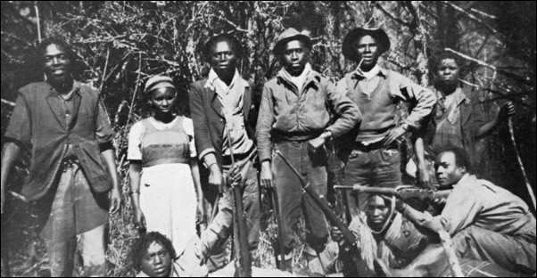
The Mau Mau was a secret society that believed force was the only way to win Kenyan rights and independence.
© Brain Wrinkles

Slide 18
Rebellion
In 1956, there was a violent rebellion that resulted in the deaths of thousands of Mau Mau fighters.
Although the British army mostly defeated the guerillas, this movement gained a great deal of support among Kenyans.
© Brain Wrinkles

Slide 19
Change
The Mau Mau uprising had spread nationalism throughout Kenya.
It showed the British that Africans would fight back and raised global awareness about the struggle for independence in Kenya.
Great Britain slowly began returning land to Kenya’s African citizens and also granting them improved rights.
© Brain Wrinkles

Slide 20
Independence
Kenyans were tired of being treated unfairly, and demanded to be free.
On December 12th, 1963, the British Empire granted Kenya its independence.
Jomo Kenyatta was the most influential leader of the freedom movement in Kenya, and was appointed as the nation’s first president.
© Brain Wrinkles

Slide 21
Kenyatta
Kenyatta was a leader of the Kenyan African National Union, and during his presidency, began a campaign called harambee, which is Swahili for “let’s pull together.”
Under Kenyatta and his successor, Daniel arap Moi, the KNAU ran unopposed in elections until the 1990s.
The country remains a multi-party state, but the reality is that the KNAU is in control of the government.
© Brain Wrinkles

Slide 22
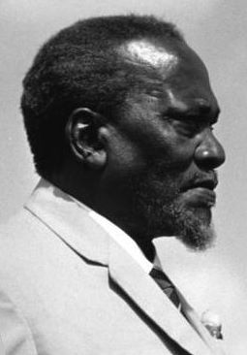
Jomo Kenyatta -- The first president and “founding father” of Kenya.
© Brain Wrinkles

Slide 23
Today
By the time of his death in 1978, Kenyatta had helped Kenya become one of the most stable and economically dynamic countries in Africa.
Even though there has been improvement in the political rights of Kenya’s people, more is still needed as there is a great deal of corruption within the country’s government.
© Brain Wrinkles

Slide 24
NIGERIA
© Brain Wrinkles

Slide 25
Nigeria
The country now known as Nigeria was a diverse region with more than 250 ethnic groups.
Nigeria had maintained its independence until 1914 when Great Britain took over the area.
© Brain Wrinkles

Slide 26
Unrest
The British government took land from the Nigeria’s tribes and controlled most of the country’s resources.
This angered many Nigerians so they started political parties to work for independence.
Most Nigerians believed that the only way to have rights was to be completely free of European rule.
© Brain Wrinkles

Slide 27
Change
At first, they protested peacefully.
After World War II, more and more Nigerians encouraged nationalism and demanded self-rule.
Nationalism and the cause for independence from the British united the majority of Nigeria’s ethnic groups.
© Brain Wrinkles

Slide 28
Independence
After many (mostly) peaceful protests, Great Britain allowed Nigeria to elect its own government.
On October 1st, 1960, Great Britain granted Nigeria independence and an independent government was established.
At first, it was one of the most stable governments of the new African countries.
© Brain Wrinkles

Slide 29
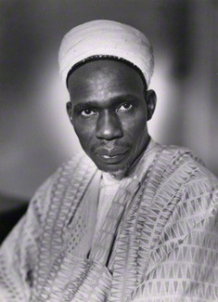
Abubakar Tafawa Balewa – Nigeria’s first prime minister. He was overthrown and murdered in a military coup in 1966.
© Brain Wrinkles

Slide 30
Power
Nigeria did not remain peaceful for long.
Unfortunately, struggles for power between different ethnic groups have resulted in three military coups and a civil war.
© Brain Wrinkles

Slide 31
Today
Nigeria suffered from violence and military rule until 1999, when a democratic government was established.
In recent years, political instability, religious competition, ethnic differences and the need to become more modern continue to plague Nigeria.
© Brain Wrinkles

Slide 32
Africa Today
By 1966, all but six African countries were independent nation-states.
Unfortunately, once the countries were independent of European rule, they still faced many challenges.
Many of the new governments were politically unstable.
© Brain Wrinkles

Slide 33
Africa Today
European powers did not teach new leaders how to self-govern after granting them independence.
Ethnic groups continue to clash over political power in many African nations.
In some African countries, military dictators took over the governments.
© Brain Wrinkles

