Slide 1
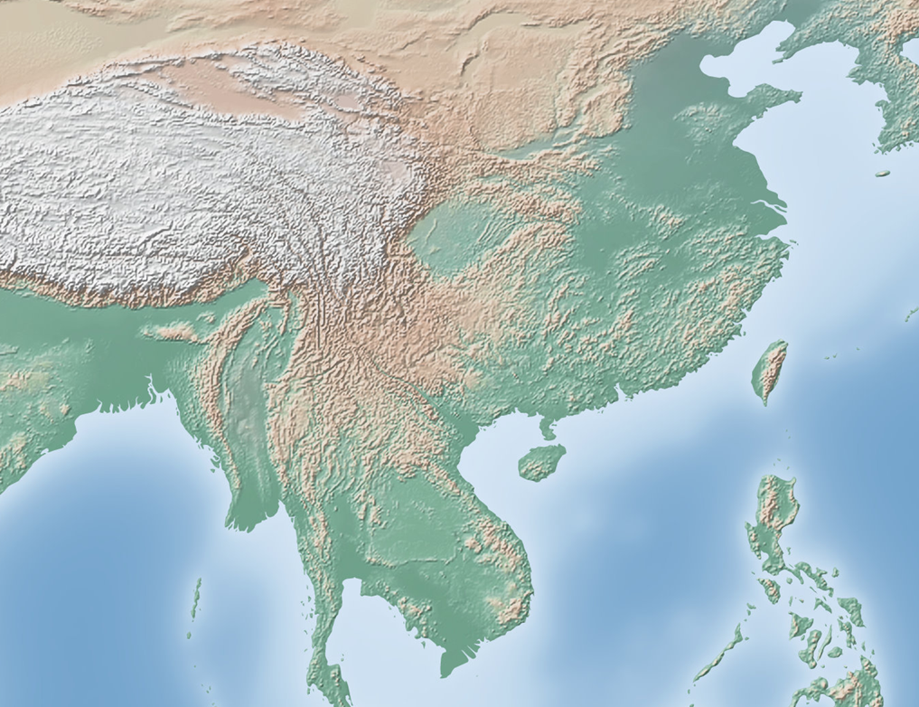
Geography of Southern & Eastern Asia

Slide 2
Essential Question: Where are the major physical features and nations of Southern & Eastern Asia located?
Standards:
SS7G9a. Locate on a world and regional political- physical map:
Ganges River, Huang He (Yellow River), Indus River, Mekong River, Yangtze (Chang Jiang) River, Bay of Bengal, India Ocean, Sea of Japan, South China Sea, Yellow Sea, Gobi Desert, Taklimakan Desert, Himalayan Mountains, and Korean Peninsula.
SS7G9b. Locate on a world and regional political-physical map the countries of China, India, Indonesia, Japan, North Korea, South Korea, and Vietnam.
Notes:
Instructional Approach(s): The teacher should introduce the essential question and the standards that align to the essential question.

Slide 3
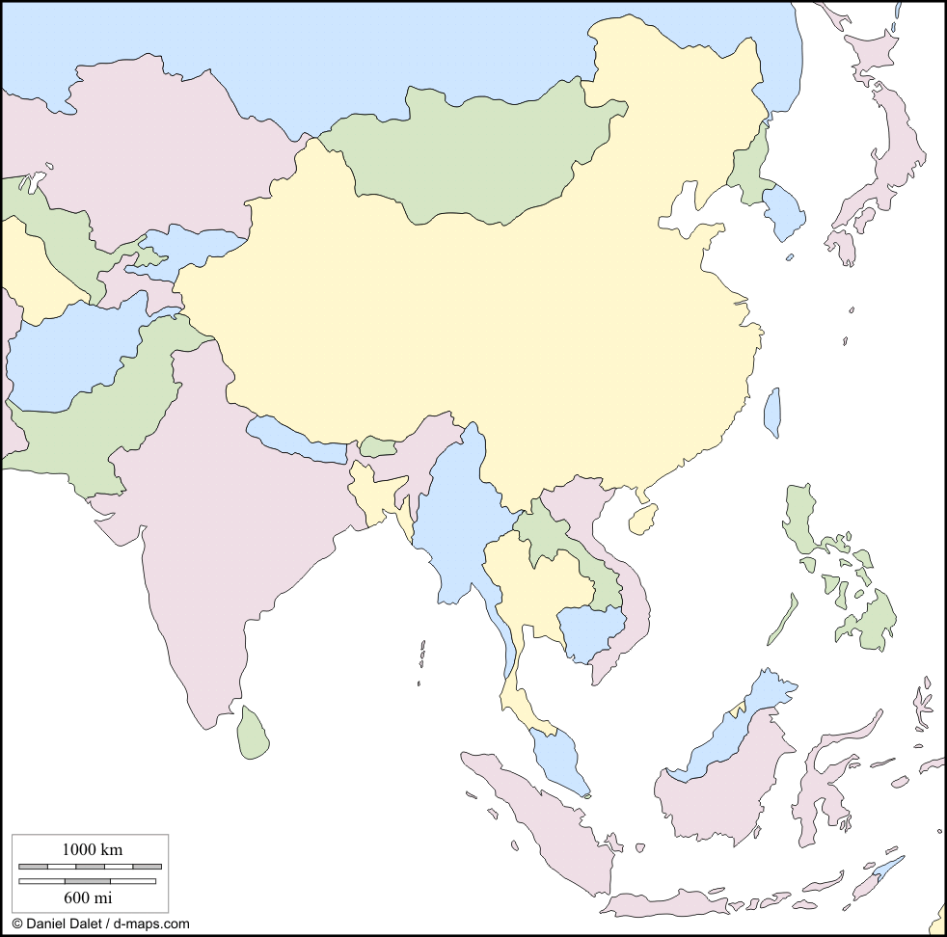
Countries of Southern & Eastern Asia
Notes:
Instructional Approach(s): The teacher should give each student a copy of the Countries of Southern & Eastern Asia Map [linked on the curriculum map] to label the countries during the lesson.

Slide 4
China
1
Notes:
Instructional Approach(s): The teacher should present the animated slide. The teacher can ask for student volunteers to name the country. When ready, the teacher can click the mouse to reveal the answer. The students should record the correct name of the nation on their map.

Slide 5
India
2
Notes:
Instructional Approach(s): The teacher should present the animated slide. The teacher can ask for student volunteers to name the country. When ready, the teacher can click the mouse to reveal the answer. The students should record the correct name of the nation on their map.

Slide 6
Vietnam
3
Notes:
Instructional Approach(s): The teacher should present the animated slide. The teacher can ask for student volunteers to name the country. When ready, the teacher can click the mouse to reveal the answer. The students should record the correct name of the nation on their map.

Slide 7
Indonesia
4
Notes:
Instructional Approach(s): The teacher should present the animated slide. The teacher can ask for student volunteers to name the country. When ready, the teacher can click the mouse to reveal the answer. The students should record the correct name of the nation on their map.

Slide 8
North Korea
5
Notes:
Instructional Approach(s): The teacher should present the animated slide. The teacher can ask for student volunteers to name the country. When ready, the teacher can click the mouse to reveal the answer. The students should record the correct name of the nation on their map.

Slide 9
South Korea
6
Notes:
Instructional Approach(s): The teacher should present the animated slide. The teacher can ask for student volunteers to name the country. When ready, the teacher can click the mouse to reveal the answer. The students should record the correct name of the nation on their map.

Slide 10
Japan
7
Notes:
Instructional Approach(s): The teacher should present the animated slide. The teacher can ask for student volunteers to name the country. When ready, the teacher can click the mouse to reveal the answer. The students should record the correct name of the nation on their map.

Slide 11
Laos
8
Notes:
Instructional Approach(s): The teacher should present the animated slide. The teacher can ask for student volunteers to name the country. When ready, the teacher can click the mouse to reveal the answer. The students should record the correct name of the nation on their map.

Slide 12
Thailand
9
Notes:
Instructional Approach(s): The teacher should present the animated slide. The teacher can ask for student volunteers to name the country. When ready, the teacher can click the mouse to reveal the answer. The students should record the correct name of the nation on their map.

Slide 13
Mongolia
10
Notes:
Instructional Approach(s): The teacher should present the animated slide. The teacher can ask for student volunteers to name the country. When ready, the teacher can click the mouse to reveal the answer. The students should record the correct name of the nation on their map.

Slide 14
Nepal
11
Notes:
Instructional Approach(s): The teacher should present the animated slide. The teacher can ask for student volunteers to name the country. When ready, the teacher can click the mouse to reveal the answer. The students should record the correct name of the nation on their map.

Slide 15
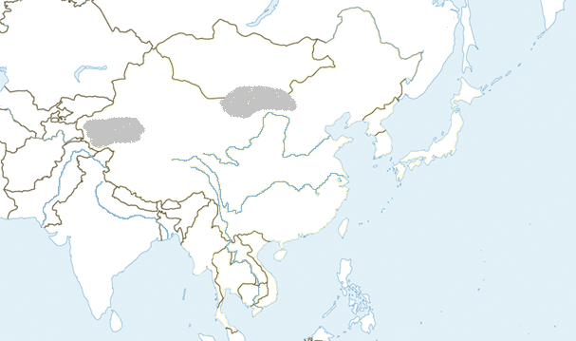
Southern & Eastern Asia Physical Features
Notes:
Instructional Approach(s): The teacher should present the animated slide. The teacher can ask for student volunteers to name the identified physical feature. When ready, the teacher can click the mouse to reveal the answer. The students should record the correct name of the physical feature on their physical features map.

Slide 16
Southern & Eastern Asia Physical Features
1
Gobi Desert
Notes:
Instructional Approach(s): The teacher should present the animated slide. The teacher can ask for student volunteers to name the identified physical feature. When ready, the teacher can click the mouse to reveal the answer. The students should record the correct name of the physical feature on their physical features map.

Slide 17
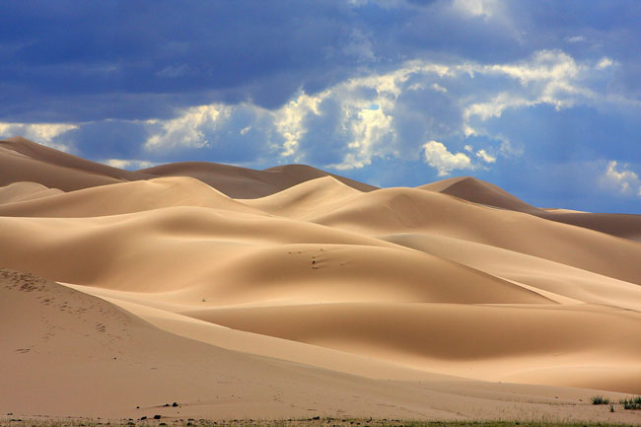
Gobi Desert
Notes:
Instructional Approach(s): The teacher should use the slide to show an illustration of the previous identified physical feature.

Slide 18
Gobi Desert:
Asia’s largest desert that stretches across southern Mongolia and northern China.
Notes:
Instructional Approach(s): The students should record the description of the physical feature previously identified on their physical features map.

Slide 19
Southern & Eastern Asia Physical Features
2
Huang He (Yellow) River
Notes:
Instructional Approach(s): The teacher should present the animated slide. The teacher can ask for student volunteers to name the identified physical feature. When ready, the teacher can click the mouse to reveal the answer. The students should record the correct name of the physical feature on their physical features map.

Slide 20
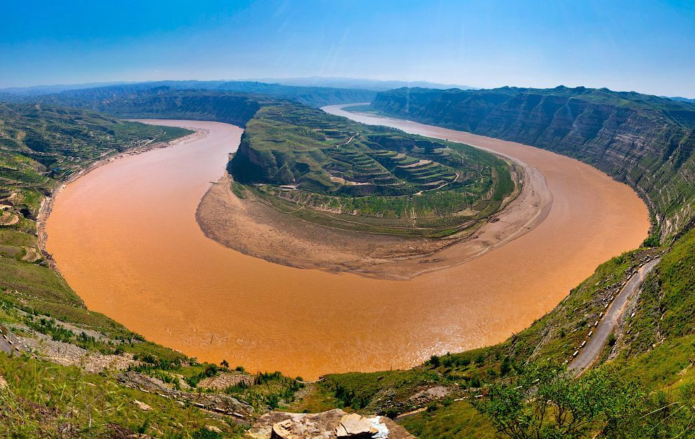
Huang He (Yellow) River
Notes:
Instructional Approach(s): The teacher should use the slide to show an illustration of the previous identified physical feature.

Slide 21
Huang He (Yellow) River:
China’s second largest river that causes devastating floods. It is named for the muddy yellow silt it carries
Notes:
Instructional Approach(s): The students should record the description of the physical feature previously identified on their physical features map.

Slide 22
Southern & Eastern Asia Physical Features
3
Yangtze River
Notes:
Instructional Approach(s): The teacher should present the animated slide. The teacher can ask for student volunteers to name the identified physical feature. When ready, the teacher can click the mouse to reveal the answer. The students should record the correct name of the physical feature on their physical features map.

Slide 23
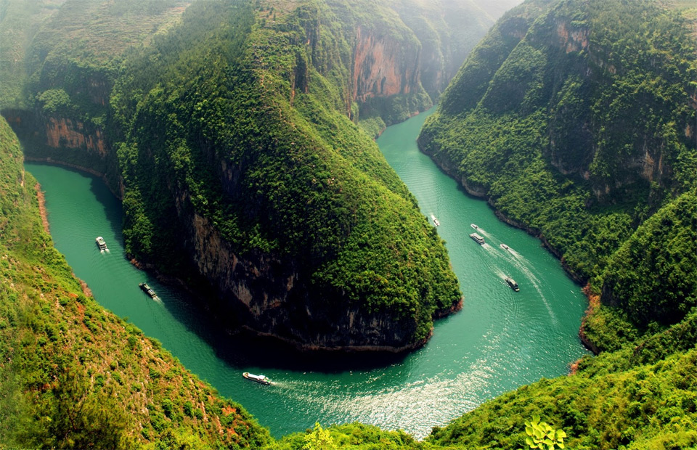
Yangtze River
Notes:
Instructional Approach(s): The teacher should use the slide to show an illustration of the previous identified physical feature.

Slide 24
Yangtze River:
Largest and longest river in China; very important because it provides hydroelectric power, water for irrigation, and transportation for cargo ships.
Notes:
Instructional Approach(s): The students should record the description of the physical feature previously identified on their physical features map.

Slide 25
Southern & Eastern Asia Physical Features
4
Mekong River
Notes:
Instructional Approach(s): The teacher should present the animated slide. The teacher can ask for student volunteers to name the identified physical feature. When ready, the teacher can click the mouse to reveal the answer. The students should record the correct name of the physical feature on their physical features map.

Slide 26
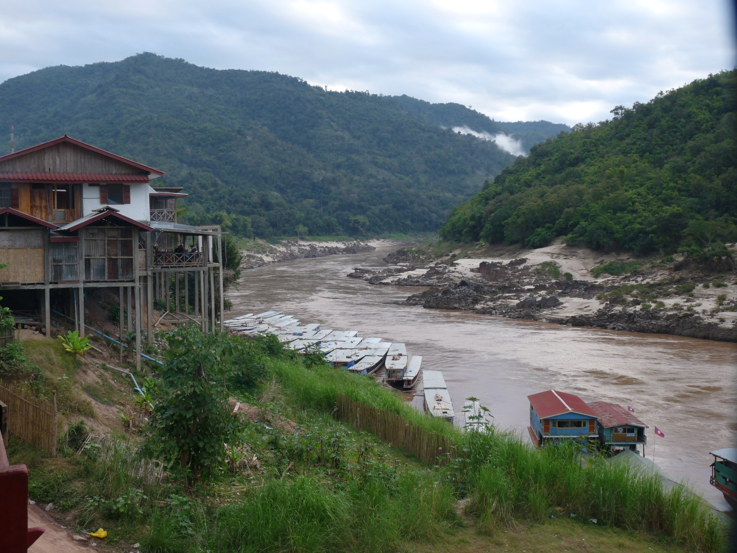
Mekong River
Notes:
Instructional Approach(s): The teacher should use the slide to show an illustration of the previous identified physical feature.

Slide 27
Mekong River:
Flows through China, Myanmar (Burma), Thailand, Laos, Cambodia, and ends in Vietnam. One of the region’s most important crops, rice, is grown in the river basin.
Notes:
Instructional Approach(s): The students should record the description of the physical feature previously identified on their physical features map.

Slide 28
Southern & Eastern Asia Physical Features
5
Ganges River
Notes:
Instructional Approach(s): The teacher should present the animated slide. The teacher can ask for student volunteers to name the identified physical feature. When ready, the teacher can click the mouse to reveal the answer. The students should record the correct name of the physical feature on their physical features map.

Slide 29
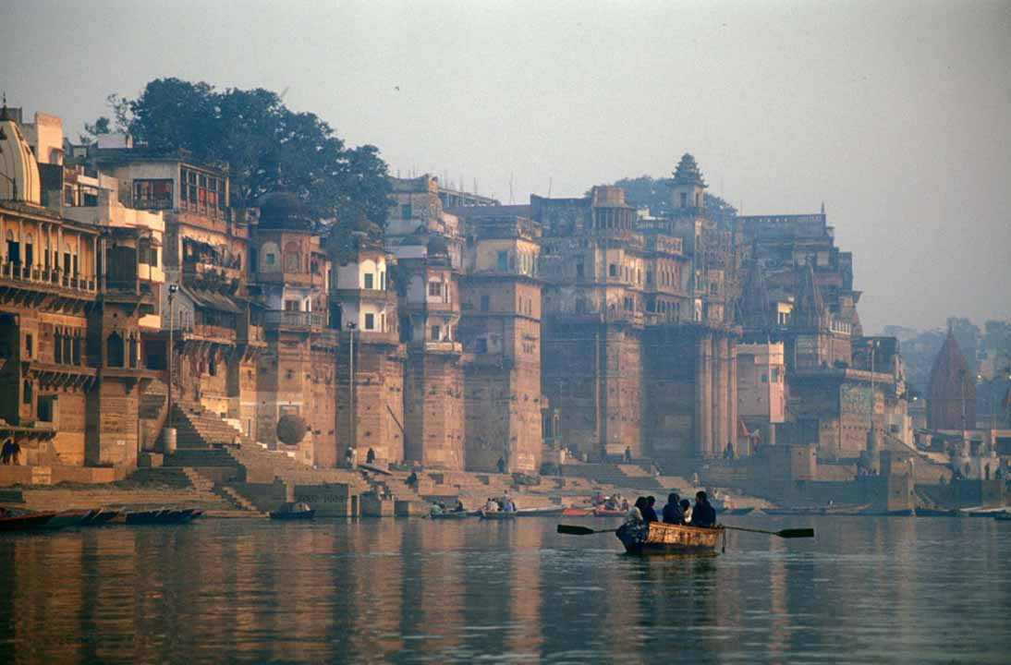
Ganges River
Notes:
Instructional Approach(s): The teacher should use the slide to show an illustration of the previous identified physical feature.

Slide 30
Ganges River:
Starts in the Himalayan Mountains; most important river in India because it runs through the most fertile and highly populated areas; considered sacred by the Hindu religion.
Notes:
Instructional Approach(s): The students should record the description of the physical feature previously identified on their physical features map.

Slide 31
Southern & Eastern Asia Physical Features
6
Himalayan Mountains
Notes:
Instructional Approach(s): The teacher should present the animated slide. The teacher can ask for student volunteers to name the identified physical feature. When ready, the teacher can click the mouse to reveal the answer. The students should record the correct name of the physical feature on their physical features map.

Slide 32
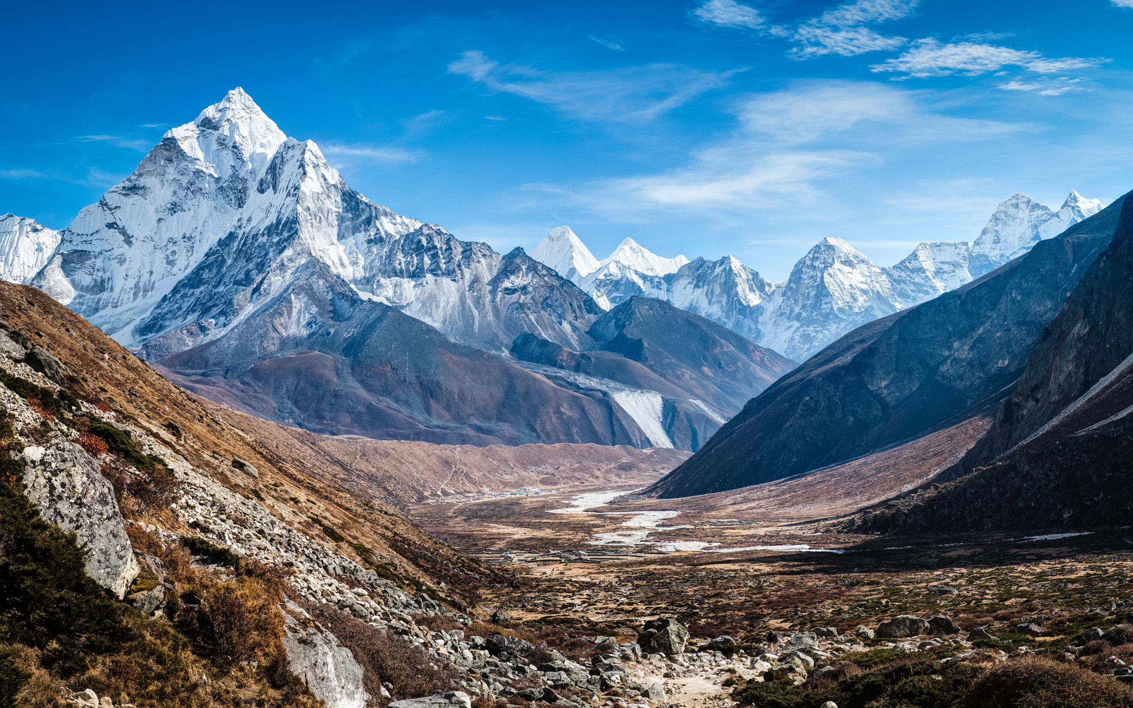
Himalayan Mountains
Notes:
Instructional Approach(s): The teacher should use the slide to show an illustration of the previous identified physical feature.

Slide 33
Himalayan Mountains:
World’s highest mountain range that sits along the northern edge of India; includes Mount Everest, the highest mountain in the world.
Notes:
Instructional Approach(s): The students should record the description of the physical feature previously identified on their physical features map.

Slide 34
Southern & Eastern Asia Physical Features
7
Taklimakan Desert
Notes:
Instructional Approach(s): The teacher should present the animated slide. The teacher can ask for student volunteers to name the identified physical feature. When ready, the teacher can click the mouse to reveal the answer. The students should record the correct name of the physical feature on their physical features map.

Slide 35
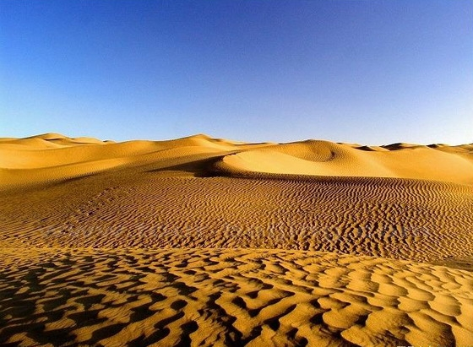
Taklimakan Desert
Notes:
Instructional Approach(s): The teacher should use the slide to show an illustration of the previous identified physical feature.

Slide 36
Taklimakan Desert:
Located in northwestern China between two mountain ranges
Notes:
Instructional Approach(s): The students should record the description of the physical feature previously identified on their physical features map.

Slide 37
Southern & Eastern Asia Physical Features
8
Indus River
Notes:
Instructional Approach(s): The teacher should present the animated slide. The teacher can ask for student volunteers to name the identified physical feature. When ready, the teacher can click the mouse to reveal the answer. The students should record the correct name of the physical feature on their physical features map.

Slide 38
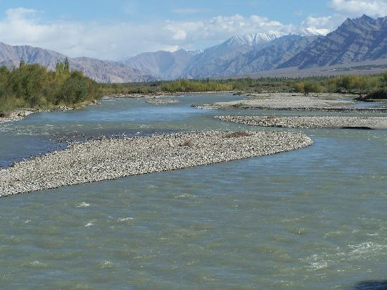
Indus River
Notes:
Instructional Approach(s): The teacher should use the slide to show an illustration of the previous identified physical feature.

Slide 39
Indus River:
Begins high in the Himalayas and slowly runs through India and Pakistan; provides water for one of the largest irrigation systems in the world
Notes:
Instructional Approach(s): The students should record the description of the physical feature previously identified on their physical features map.

Slide 40
Southern & Eastern Asia Physical Features
9
Indian Ocean
Notes:
Instructional Approach(s): The teacher should present the animated slide. The teacher can ask for student volunteers to name the identified physical feature. When ready, the teacher can click the mouse to reveal the answer. The students should record the correct name of the physical feature on their physical features map.

Slide 41
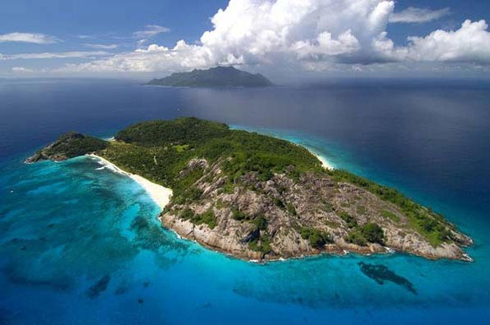
Indian Ocean
Notes:
Instructional Approach(s): The teacher should use the slide to show an illustration of the previous identified physical feature.

Slide 42
Indian Ocean: Third largest ocean; lies between Africa, Asia, and Australia
Notes:
Instructional Approach(s): The students should record the description of the physical feature previously identified on their physical features map.

Slide 43
Southern & Eastern Asia Physical Features
10
Bay of Bengal
Notes:
Instructional Approach(s): The teacher should present the animated slide. The teacher can ask for student volunteers to name the identified physical feature. When ready, the teacher can click the mouse to reveal the answer. The students should record the correct name of the physical feature on their physical features map.

Slide 44
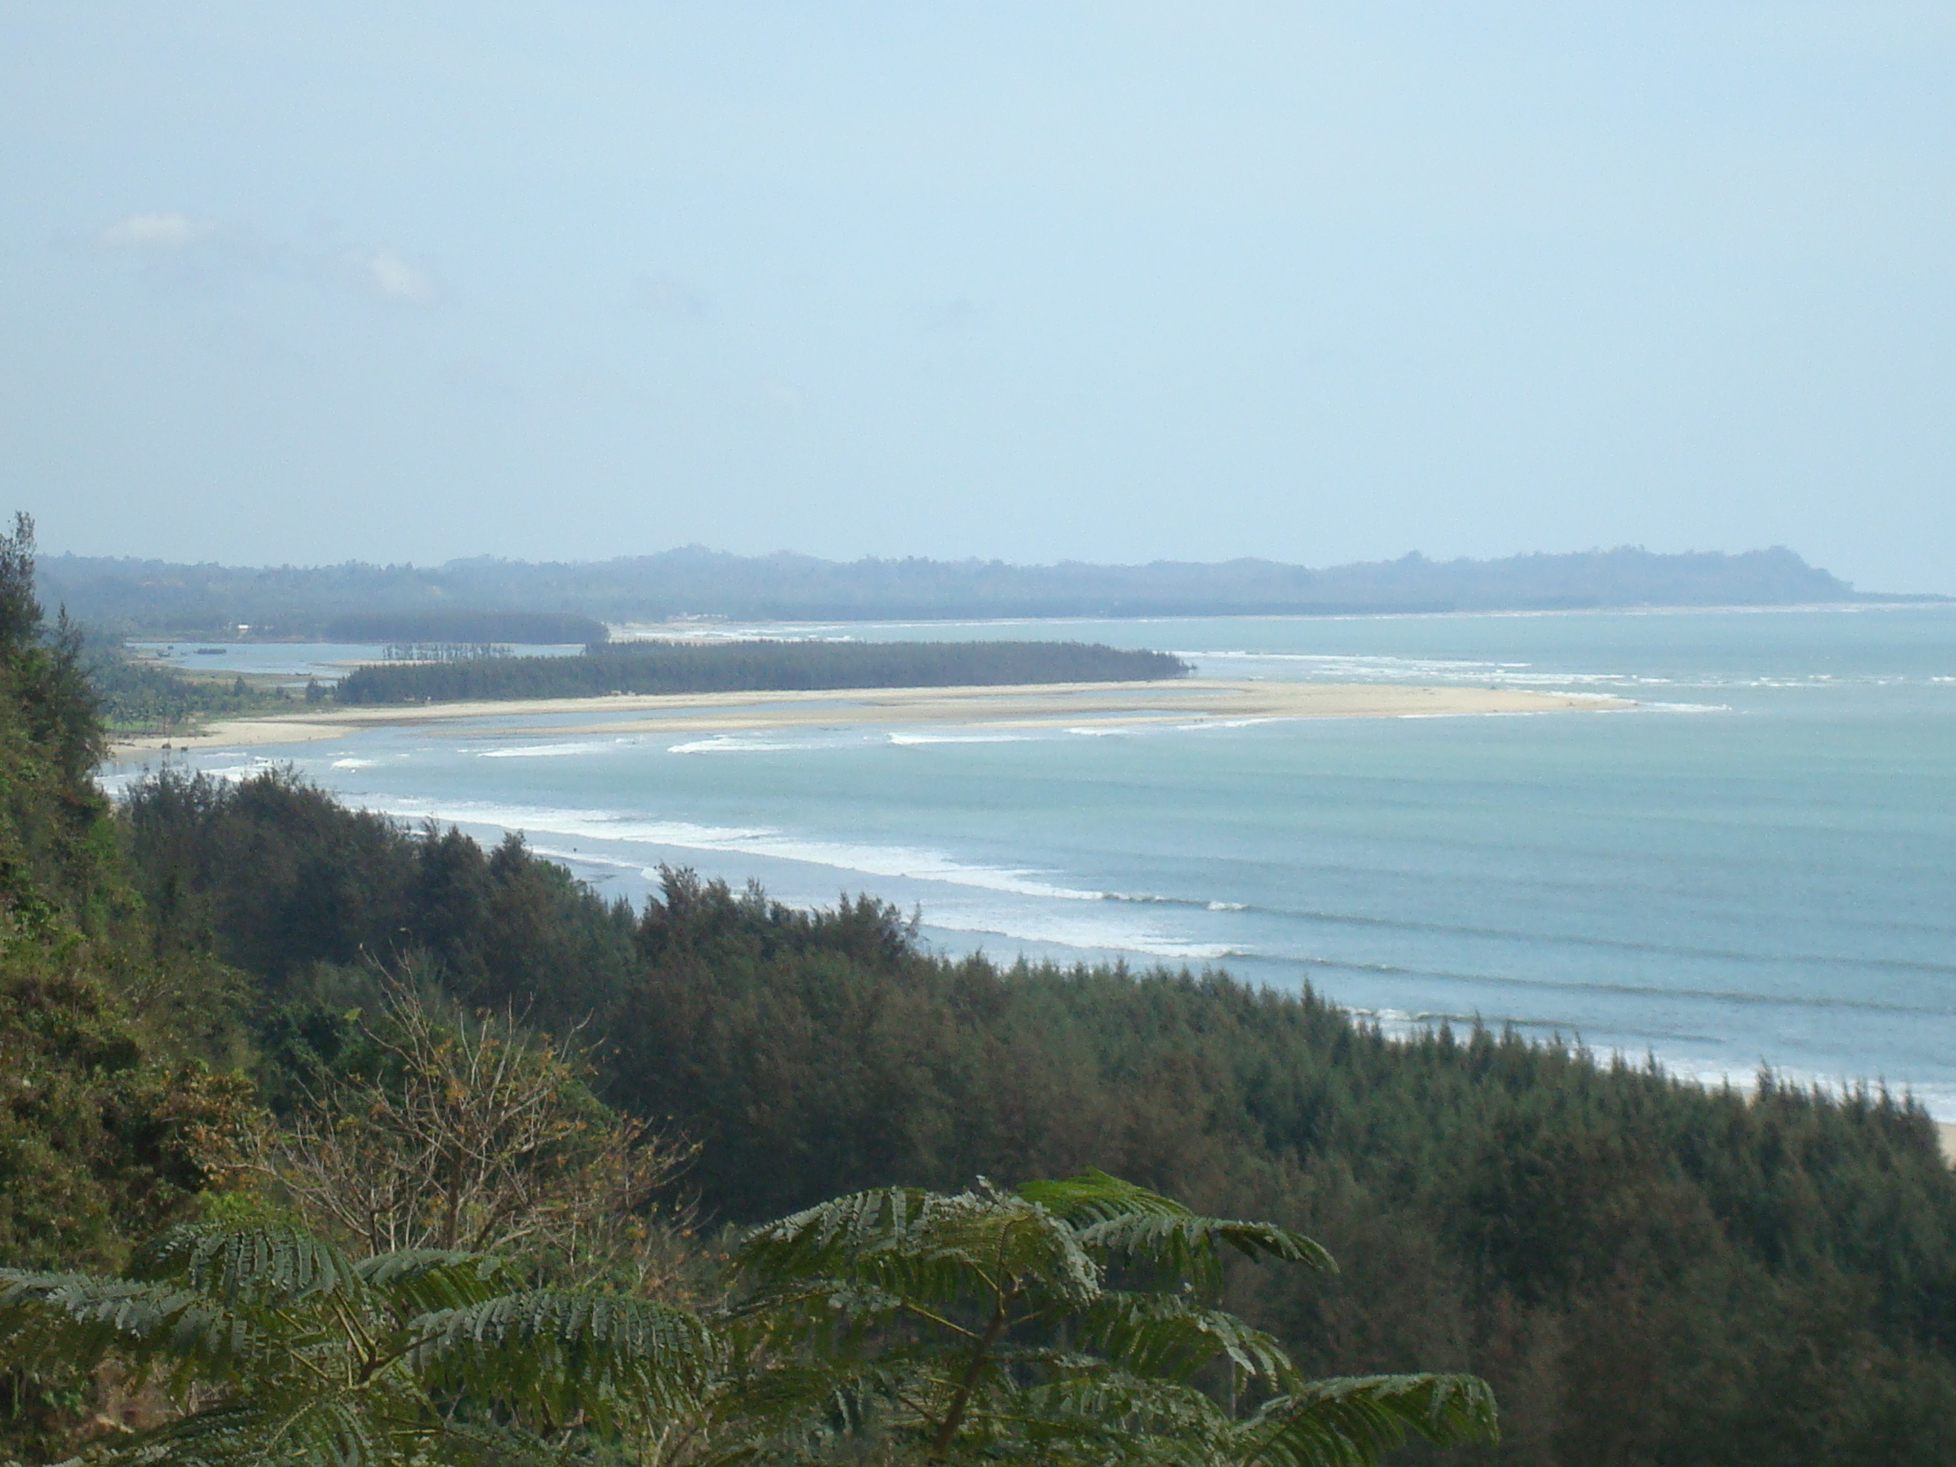
Bay of Bengal
Notes:
Instructional Approach(s): The teacher should use the slide to show an illustration of the previous identified physical feature.

Slide 45
Bay of Bengal:
An “arm” of the Indian Ocean with India on its west; many large rivers, including the Ganges, flow into it
Notes:
Instructional Approach(s): The students should record the description of the physical feature previously identified on their physical features map.

Slide 46
Southern & Eastern Asia Physical Features
11
South China Sea
Notes:
Instructional Approach(s): The teacher should present the animated slide. The teacher can ask for student volunteers to name the identified physical feature. When ready, the teacher can click the mouse to reveal the answer. The students should record the correct name of the physical feature on their physical features map.

Slide 47
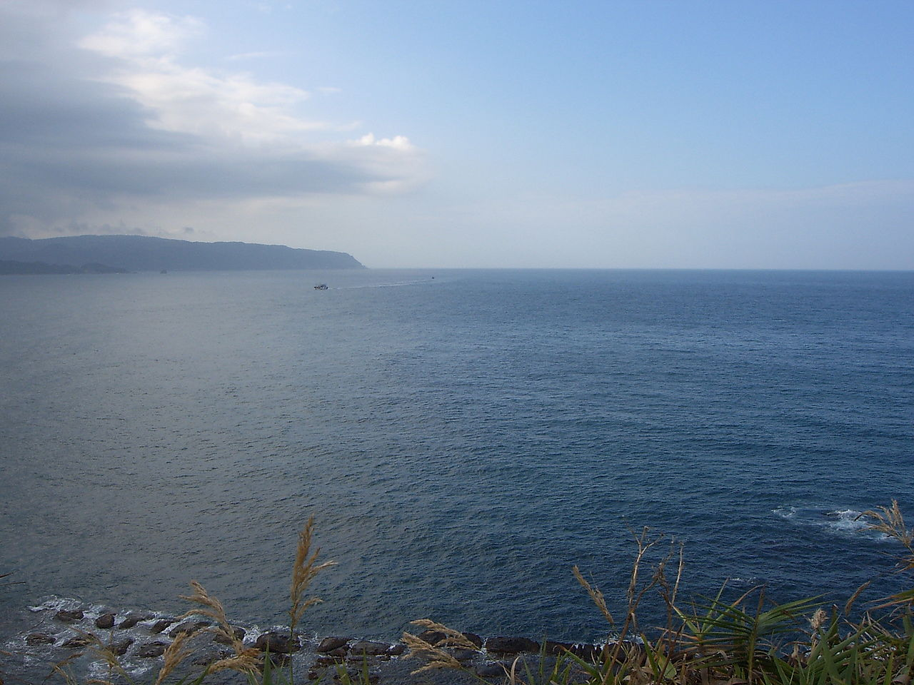
South China Sea
Notes:
Instructional Approach(s): The teacher should use the slide to show an illustration of the previous identified physical feature.

Slide 48
South China Sea:
Lies between Vietnam and the Philippines; has violent monsoons and typhoons.
Notes:
Instructional Approach(s): The students should record the description of the physical feature previously identified on their physical features map.

Slide 49
Southern & Eastern Asia Physical Features
12
Yellow Sea
Notes:
Instructional Approach(s): The teacher should present the animated slide. The teacher can ask for student volunteers to name the identified physical feature. When ready, the teacher can click the mouse to reveal the answer. The students should record the correct name of the physical feature on their physical features map.

Slide 50
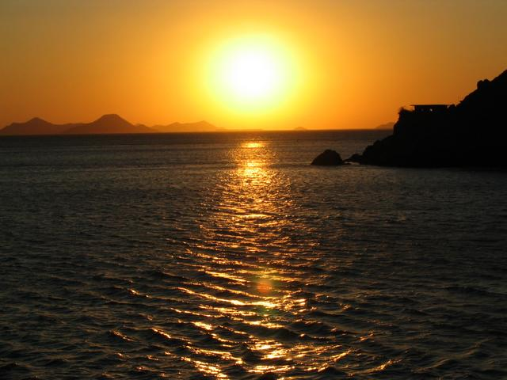
Yellow Sea
Notes:
Instructional Approach(s): The teacher should use the slide to show an illustration of the previous identified physical feature.

Slide 51
Yellow Sea:
An “arm” of the Pacific Ocean that lies between China and Korea; it becomes the East China Sea south of the Korean Peninsula
Notes:
Instructional Approach(s): The students should record the description of the physical feature previously identified on their physical features map.

Slide 52
Southern & Eastern Asia Physical Features
13
Korean Peninsula
Notes:
Instructional Approach(s): The teacher should present the animated slide. The teacher can ask for student volunteers to name the identified physical feature. When ready, the teacher can click the mouse to reveal the answer. The students should record the correct name of the physical feature on their physical features map.

Slide 53
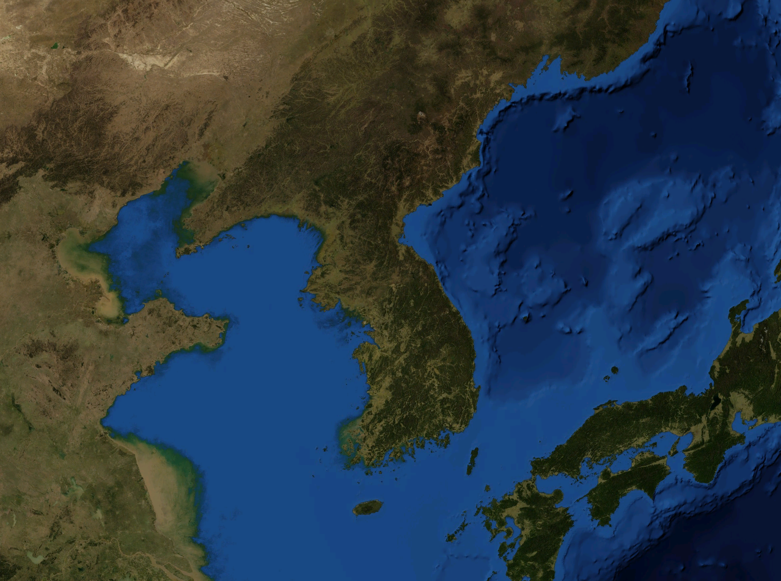
Korean Peninsula
Notes:
Instructional Approach(s): The teacher should use the slide to show an illustration of the previous identified physical feature.

Slide 54
Korean Peninsula:
Extends out from China in between the Yellow Sea and the Sea of Japan; divided into two countries
Notes:
Instructional Approach(s): The students should record the description of the physical feature previously identified on their physical features map.

Slide 55
Southern & Eastern Asia Physical Features
14
Sea of Japan
Notes:
Instructional Approach(s): The teacher should present the animated slide. The teacher can ask for student volunteers to name the identified physical feature. When ready, the teacher can click the mouse to reveal the answer. The students should record the correct name of the physical feature on their physical features map.

Slide 56
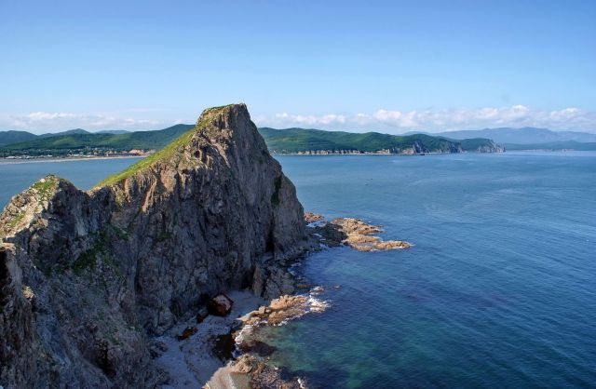
Sea of Japan
Notes:
Instructional Approach(s): The teacher should use the slide to show an illustration of the previous identified physical feature.

Slide 57
Sea of Japan:
An “arm” of the Pacific Ocean that lies between the continent of Asia and Japan
Notes:
Instructional Approach(s): The students should record the description of the physical feature previously identified on their physical features map.

