Slide 1
The British Turn the Tide
With added money support the British begin to take the lead
Begin working to take fort by fort
French begin to give up forts around the Great Lakes and move back to New France
The Iroquois shift their allegiance to the British believing the French cause was hopeless

Slide 2
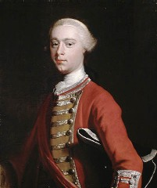
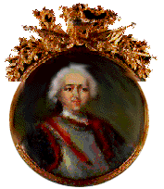
The Fall of Quebec
The British invaded New France and went for the capital at Quebec
General James Wolfe led about 9,000 British troops.
Marquis de Montcalm led 7,500 French troops
Quebec taken by British
Wolfe
Montcalm

Slide 3
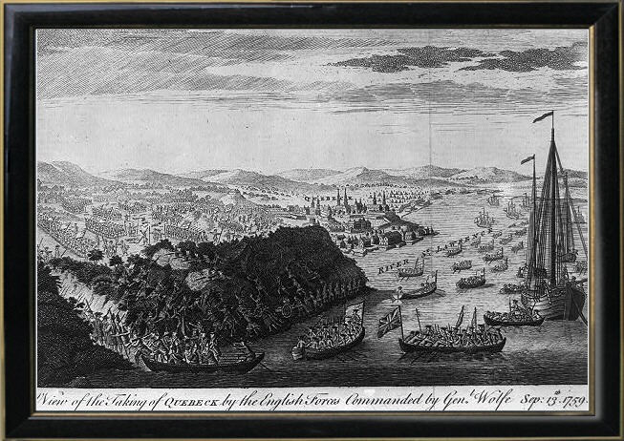

Slide 4
How do the British win the war?
1. Parliament sent a whole lot of money to support the effort fearing the impact on the empire if the French won
2. Better prepared, better led troops
3. Good strategy
4. Gain Iroquois as allies

Slide 5
The Treaty of Paris (1763)
France --> lost her Canadian possessions, most of her empire in India, and claims to lands east of the Mississippi River.
Spain --> got all French lands west of the Mississippi River, New Orleans, but lost Florida to England.
England --> got all French lands in Canada, exclusive rights to Caribbean slave trade, and commercial dominance in India.

Slide 6
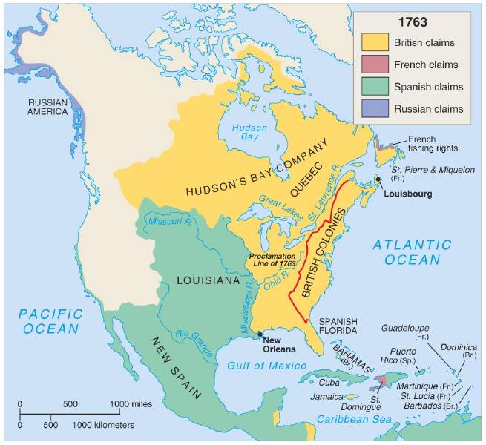
North America in 1763

Slide 7
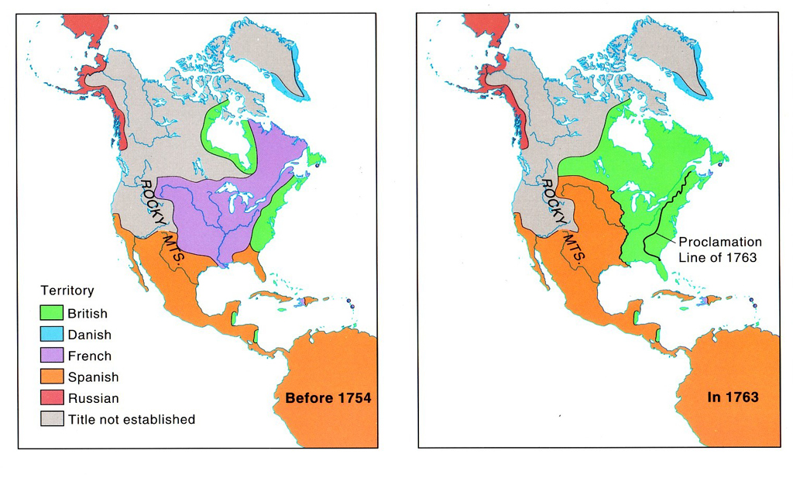
What changed?

Slide 8
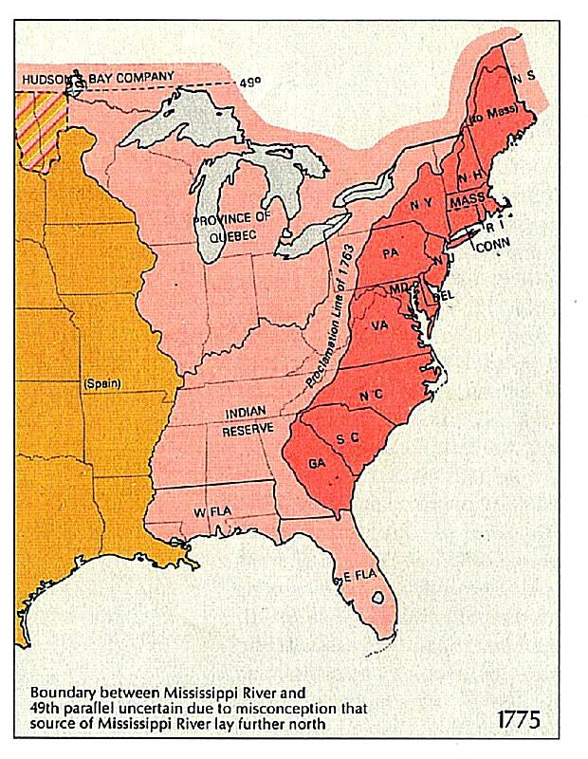
Proclamation of 1763
Moved Georgia’s southern boundary to the St. Mary’s River
Forbade colonists to settle west of the Appalachian Mountains
Forced Creek and Cherokee to give up more land to the colony of Georgia increasing water access and farmland

Slide 9
Effects of War on Great Britain
It increased her colonial empire in the Americas.
It greatly enlarged England’s debt.
Britain’s contempt for the colonists created bitter feelings.

Slide 10
Effects of War on American Colonies
It united them against a common enemy for the first time.
It created bitter feelings towards the British that would only intensify.
The colonists can move further west because the French no longer occupy that territory

Slide 11
Effects on Georgia
Georgia settlers begin to move further west off the coast
Moves the southern border to the St. Mary’s river
Provide new water access for shipping
New farmland and forests for lumber

