Slide 1
U.S. Presence
Southwest
Asia
in
Persian Gulf, Afghanistan,
& Iraq

Slide 2
Persian Gulf
Conflict
Operation Desert Storm

Slide 3
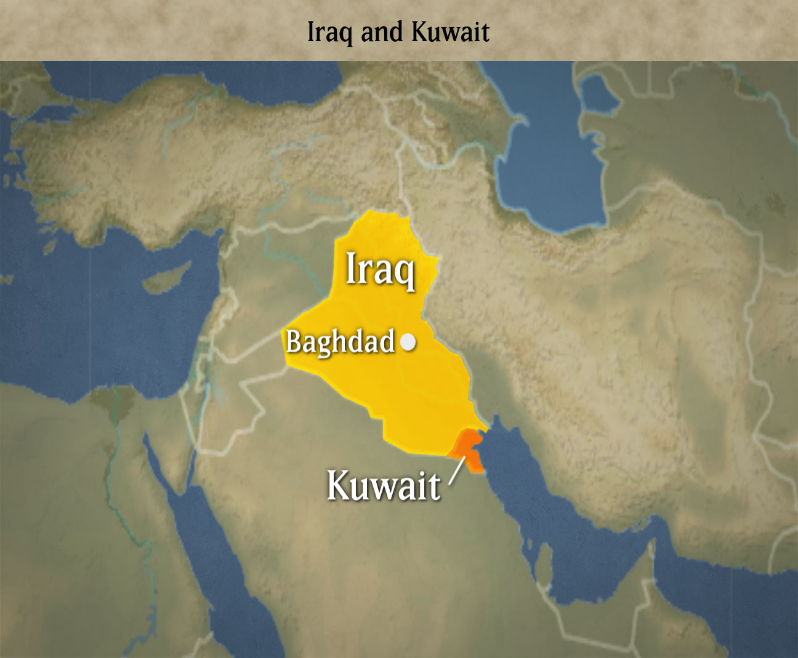

Slide 4
Kuwait
In 1920, the country of Kuwait was created.
As a result, Iraq lost its access to the Persian Gulf.
Saddam Hussein, Iraq’s dictator, wanted to get this access back, as well as acquiring Kuwait’s large oil reserves.
He felt that the oil fields belonged to Iraq.
Iraqi forces invaded Kuwait in August 1990.
In order to survive the attack, the small country of Kuwait knew it would need allies…

Slide 5
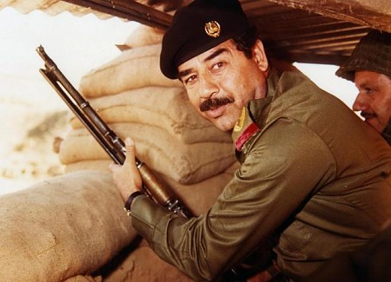

Slide 6
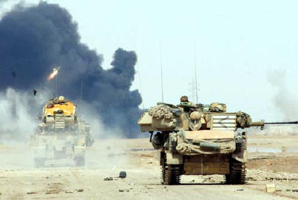
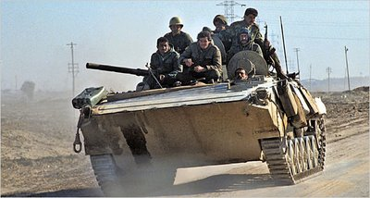
August 2nd, 1990 – Iraq invades Kuwait

Slide 7
Persian Gulf War
The US was concerned about this invasion, as a lot of the country’s oil came from Kuwait & Saudi Arabia.
In January 1991, the United States and a group of other countries started “Operation Desert Storm”, a military mission to recapture Kuwait.
The coalition employed missile attacks and used ground forces to quickly drive Iraqi forces out of Kuwait in just six weeks.

Slide 8
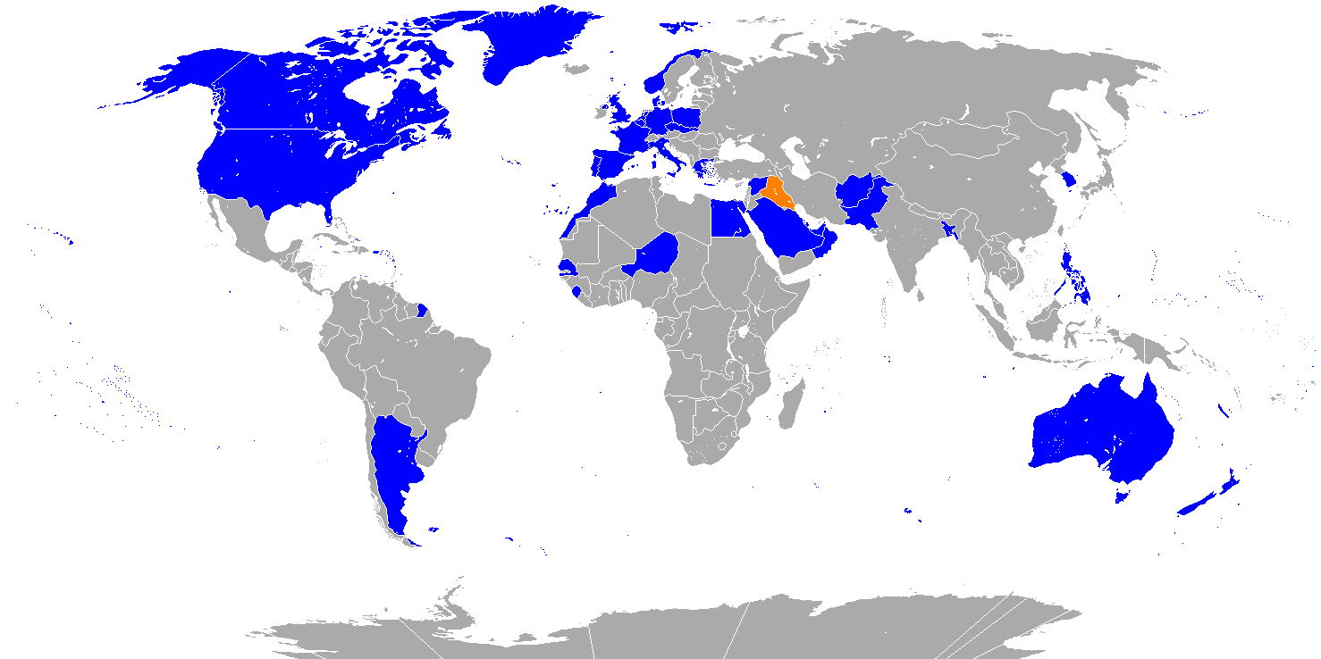
Blue = Coalition Nations

Slide 9
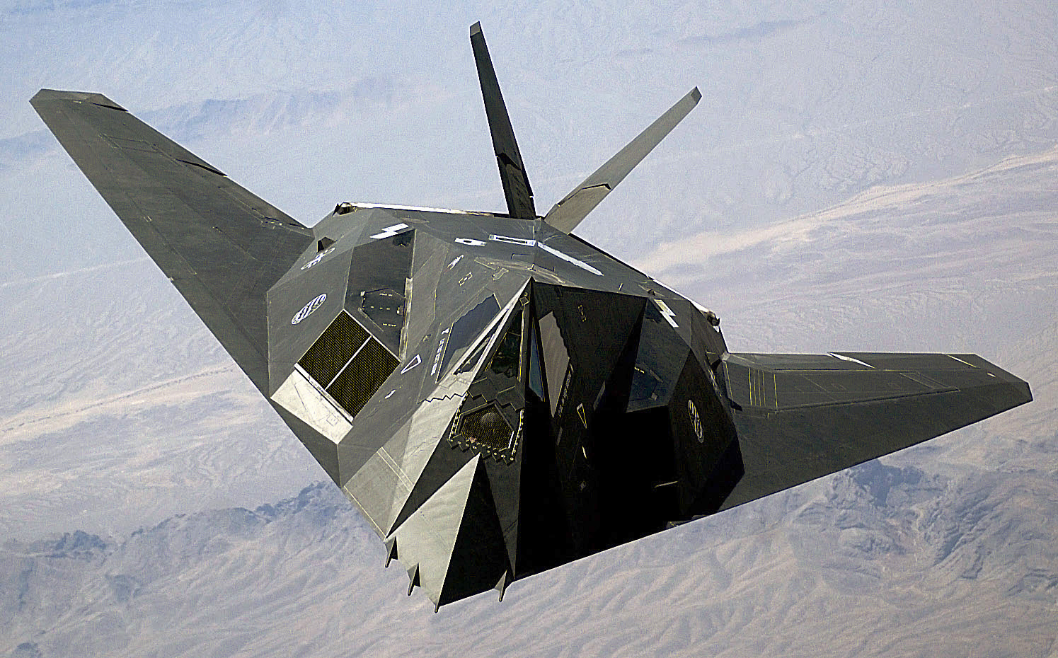
A US Nighthawk – one of the key players in Desert Storm.

Slide 10
End of the War
By February of 1991, the Iraqi government agreed to a truce and withdrew from Kuwait.
Iraq left, but not before Saddam Hussein had his soldiers set nearly 1,000 oil fields on fire, causing immense environmental damage.
Both Iraq and Kuwait were badly damaged during the war.

Slide 11
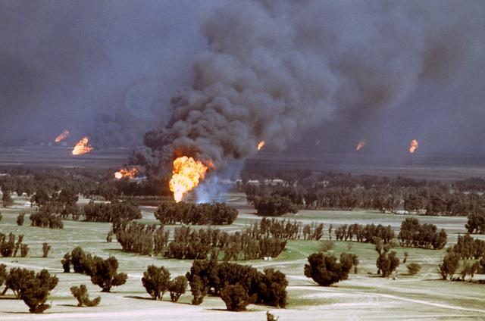
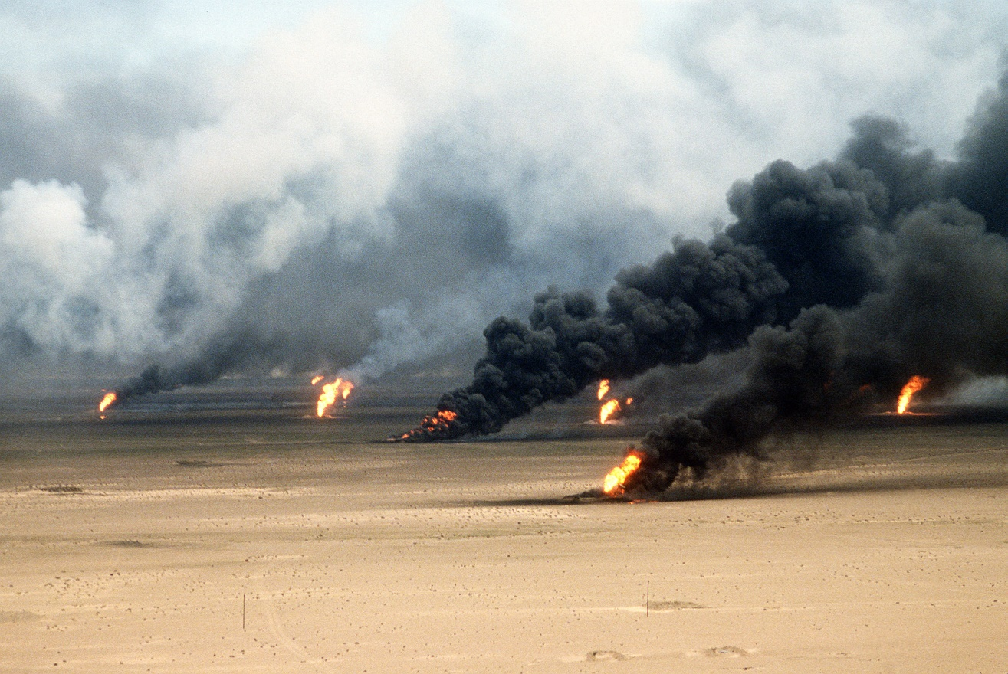
Oil fires set in Kuwait
by Iraqi forces.

Slide 12
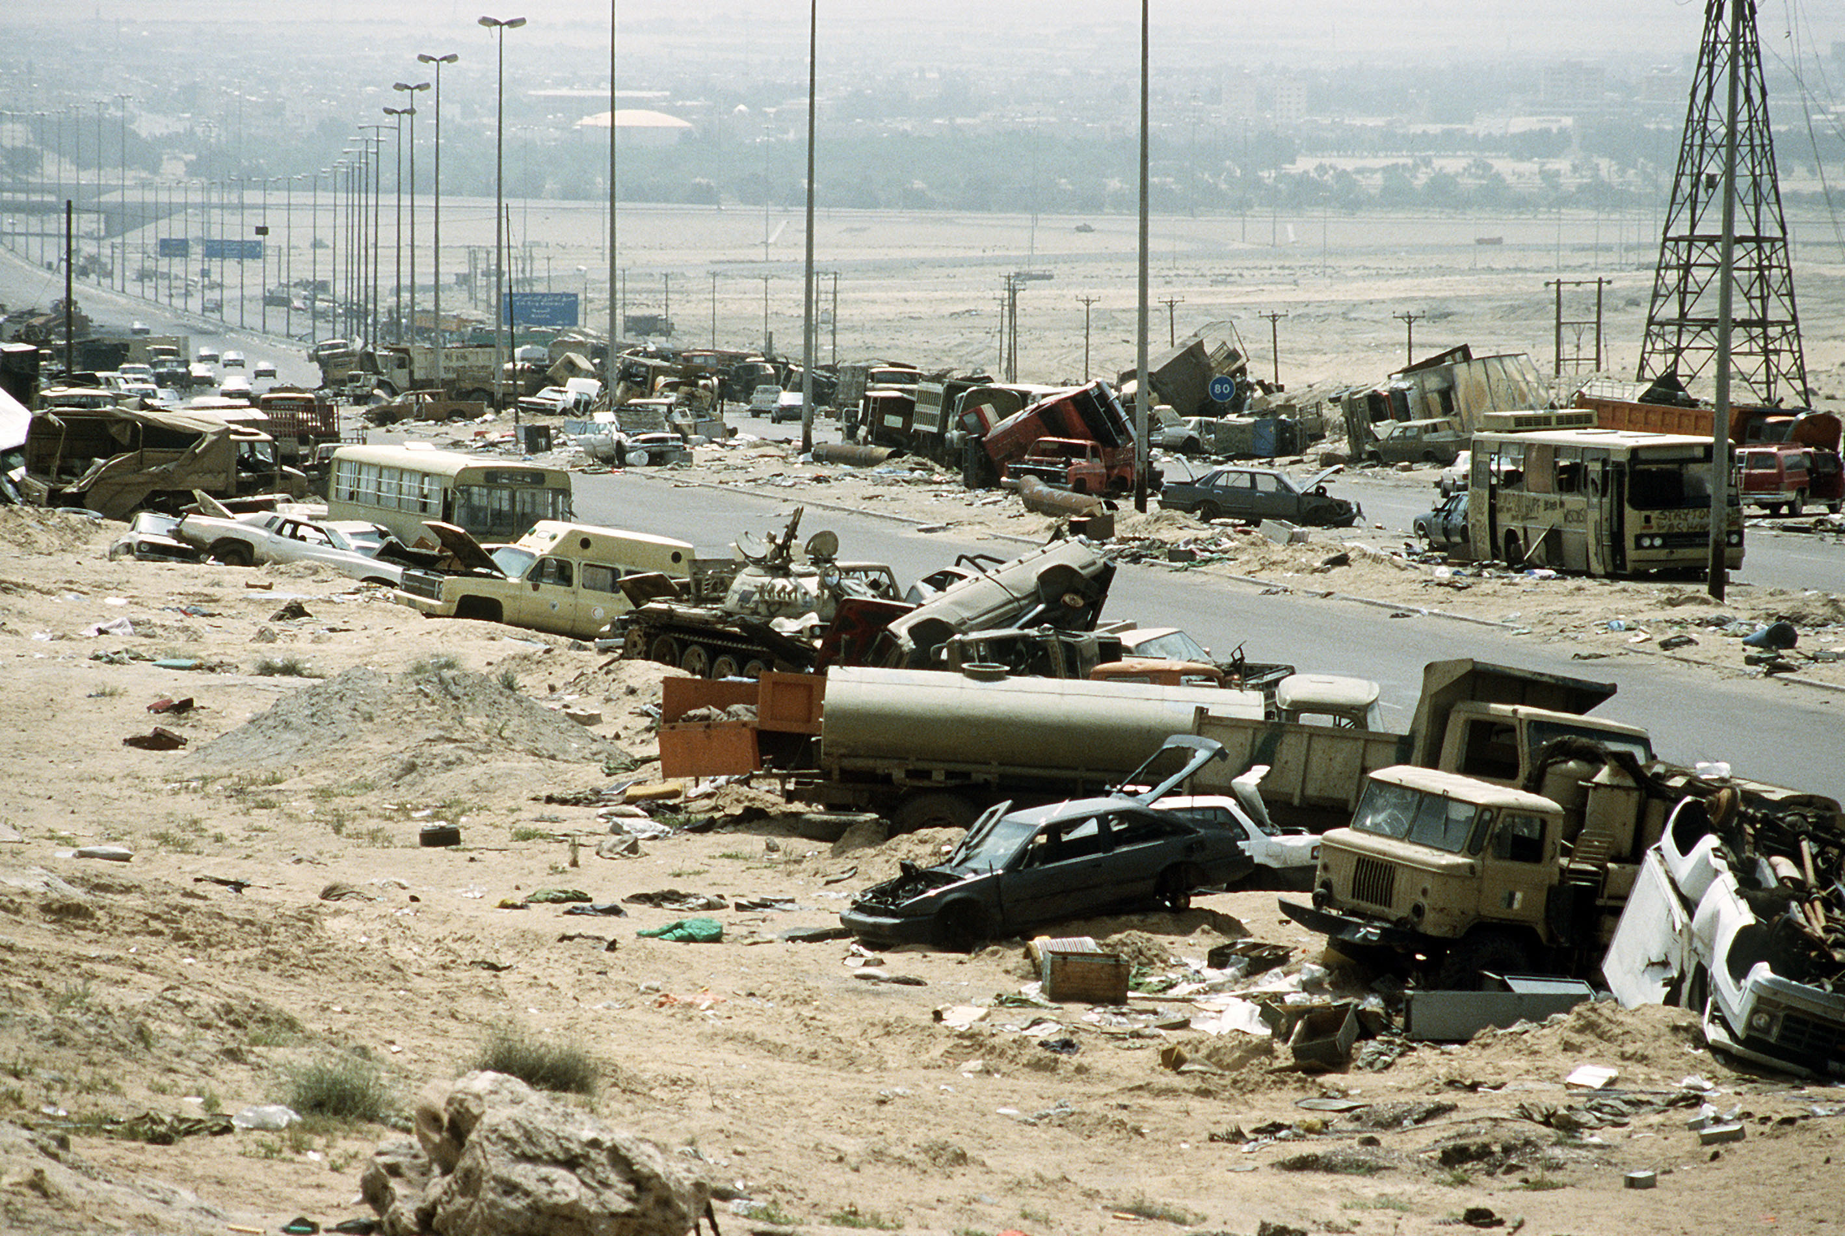
Destroyed military & civilian vehicles along the “Highway of Death”, a six mile stretch of road between Kuwait and Iraq.

Slide 13
U.N. Embargo
When Iraq invaded Kuwait, the United Nations imposed an embargo that prevented Iraq from exporting oil or importing goods.
The UN would not lift the embargo until Iraq destroyed its chemical and biological weapons and promised to stop making nuclear weapons.
This process began in 1991, and when the UN inspection team left in 1998, there was speculation that only 85% had actually been destroyed.

Slide 14
Iraq
Invasion
Operation Iraqi Freedom

Slide 15
Iraq
After the UN inspection team left, many Americans believed that Hussein was hiding weapons of mass destruction (WMDs) throughout the country, as well as providing aid to members of al-Qaeda.
In 2003, the United States, Great Britain, Australia, & other countries launched a military invasion of Iraq called “Operation Iraqi Freedom”.

Slide 16
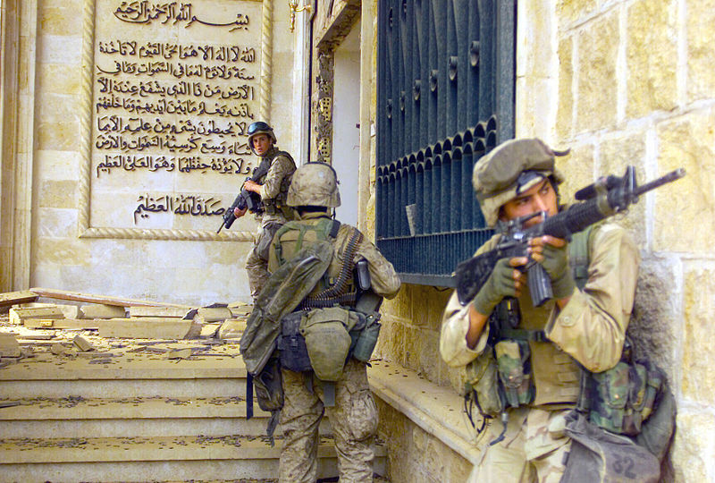
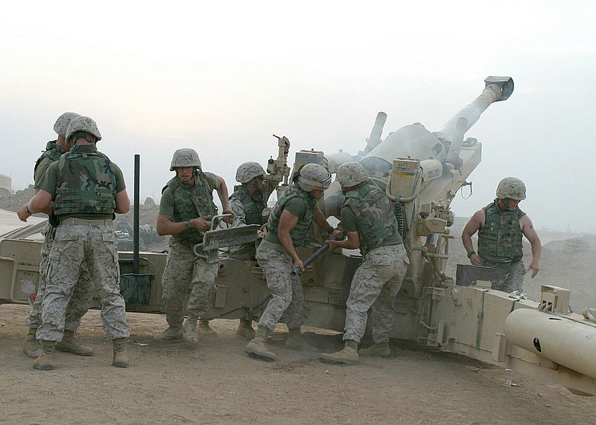
U.S. marines fire a M198 Medium Howitzer.
U.S. marines enter a palace in Baghdad.

Slide 17
Results
Saddam Hussein’s government collapsed quickly, and the military operation was over in less than two months.
No WMDs were ever found.
In December 2003, Hussein was captured, tried, and sentenced to death.
He was executed in December 2006.

Slide 18
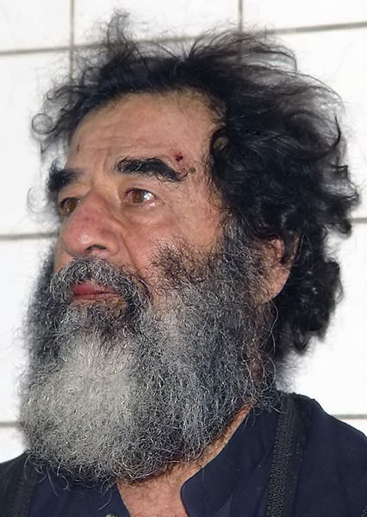
Saddam Hussein was found hiding in a hole armed with a pistol, an AK-47 assault rifle, and $750,000 cash.

Slide 19
Iraq Today
Rebuilding Iraq after the invasion has been difficult.
In 2005, Iraqi citizens took part in free elections to establish a new democratic government.
U.S. forces remained in Iraq until the new Iraqi government was secure and stable.
In December 2011, the U.S. forces withdrew.
Unfortunately, there is still conflict in Iraq today, as the Shia and Sunni Muslims are fighting one another for power of the country.

Slide 20
Afghanistan
Invasion
Operation Enduring Freedom

Slide 21
Osama bin Laden
In 1996, the Taliban (an extremely religious group) established power in Afghanistan.
The anti-American Taliban was thought to be harboring Osama bin Laden’s terrorist group al-Qaeda, whose goal was to bring an end to Western influence in the Middle East.
The U.S. government identified bin Laden as the most likely suspect responsible for the September 11th, 2001 attacks on the World Trade Center and the Pentagon.

Slide 22
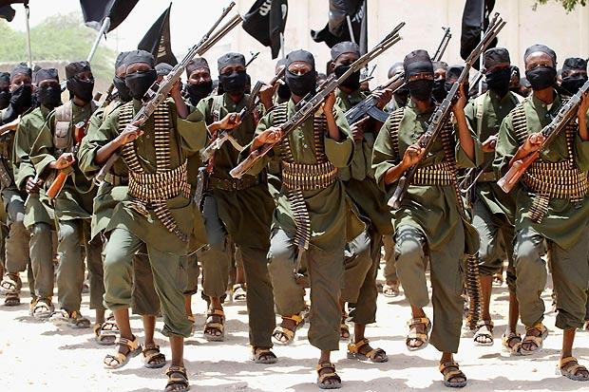
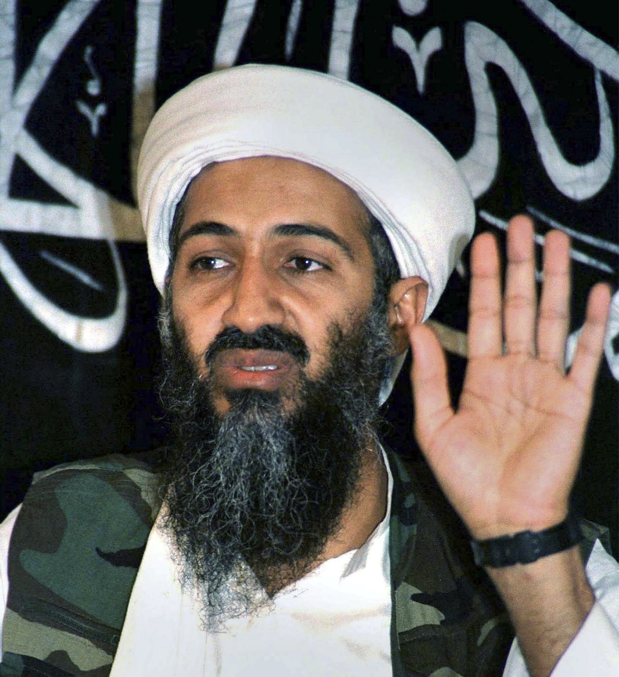
Al-Qaeda
Osama bin Laden

Slide 23
9/11
On September 11, 2001, al-Qaeda attacked three targets in the United States.
The terrorists hijacked four planes.
Two places crashed into the World Trade Center in New York City.
Another airplane crashed into the Pentagon in Virginia, just outside of Washington, DC.
The fourth plane was intended to hit the White House, but crashed in rural Pennsylvania.
Over 3,000 people were killed in these attacks.

Slide 24
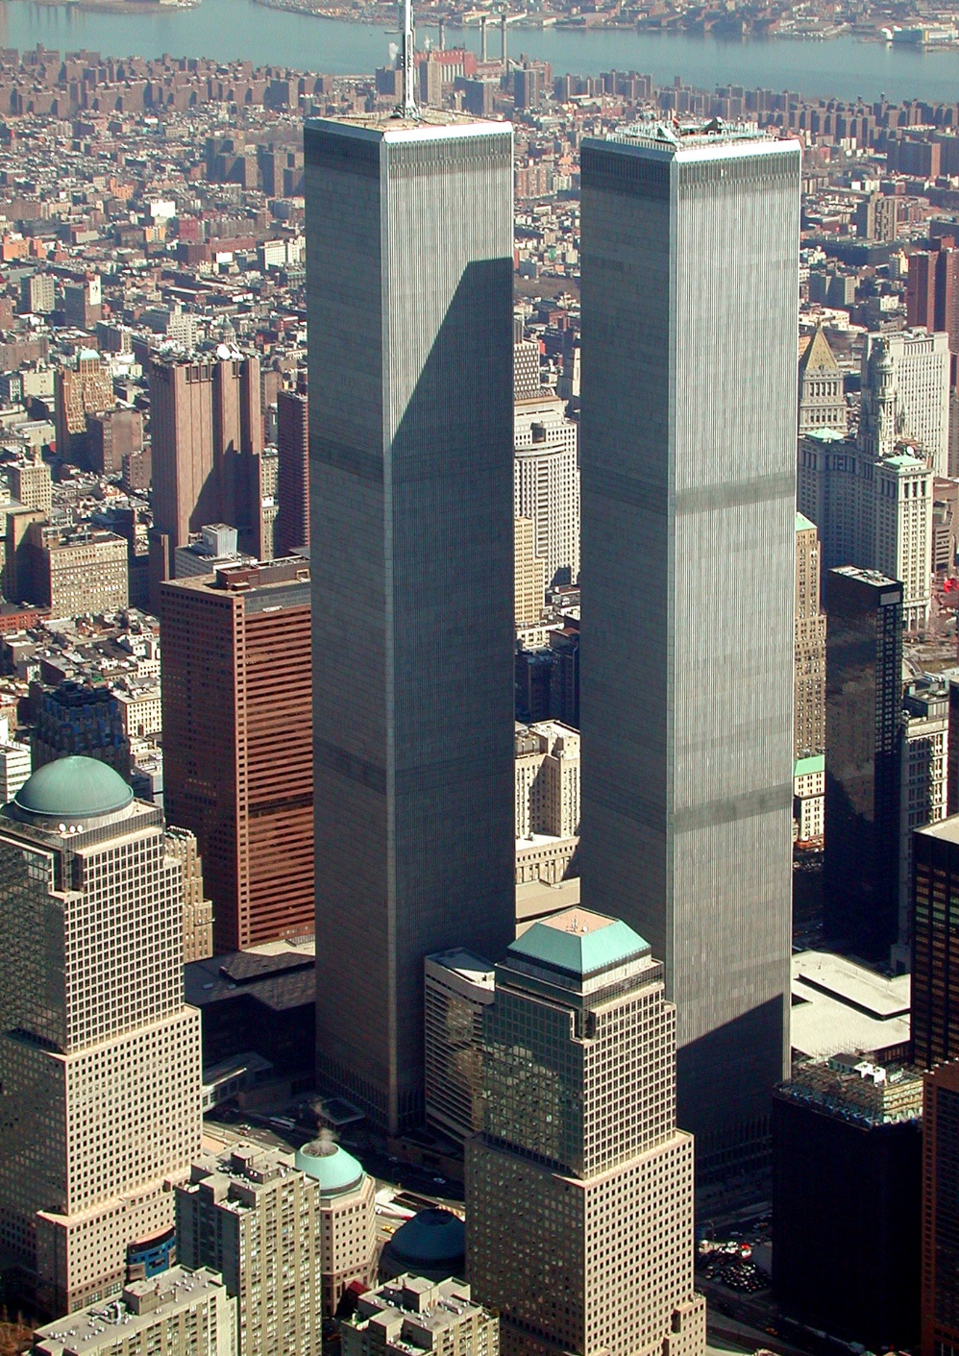
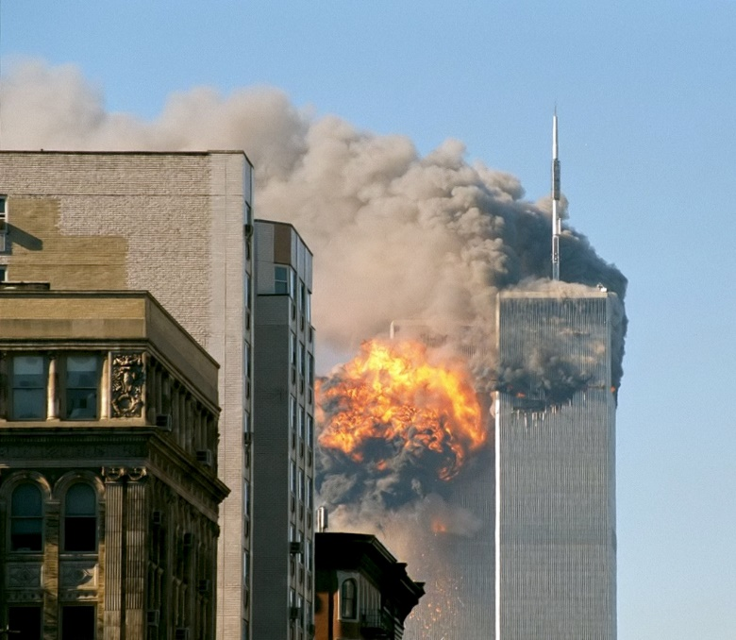
Two days after the September 11 attacks, U.S. President George W. Bush stated: "The most important thing is for us to find Osama bin Laden. It is our number one priority and we will not rest until we find him.“

Slide 25
U.S. Invasion
Sources in the U.S. government believed that the Taliban was allowing Bin Laden and his followers to hide out in the mountains of Afghanistan.
On October 7th, 2001, U.S. troops entered Afghanistan to disable the Taliban and locate bin Laden.
After launching a series of attacks, the Taliban was defeated.
The U.S. helped form a new democratic government in Afghanistan.
Efforts to locate bin Laden failed, and he went into hiding for the next ten years.

Slide 26
The End
On May 2, 2011, at 1:00 am, Navy SEALS raided Osama bin Laden’s compound in Pakistan.
Bin Laden was shot and killed in the raid.
His body was taken to Afghanistan for identification, then buried at sea within 24 hours.
According to U.S. officials, bin Laden was buried at sea because no country would accept his remains.

Slide 27
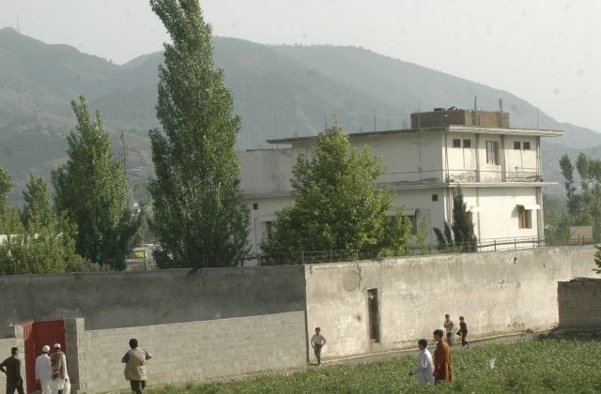
Osama bin Laden’s compound in Pakistan where he was found in 2011.

