Slide 1
Deserts
There are ___________________ of land in the Middle East, and more than half of it is covered by large desert areas.
The most ___________________ in the region is desert.
The Rub al-Khali ___________________ is in southern Saudi Arabia.
The ___________________ is located between Syria and Iraq.
LIVE
The desert areas are not a favorable place to live due to the extremely ___________________ .
Food and ___________________ to find; however, oases provide a temporary water source.
___________________(desert nomads) have called the desert home for thousands of years.
They live in ___________________ and in huts.
Since the ___________________ , most people have moved away from the desert areas.
Over the last 50 years, residents have been exchanging the harsh nomadic life for ___________________ .
In Saudi Arabia, only about ___________________ remains as nomadic herders.
TRADE
Many Bedouins are ___________________ herders.
They trade animals and ___________________ with people who live in towns along the desert’s edge.
Most people have left the desert behind and have moved to cities to ___________________ .
TRAVEL
People travel across the desert in ___________________ .
Some even use All Terrain Vehicles (ATVs) to maneuver ___________________ .
© Brain Wrinkles
Where People Live & Trade
CLOZE Notes 1

Slide 2
Rivers
The Tigris River runs through ___________________ and joins with the Euphrates to become the Shatt al Arab, which empties into the Persian Gulf.
The ___________________ runs through Turkey, Syria, and Iraq.
The ___________________ forms part of the border for Syria, Jordan, and Israel.
LIVE
Cities are built near rivers to take advantage of the ___________________ in Southwest Asia.
Access to water for ___________________ make the area much easier to live in.
Farmers grow crops by rivers and in river valleys because they provide a ___________________ .
Rivers also provide a good ___________________ (fish).
In countries that have a ___________________ , the population increases around port cities.
Here, there are ___________________ in transportation, shipbuilding, and repair.
Turkey has major port cities along the Aegean, Black, and ___________________ .
Saudi Arabia has port cities along the Red Sea and ___________________ .
WORK
Cities and towns on rivers have become major ___________________ .
Most people in these cities make a living working in ___________________ .
Rivers are also ___________________ for people in cities to use to ship goods to other merchants.
___________________ are also important areas of income for people who live near rivers.
TRADE
Rivers have always provided ___________________ for transportation.
People use boats for ___________________ along rivers.
Southwest Asia’s waterways are also important to ___________________ because they have helped make the region a center for shipping and trade for hundreds of years.
The region is a ___________________ between Asia, Africa, and Europe.
© Brain Wrinkles
Where People Live & Trade
CLOZE Notes 2

Slide 3
Southwest Asia:
Where People
Live & Trade
© Brain Wrinkles

Slide 4
DESERTS
© Brain Wrinkles

Slide 5
Deserts
There are 2.8 million miles of land in the Middle East, and more than half of it is covered by large desert areas.
The most common landform in the region is desert.
The Rub al-Khali (or “empty quarter”) is in southern Saudi Arabia.
The Great Syrian Desert is located between Syria and Iraq.
© Brain Wrinkles

Slide 6
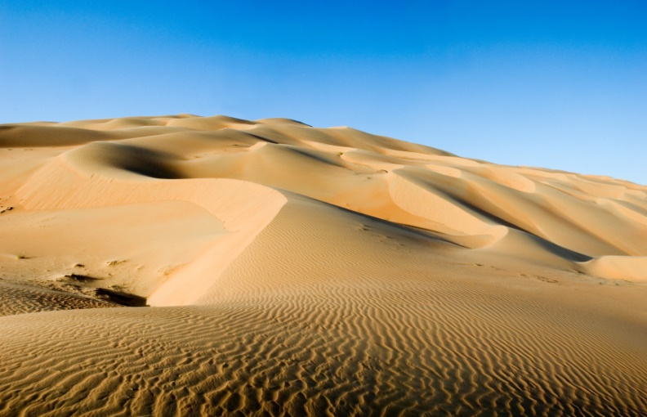
In some places, temperatures can reach 125°F during the day.
© Brain Wrinkles

Slide 7
LIVE
The desert areas are not a favorable place to live due to the extremely hot and arid climate.
Food and water is difficult to find; however, oases provide a temporary water source.
Bedouins (desert nomads) have called the desert home for thousands of years.
They live in tent camps and in huts.
© Brain Wrinkles

Slide 8
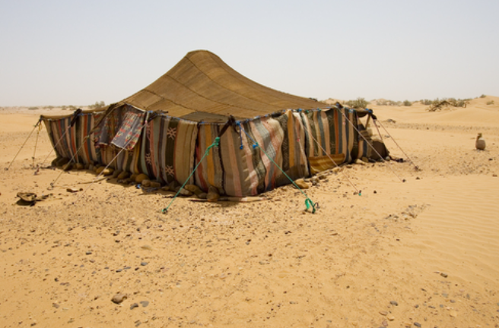
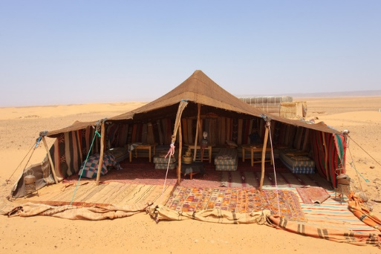
© Brain Wrinkles

Slide 9
LIVE
Since the discovery of oil, most people have moved away from the desert areas.
Over the last 50 years, residents have been exchanging the harsh nomadic life for work in the cities.
In Saudi Arabia, only about 1% of the population remains as nomadic herders.
© Brain Wrinkles

Slide 10
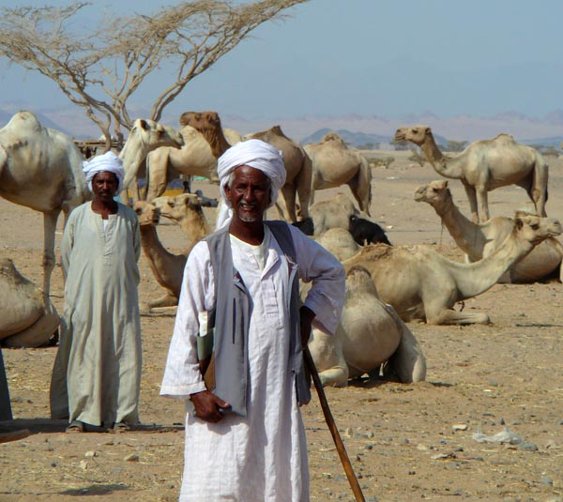
© Brain Wrinkles

Slide 11
TRADE
Many Bedouins are sheep, camel, and goat herders.
They trade animals and hand-made goods with people who live in towns along the desert’s edge.
Most people have left the desert behind and have moved to cities to find work.
© Brain Wrinkles

Slide 12
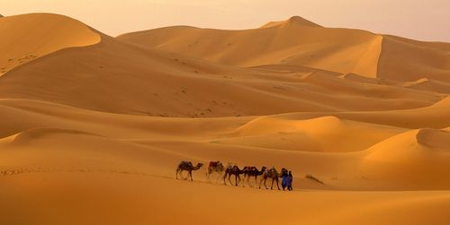
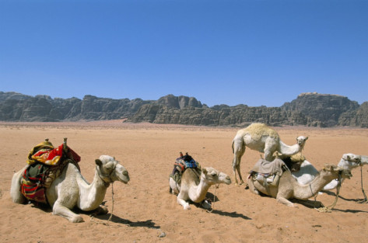
© Brain Wrinkles

Slide 13
TRAVEL
People travel across the desert in camel caravans.
Some even use All Terrain Vehicles (ATVs) to maneuver across the sand.
© Brain Wrinkles

Slide 14
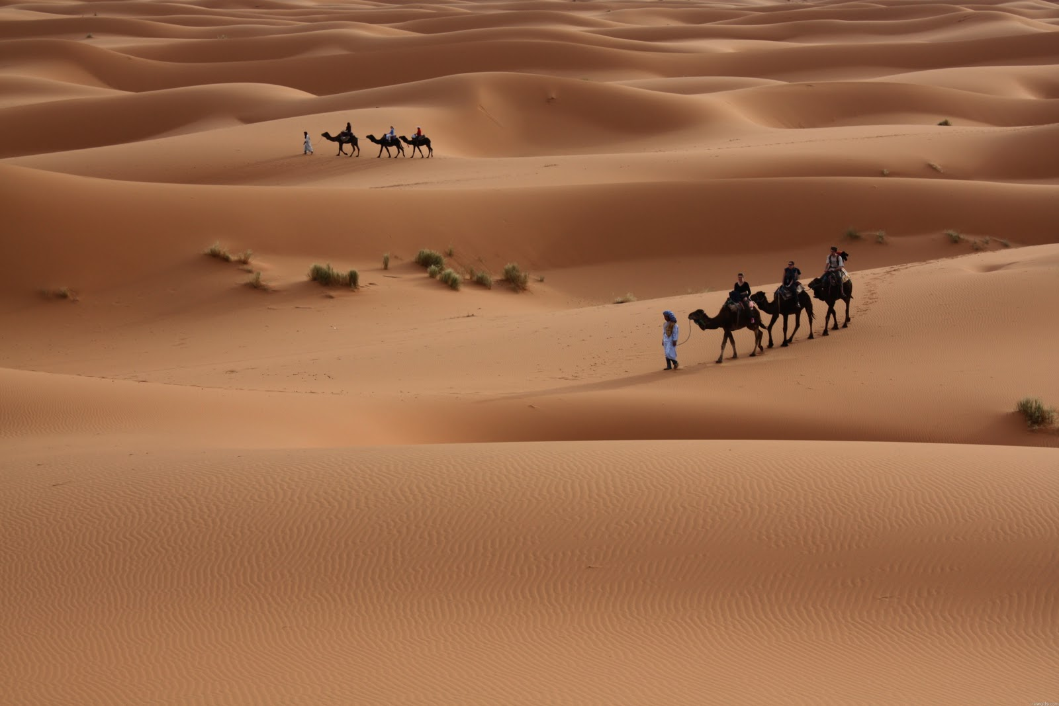
© Brain Wrinkles

Slide 15
RIVERS
© Brain Wrinkles

Slide 16
Rivers
The Tigris River runs through Turkey and Iraq and joins with the Euphrates to become the Shatt al Arab, which empties into the Persian Gulf.
The Euphrates River runs through Turkey, Syria, and Iraq.
The Jordan River forms part of the border for Syria, Jordan, and Israel.
© Brain Wrinkles

Slide 17
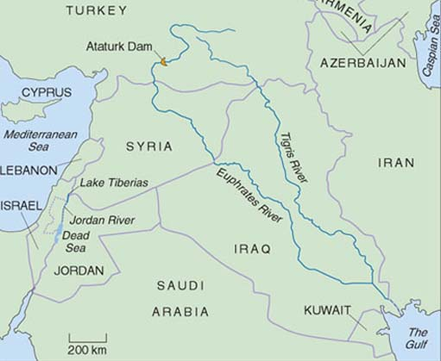
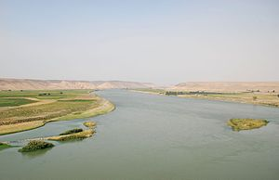
© Brain Wrinkles

Slide 18
LIVE
Cities are built near rivers to take advantage of the scarce water sources in Southwest Asia.
Access to water for bathing and drinking make the area much easier to live in.
Farmers grow crops by rivers and in river valleys because they provide a source of irrigation.
Rivers also provide a good source of food (fish).
© Brain Wrinkles

Slide 19
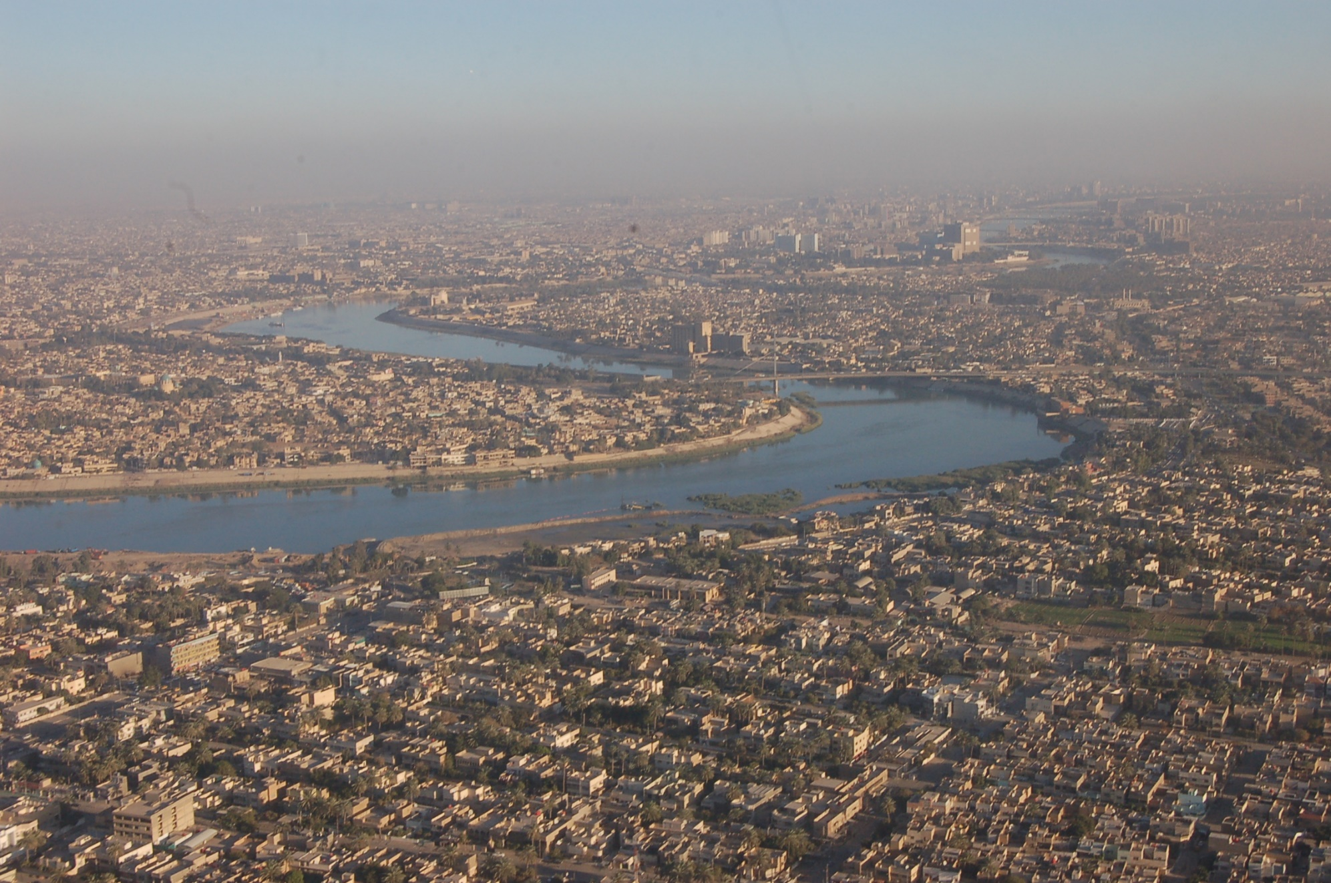
Baghdad, Iraq & the Tigris River
© Brain Wrinkles

Slide 20
LIVE
In countries that have a deep-sea harbor, the population increases around port cities.
Here, there are employment opportunities in transportation, shipbuilding, and repair.
Turkey has major port cities along the Aegean, Black, and Mediterranean Seas.
Saudi Arabia has port cities along the Red Sea and Persian Gulf.
© Brain Wrinkles

Slide 21
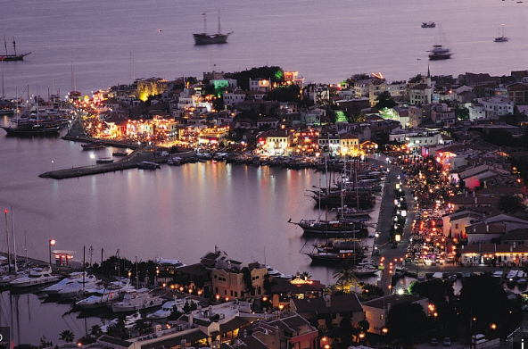
Marmaris, Turkey
© Brain Wrinkles

Slide 22
WORK
Cities and towns on rivers have become major hubs of industry.
Most people in these cities make a living working in industrial factories.
Rivers are also important trade routes for people in cities to use to ship goods to other merchants.
Farming and fishing are also important areas of income for people who live near rivers.
© Brain Wrinkles

Slide 23
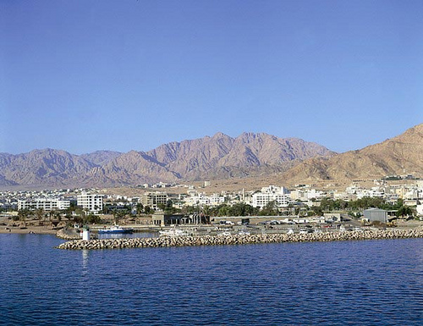
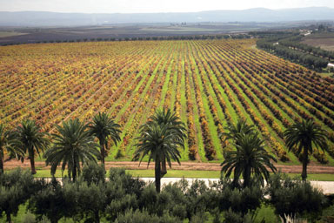
Al Aqaba, Jordan & the Jordan River
© Brain Wrinkles

Slide 24
TRADE
Rivers have always provided important routes for transportation.
People use boats for travel and trade along rivers.
Southwest Asia’s waterways are also important to national economies because they have helped make the region a center for shipping and trade for hundreds of years.
The region is a trade hub between Asia, Africa, and Europe.
© Brain Wrinkles

Slide 25
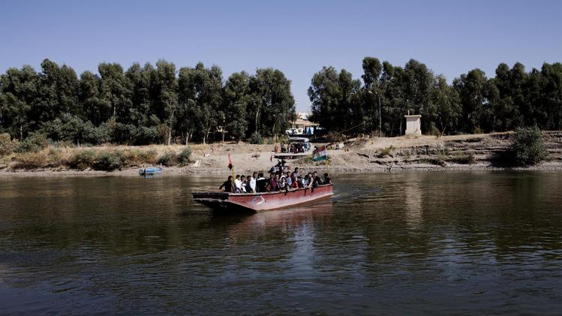
© Brain Wrinkles

