Slide 1
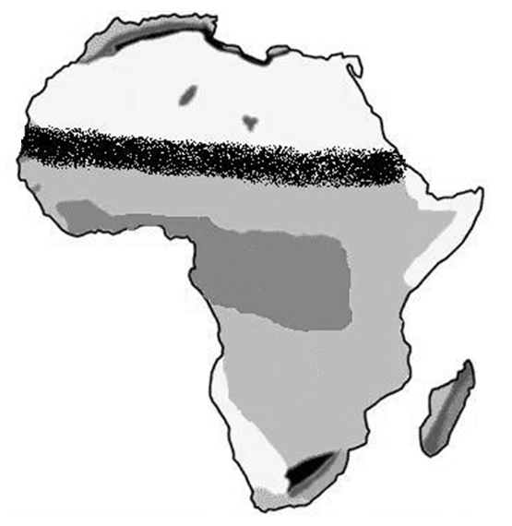
Based on what you have learned about Africa’s physical features, what kind of environmental issues might affect the continent and its people?

Slide 2
How do environmental issues impact Africa?

Slide 3
Standards:
SS7G2a. Explain how water pollution and the unequal distribution of water impacts irrigation, trade, industry, and drinking water.
SS7G2b. Explain the relationship between poor soil and deforestation in Sub-Saharan Africa.
SS7G2c. Explain the impact of desertification on the environment of Africa from the Sahel to the rainforest.

Slide 4
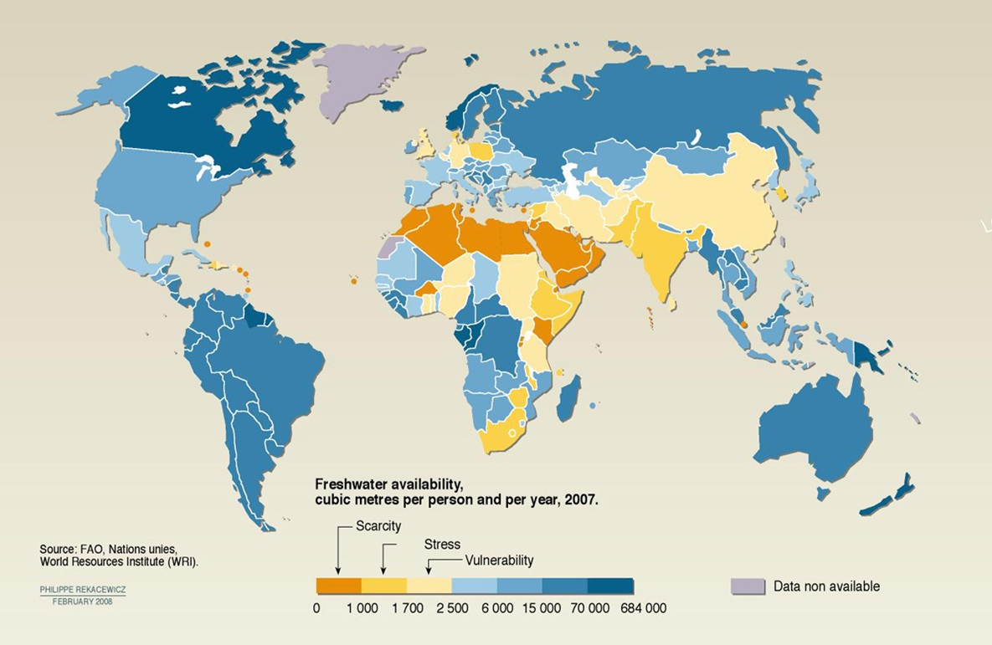
What does this map tell us about water in Africa?
There is an unequal distribution of water in Africa.
What physical feature(s) is located in this area? How does it relate to the amount of water it receives?

Slide 5
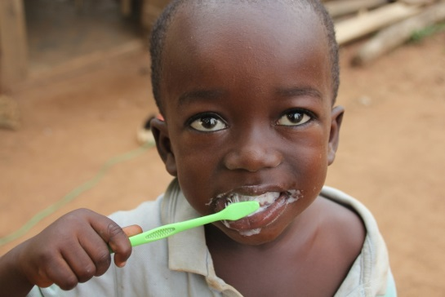
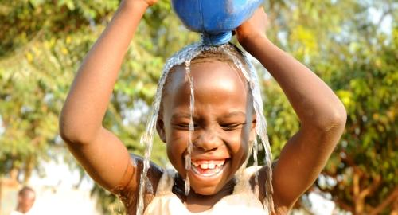
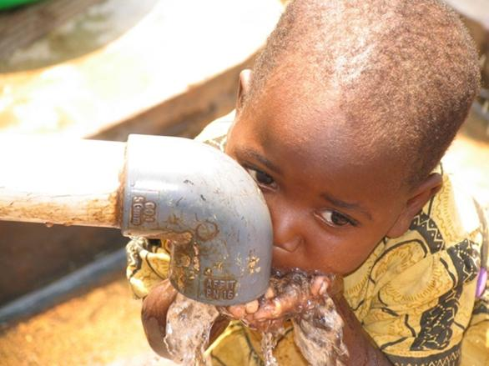
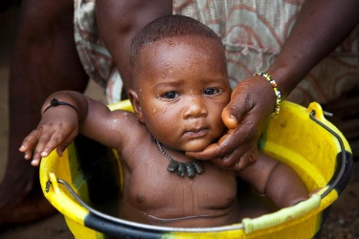
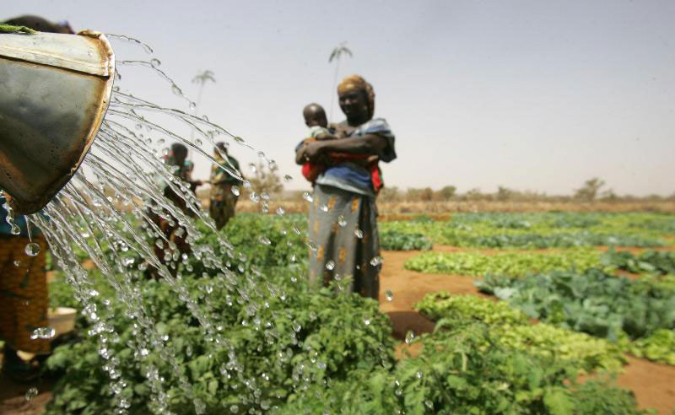
Why or how do we use water?
Drinking
Hygiene
Irrigation
Business/Industry

Slide 6
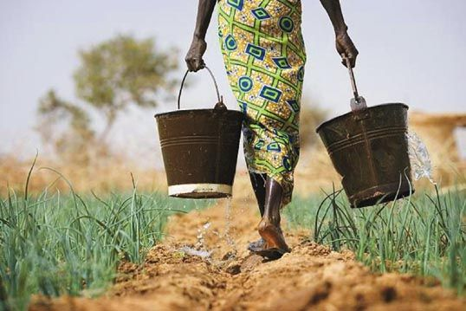
What is irrigation?
Irrigation is the watering of land to make it ready for agriculture (growing crops and raising animals)

Slide 7
Unequal Distribution of Water
Some parts of Africa have an adequate fresh water supply, while water is scarce in other areas such as the Sahara.
As the population grows, the demand for fresh water is increasingly greater than the available supply.
Women and children walk daily to collect water, but it is not enough

Slide 8
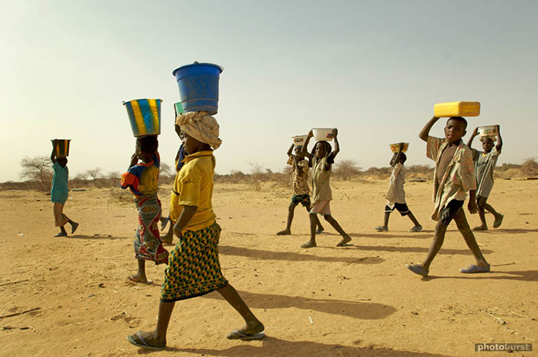
Unequal Distribution of Water
Walking for Water [3:20]

Slide 9
Unequal Distribution of Water
The inadequate supply of water in Africa makes irrigation necessary, but difficult.
Water supplies are needed in the cities because of population growth, which means less for irrigation.

Slide 10
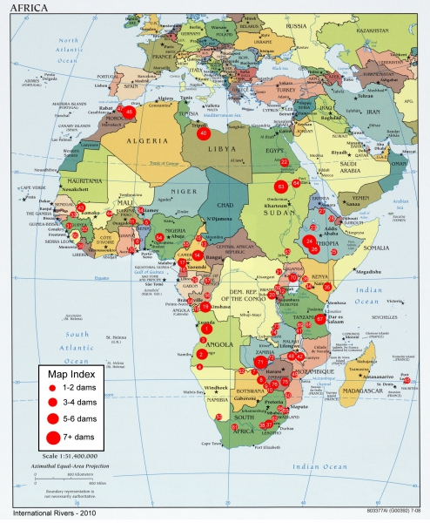
Unequal Distribution of Water
Some rivers have large dams for water distribution and power production that increase trade and industry for surrounding areas.

Slide 11
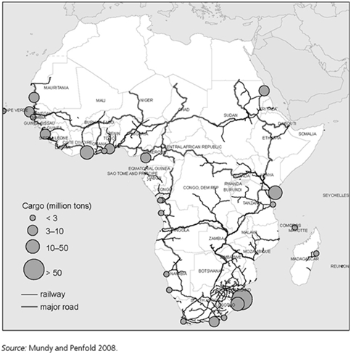
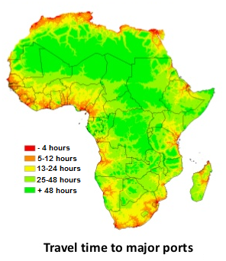
Examine the two images below. How does access to water affect countries in Africa?
Some of the Major Ports in Africa

Slide 12
Unequal Distribution of Water
African countries with immediate access to water for shipping have an advantage.
They can trade with countries around the world and use the profits to their benefit.

Slide 13
Making Connections…
How is the situation with water in Africa similar to the situation of water in the Middle East?

Slide 14
Water Pollution in Africa

Slide 15
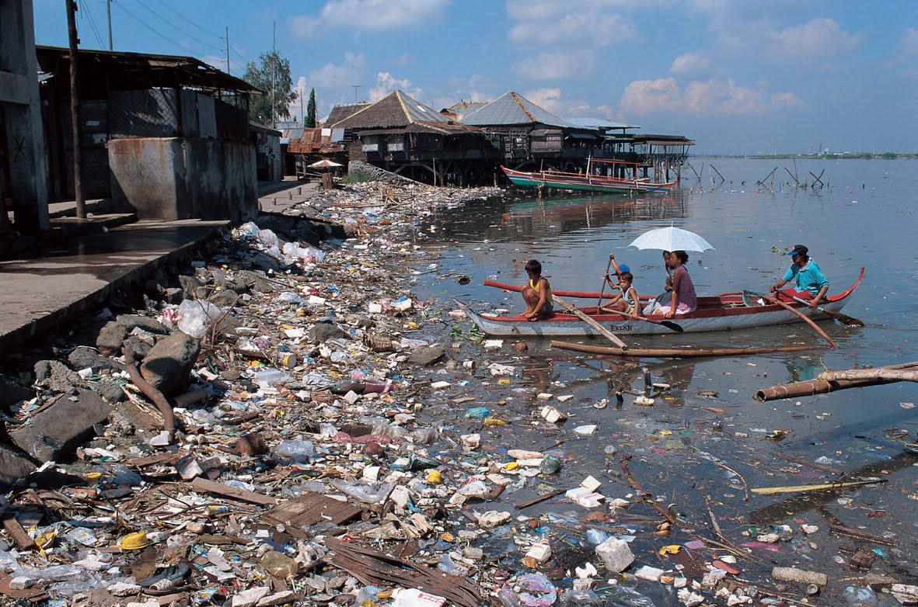
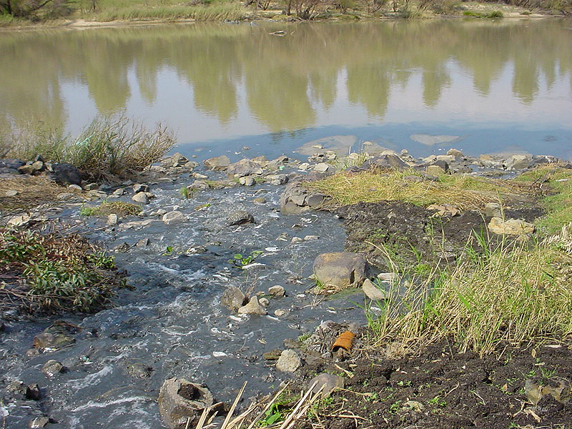
Water Pollution in Africa
Pesticides, fertilizers, human waste, storm water runoff, mining, and manufacturing contribute to water pollution in Africa.

Slide 16
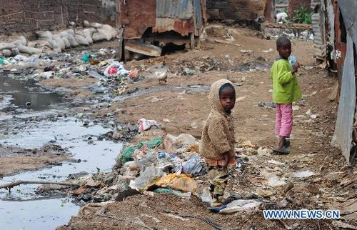
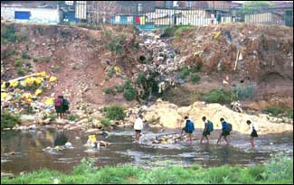
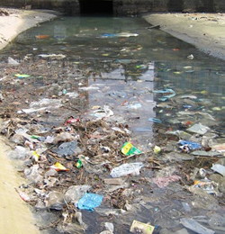
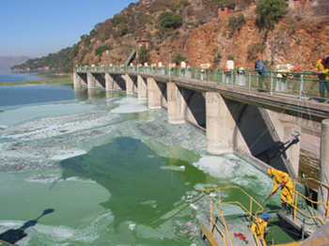
Water Pollution in Africa

Slide 17
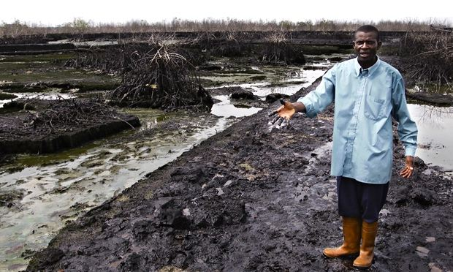
Water Pollution in Africa
Water is often polluted with oil spills that affect trade by ruining the land for farming and the water for fishing

Slide 18
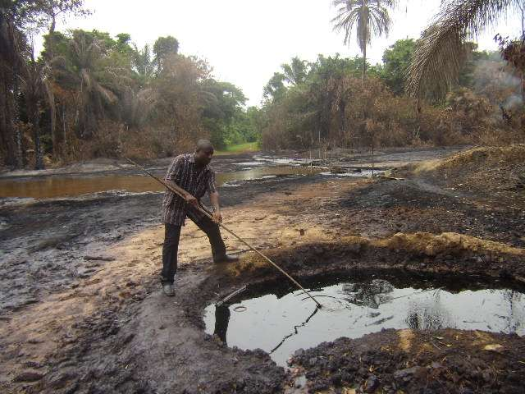
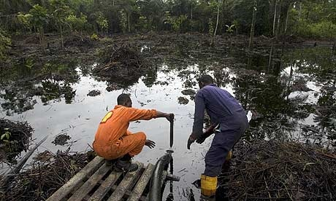
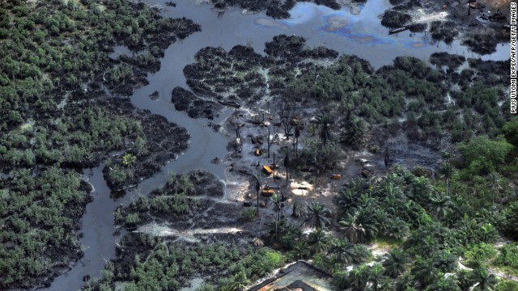
Oil Spills in Nigeria and on the Niger Delta

Slide 19
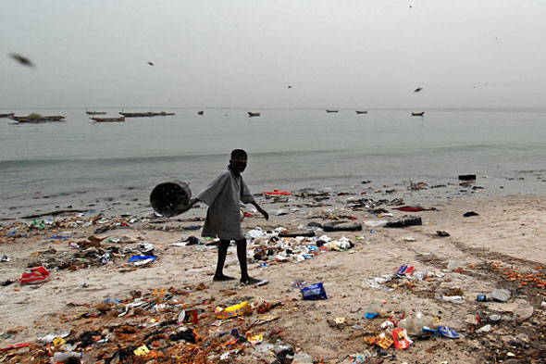
Water Pollution in Africa
Many coastal beaches are no longer safe for swimming due to waste from industry and ships

Slide 20
Making Connections…
Compare and contrast water pollution in Southern & Eastern Asia with water pollution in Africa.

Slide 21
Clean Water Activities

Slide 22
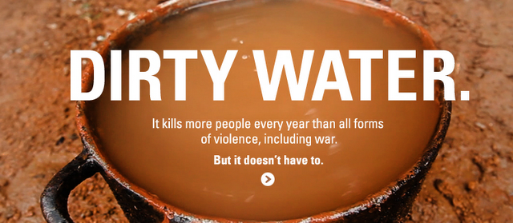
Water Pollution in Africa
Unclean drinking water is a major problem in Africa. As the population grows, the amount of clean water is decreasing

Slide 23
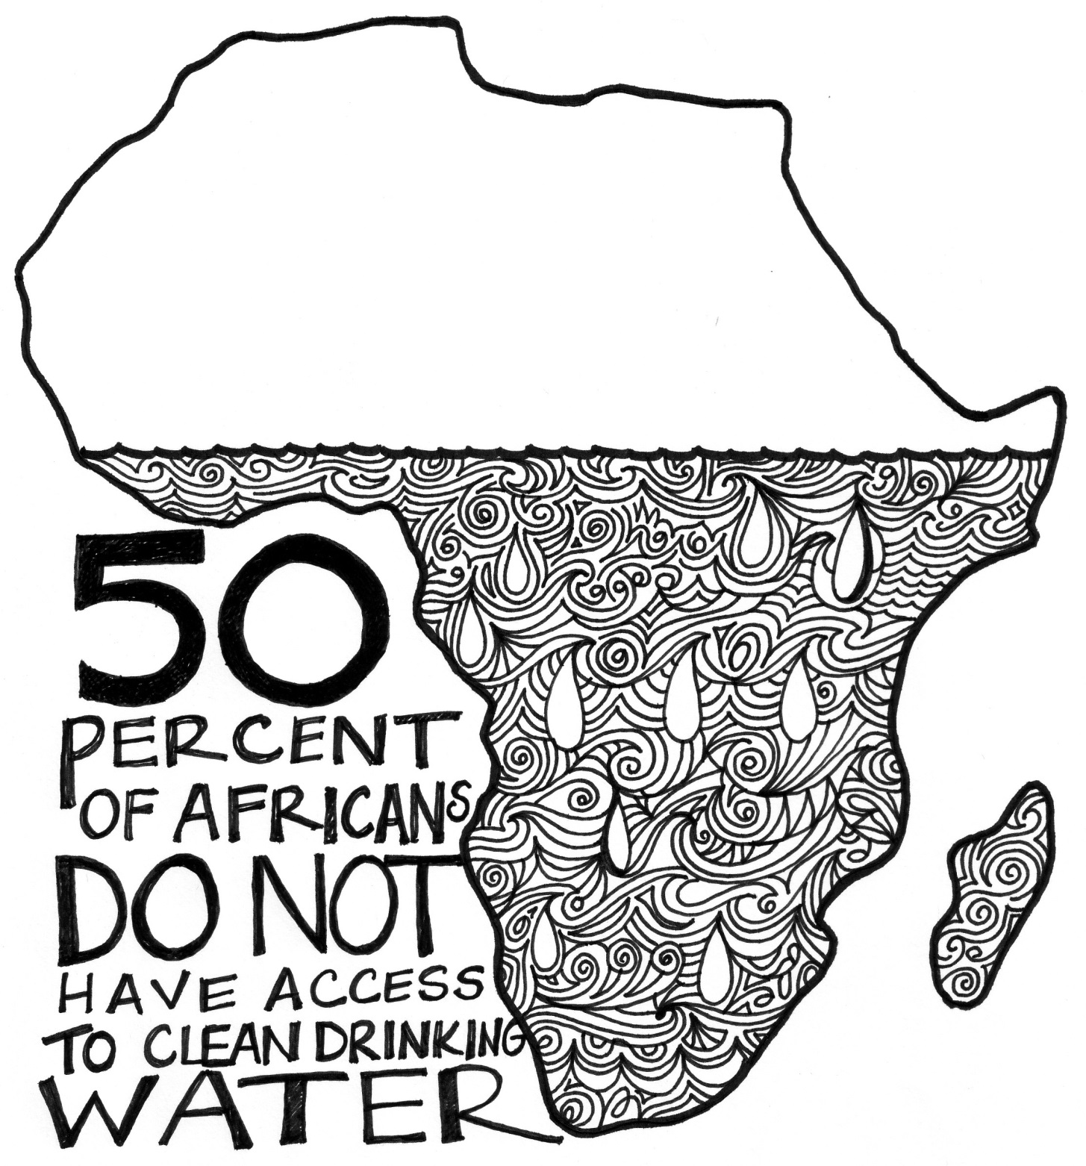

Slide 24
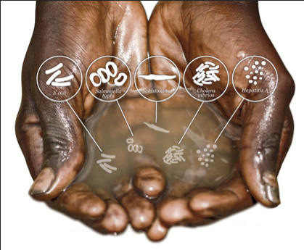
Water Pollution in Africa
There are few places in rural Africa that have plumbing for water or sanitation to purify the drinking water.

Slide 25
Water Pollution in Africa
Watch one of the video clips below on water in Africa
Water Changes Everything [3:23]
Water: A Global Crisis [3:47 but stop around 3:20]

Slide 26
What is Deforestation?

Slide 27
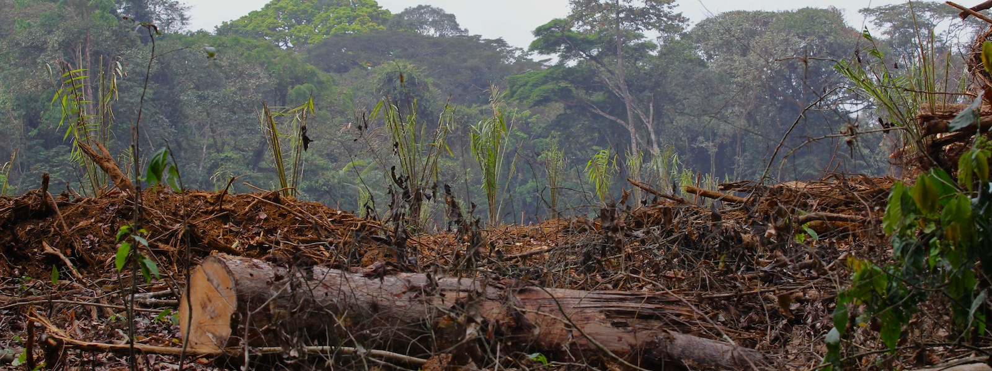
Deforestation
The clearing of trees

Slide 28
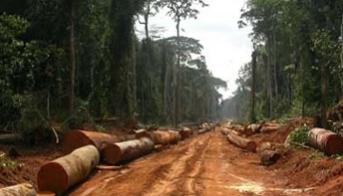
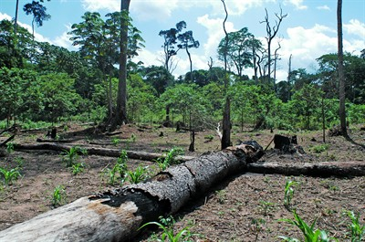
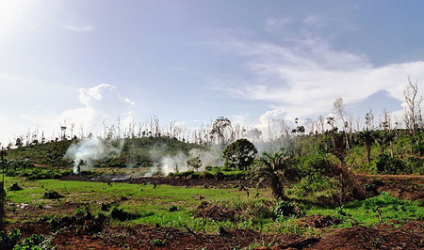
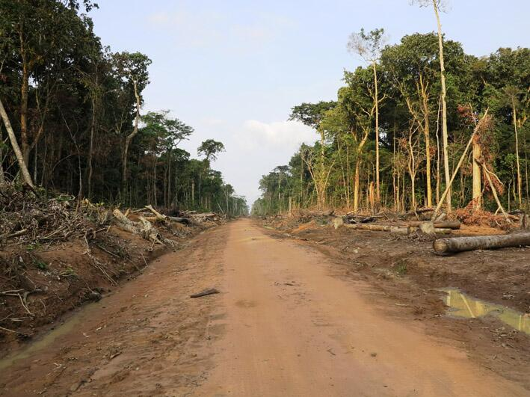
Deforestation

Slide 29
Causes of Deforestation
Commercial Logging(main cause)
Road building
Agriculture
Mining
New settlements

Slide 30
Effects of Deforestation
When the trees are cut down, no roots remains to hold the soil in place.
Wind and rain then erodes what is left of the soil washing away important nutrients.
Then the sun heats the exposed soil.
In effect, Deforestation leads to soil that is poor in nutrients and unable to support agriculture.

Slide 31
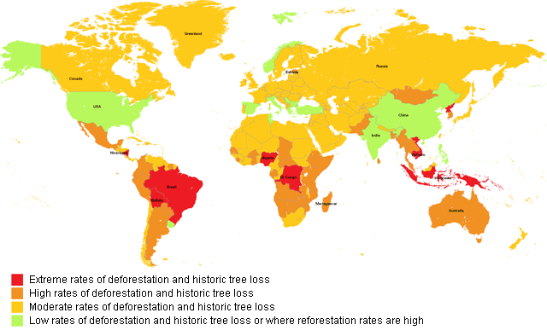
Deforestation in Africa
Deforestation [4:28]

Slide 32
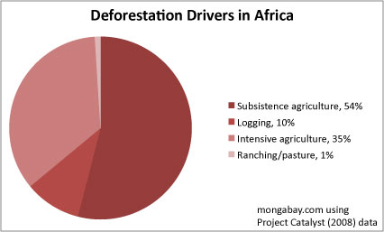
Deforestation in Africa

Slide 33
What is Desertification?

Slide 34
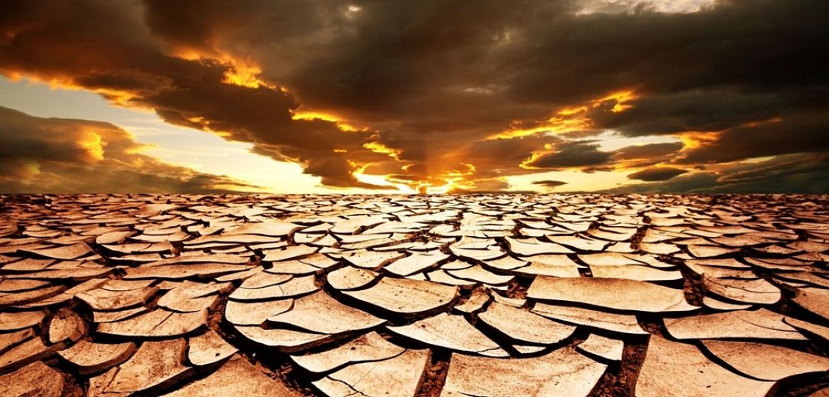
Desertification
The process by which a desert spreads

Slide 35
Causes of Desertification
Poor farming practices (slash & burn: Cutting down trees & then burning the land to make it fertile)
Land clearing (deforestation)
Overgrazing of livestock
Removing surface & underground water for industrial and home use

Slide 36
Desertification
Desertification, along with drought, has led to a constant spread of desert areas.
Population growth has made the problem worse. People and animals compete for an already limited water supply.
Threatens 1/3 of Africa

Slide 37
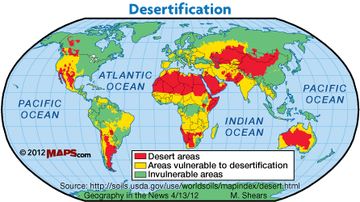
Desertification

Slide 38
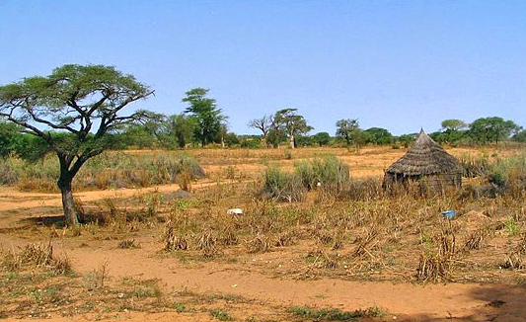
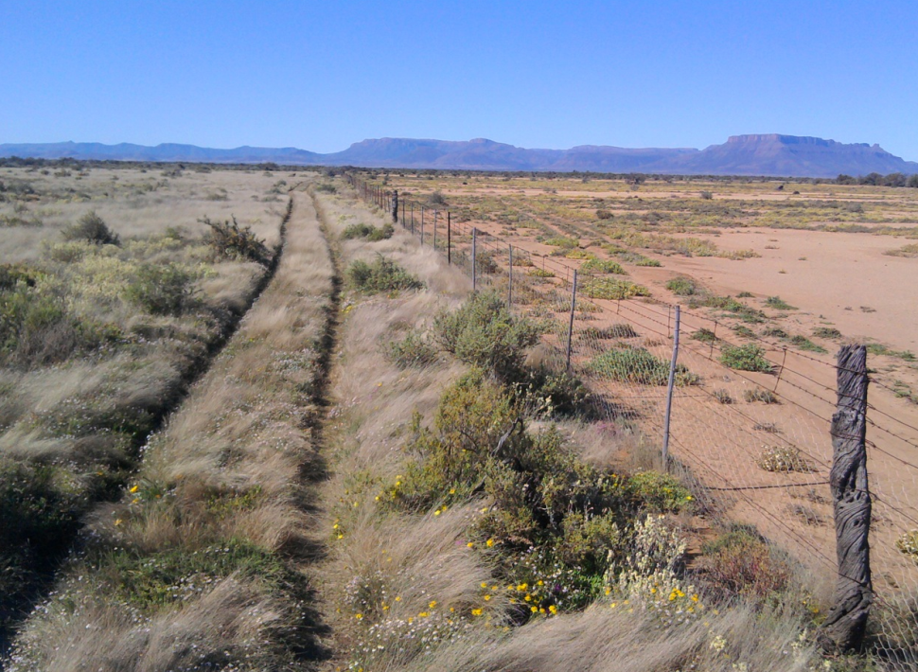
Desertification
Desertification in the Sahel [3:28]

Slide 39
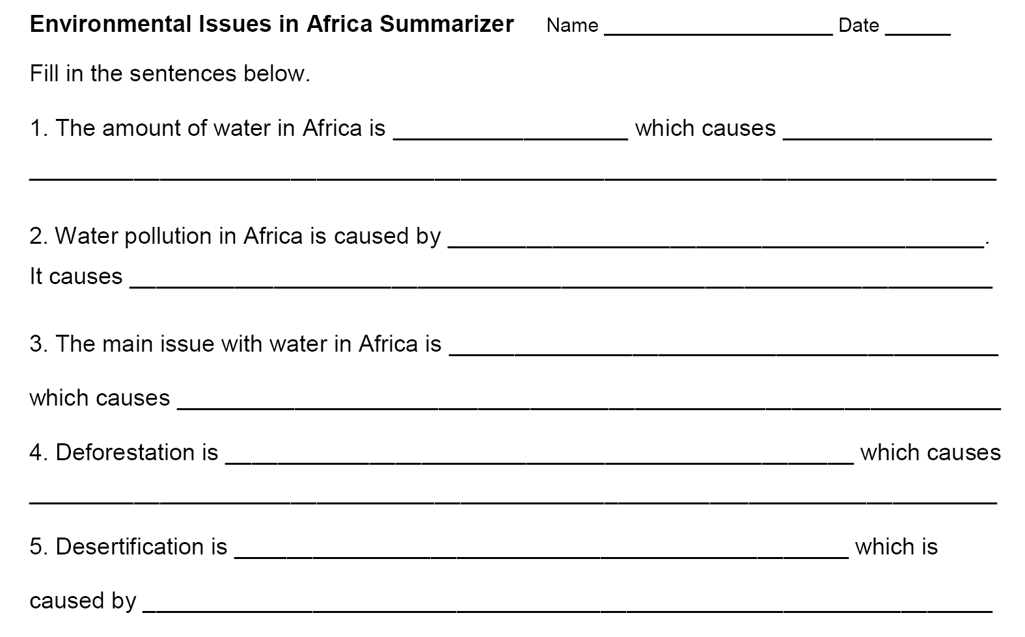
Summarizer

