Slide 1
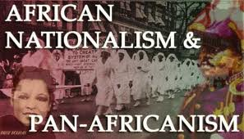
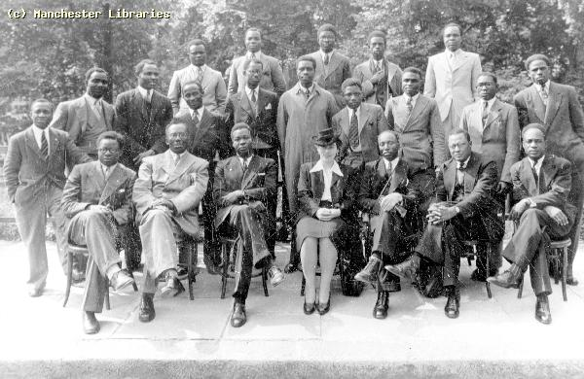
Independence
Pan Africanism
The common bond shared by people of African descent
Africans around the world should work together to achieve independence
You Tube video clip
Black leaders from around the world met in England in 1945 (Pan-African Congress)
Some of these leaders later became president of their newly independent African country (ex. Jomo Kenyatta in Kenya and Kwame Nkrumah in Ghana)
Nationalism
The idea that people can rule themselves
Gained strength after WWII
Helped some African countries gain their independence
England, 1945

Slide 2
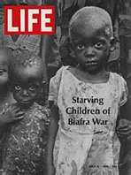
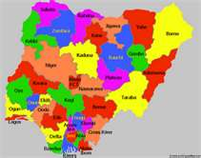
Nigeria Independence – 1960
Former British colony
Nonviolent movement for independence
Tension among ethnic groups (250) made independence difficult
Civil War with Biafra (East Nigeria) over control of oil
Rule by military leaders resulted in multiple coups (trying to overthrow gov’t) in the 60s, 70s, 80s,
and 90s.

Slide 3
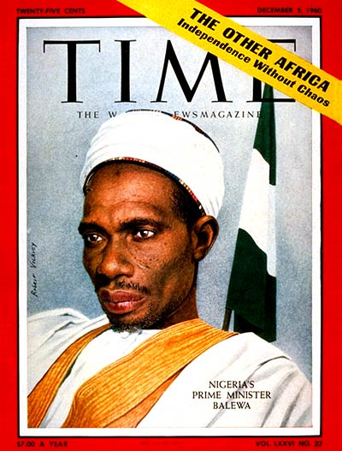
Sir Abubakar Balewa
Was born a commoner
Became a teacher and headmaster
Earned a teacher’s certificate in history in London
Became the first prime minister of Nigeria in 1957
Helped to achieve independence in Nigeria and create the Organization of African Unity (OAU)
Was killed in 1966 during a military coup

Slide 4
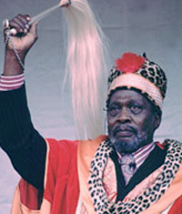
Kenya Independence - 1963
Former British Colony
Violent uprising in the 50s led to deaths of thousands of black Kenyans
Jomo Kenyatta
Organizer of Pan African Congress
Imprisoned for “managing” the Mau Mau—6 yrs. hard labor
Father of modern Kenya
Peacefully led fight against British
President 1964 to 1978
Led Kenya to be a relatively stable, democratic government but held many political prisoners

