Slide 1
Georgia studies Milestone
To assist you with key concepts and vocabulary to pass the Milestone Exam
2016-2017

Slide 2
Georgia Geography

Slide 3
Early Georgia History
Paleo Indians Woodland Indians
Archaic Indians Mississippian Indians
(P.A.W.M. )

Slide 4
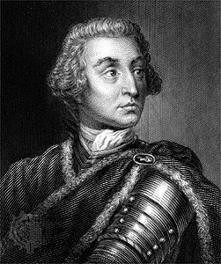
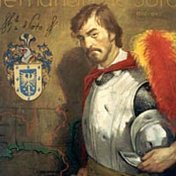
Georgia’s Colonization
Hernando de Soto- searched for gold; first European explorer to enter Georgia
James Oglethorpe- wanted to help poor persons and improve prison conditions. He asked King George II for land SW of Carolina to settle; started the colony of Georgia.
Charter of 1732- it made Oglethorpe’s group of 21 men trustees in order to manage GA for 21 years

Slide 5
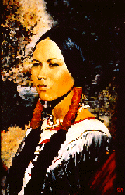
Mary Musgrove and Chief Tomochichi
Tomochichi was chief of the Yamacraw Indians. He played an important role in peaceful negotiations between Europeans and Native Americans. Mary Musgrove was a negotiator/translator for James Oglethorpe.

Slide 6
Georgia’s Colonization continued…
Reason’s for settlement: charity, economics, and defense
Salzburgers: banished because they were Protestant. They established the town of Ebenezer.
Trustees did not aid the Malcontents due to their wealth.
Paid for their own voyage
Wanted to purchase more land
Wanted to enslave people
Resented the British trustees rules and regulations

Slide 7
Georgia’s Colonization continued…
Spanish threat:
Britain builds Fort Frederica to protect the colony.
British colonists are unsuccessful in attacking St. Augustine (The War of Jenkins’s Ear 1740).
The Spanish finally forced to retreat after the Battle of Bloody Marsh (1742).
Royal colony/governors:
The Trustee period was officially over in 1752.
However, GA did not get its first governor (John Reynolds) until 1754.
The Crown of England now oversaw the control of GA.
GA does very well as a royal colony (exports rice, indigo, deerskins, lumber, beef, and pork).

Slide 8
Revolution in Georgia
French and Indian War (Seven Years War): between the French and the British; causes were greed & fear over land (particularly the Ohio River Valley); the British win
Proclamation of 1763: issued by King George III; it forbade colonists to settle west of the Appalachian Mountains

Slide 9
Sugar Act | Stamp Act | Townshend Acts | Tea Act | Intolerable Acts
Placed a tax on sugar and molasses imported from the West Indies. | 1765, placed a tax on newspapers, legal documents, licenses. | 1767, placed an import tax on tea, paper, glass, and coloring paint. | 1773, Allowed the East India Company to ship tea directly to the colonies. | Port of Boston was closed until they paid for the tea.
GA did a great deal of trading with sugar-producing countries | Placed to raise money for the French and Indian War |  | The tea could be sold less than the colonial merchants could. | Massachusetts colonists could not have town meetings w/o approval
(i.e. Jamaica and Barbados). Passed in 1764. | The Liberty Boys came together to oppose the tax |  | Led to the Boston Tea Party. | Led to the Quartering Act (colonists had to house British soldiers)

Slide 10
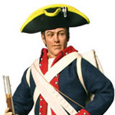
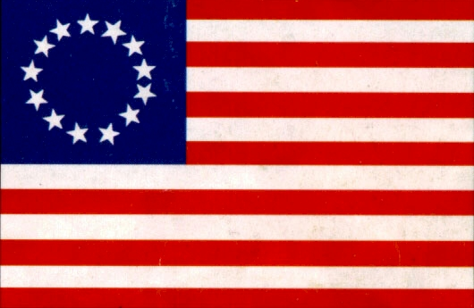
Georgia’s Colonization continued…
Declaration of Independence:
Approved on July 4, 1776.
It was officially signed on August 2, 1776.
Three Georgians signed the document:
1. Lyman Hall
2. George Walton
3. Button Gwinnett
The document was written primarily by Thomas Jefferson.
Loyalists: colonists who supported Great Britain
Patriots: colonists who supported the Revolution

Slide 11
Key People- Revolution in Georgia
Elijah Clarke: colonel of the British militia who led his men to victory over the Battle of Kettle Creek
Austin Dabney: freeborn mulatto who was credited with saving the life of E. Clarke at Kettle Creek
Nancy Hart: GA’s most famous heroine; Hart Co. is the only county named after a woman; killed/disarmed Tories/soldiers that were in her house.
Battle of Kettle Creek: minor battle but major victory for Georgia; outnumbered militia men led by E. Clarke defeated a British force of 800 men

Slide 12
Revolution in Georgia continued…
Button Gwinnett, Lyman Hall, and George Walton:
The 3 Georgia representatives that signed the Declaration of Independence
Each of them have a county named after them
Siege of Savannah:
Siege – When forces try to capture a fortified fort or town by surrounding it and preventing any supplies from reaching it.
The siege lasted three weeks and was a failed attack.

Slide 13
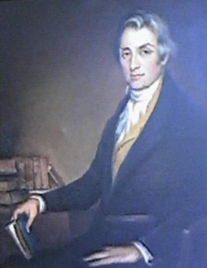
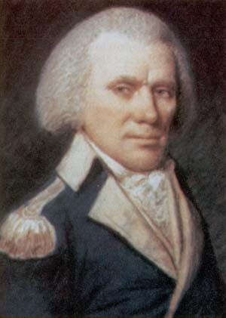
Revolution in Georgia continued…
Abraham Baldwin:
Also represented GA at the Constitutional Convention and signed the Constitution.
His vote on equal representation in the Senate played an important part in the Great Compromise.
Represented GA in the U.S. Congress
Founded the University of GA.
William Few:
Helped write the GA Constitution of 1777.
Was elected to serve GA in the Continental Congress in 1780.
Represented GA during the Constitutional Convention and signed the U.S. Constitution.
Later elected to U.S. Congress

Slide 14
Strengths and Weaknesses of Georgia Constitution of 1777
Strengths:
First constitution written in GA
Helped the colony transition into a state
Had a separation of powers (the state legislature had the most power)
Guaranteed certain individual rights
Freedom of religion
Freedom of the press
Trial by jury
Weaknesses:
Voting rights belonged only to white males over 21 years of age who could afford to pay taxes.
Only Protestant men could be legislators.
Had to be rewritten (1789) in order to conform with the U.S. Constitution (1787

Slide 15
Constitutional Convention of 1787
Leaders from each state met at the Constitutional Convention of 1787 because the federal government needed to be given more power.
The Constitution was written to replace the Articles of Confederation.
The Constitution is the basis for laws in the U.S.

Slide 16
Georgia in a divided Nation
*Key Concepts include:
Louisville, land lotteries, Yazoo land fraud, Alexander McGillivray, William McIntosh, Sequoyah, Trail of Tears, and more!

Slide 17
Establishment of UGA
Georgia’s new leadership after the Revolutionary War showed a strong interest in education and religion.
In 1784, the general assembly set aside 40,000 acres of land for the University of Georgia (UGA).
Plan for university written by Abraham Baldwin.

Slide 18
S.A.L.M.A.
Savannah
Augusta
Louisville (named after King Louis XVI of France)
Milledgeville
Atlanta
(Georgia’s Capitals)

Slide 19
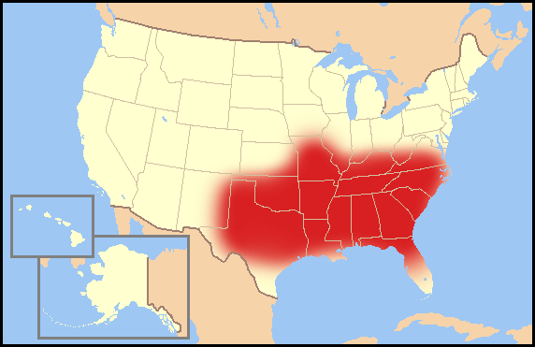
The spread of Baptist & Methodist churches
A major religious movement that swept through the U.S. between 1790-1830.
Increased the interest in religion.
Helped the development of Baptist, Methodist, and Presbyterian churches throughout the south (Bible Belt).

Slide 20
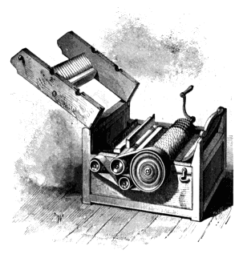
Georgia in a Divided Nation
Headright system- heads of families were entitled to 200 acres of land (limit was 1000)
Land lotteries- limited to white men, orphans, and widows; GA sold ¾ of the state to 100,000 people; The government looked at your age, war service, marital status, and years of residence in GA
Cotton gin- separated seeds from cotton
(major cash crop in the south)

Slide 21
The Yazoo Land Fraud
In the Yazoo land sale, the government sold 35 million acres of land in western Georgia (now the state of Mississippi) to 4 companies for $500,000.
The price of an acre was about 1.5 cents
The citizens of Georgia protested because of this cheap sale of land
The Yazoo land sale was reversed with the 1796 Rescinding Act
In this act, the U.S. government promised to help remove the remaining Creek Indians from Georgia.

Slide 22
Alexander McGillivray and William McIntosh
McIntosh signed the Treaty of Indian Springs in 1825, ceding the Creek’s remaining land in Georgia for $200,000.
Many Creeks were enraged. A war party of Creeks murdered (mutilated) McIntosh and several other leaders who had signed the treaty
The Creeks were led by Alexander McGillivray, the son of a Scottish trader and half-French, half-Creek mother.
During the Revolutionary War, he and the Creek Indians raided settlements in Georgia and Tennessee.
Georgians negotiated with him for Creek property for years before he finally ceded Creek land near the Oconee River in 1790 in the Treaty of New York.

Slide 23
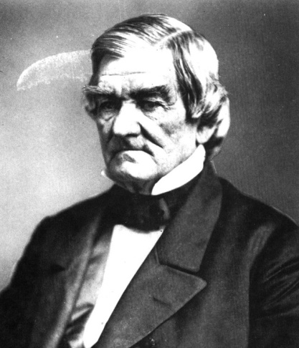
Sequoyah and John Ross
Sequoyah (aka George Gist) created the Cherokee syllabary (written language). John Ross established a constitution for the Cherokee people and became the Principal Chief of the Cherokee Nation.

Slide 24
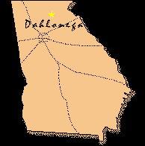
-Dahlonega Gold Rush -Worcester v. Georgia
Gold was discovered in Dahlonega in 1829.
Dahlonega was located on Cherokee land.
In 1830, Congress passed the Indian Removal Act, which ordered all Indians east of the Mississippi River to leave their homes and move west of the river.
In 1832, Chief Justice John Marshall ruled in favor of the Cherokee in Worcester v. Georgia.
Marshall said that the Georgia laws were not valid in Cherokee lands.
President Andrew Jackson ignored the ruling and ordered that the Indians be removed.

Slide 25
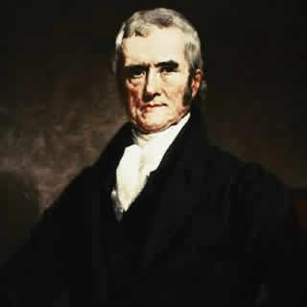
Andrew Jackson and John Marshall
Andrew Jackson was elected president of the U.S. in 1828. His major issue concerned Indian removal to the west. Marshall was Chief Justice of the U.S. Supreme Court.

Slide 26
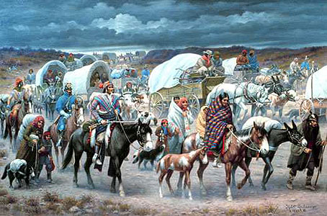
Trail of Tears
In 1838, federal soldiers herded the Cherokee people on an 800-mile journey to the Indian Territory in modern-day Oklahoma. The men, women and children died from the harsh weather, disease and lack of food during the six-month trek.
Over 17,000 Cherokees were forced off of their land.
Over 4,000 Cherokees died from the cold or starvation (mostly the elderly and children).
Over 80,000 different Native American groups were removed from their land.
In total, over 10,000 Native Americans died during the Trail of Tears.

Slide 27
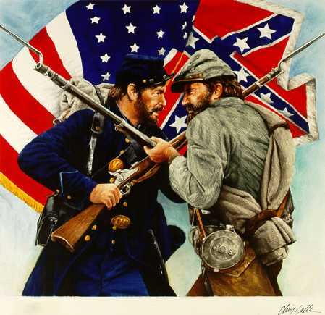
Causes of the civil war
Key Concepts include:
Slavery, states’ rights, nullification, Missouri Compromise, Compromise of 1850, the Georgia Platform, Kansas-Nebraska Act, Dred Scott case, Election of 1860, and more.

Slide 28
Slavery and states’ rights
Many events led to the Civil War in the U.S.
Events include:
Slavery
Economic differences between the North and South
Secession – the withdrawal of a state from the Union
The issue of States’ Rights
Nullification – the argument that a state has the right not to follow federal law.

Slide 29
Missouri Compromise
The Missouri Compromise of 1820
The U.S. had an equal number of states where slavery was legal and illegal.
The South wanted Missouri to be a slave state.
The North wanted Missouri to be a free state.
The compromise sought a balance of slave states and non-slave states.
Missouri joined the Union as a slave state, while Maine joined as a free state.
The compromise also banned slavery above the 36° 30’ parallel.

Slide 30
Missouri Compromise of 1820

Slide 31
Compromise of 1850
Slavery and the balance of power between slave states and free states was again a major issue.
The compromise consisted of five parts:
1. California will be entered as a free state and Texas as a slave state.
2. The compromise included the Fugitive Slave Act.
This Act said that all states must return runaway slaves back to their owners.
3. Prohibited/banned slave trade in Washington D.C.
4. The territories of New Mexico and Utah were organized.
5. Popular sovereignty will be used to determine if future states will allow slavery.

Slide 32
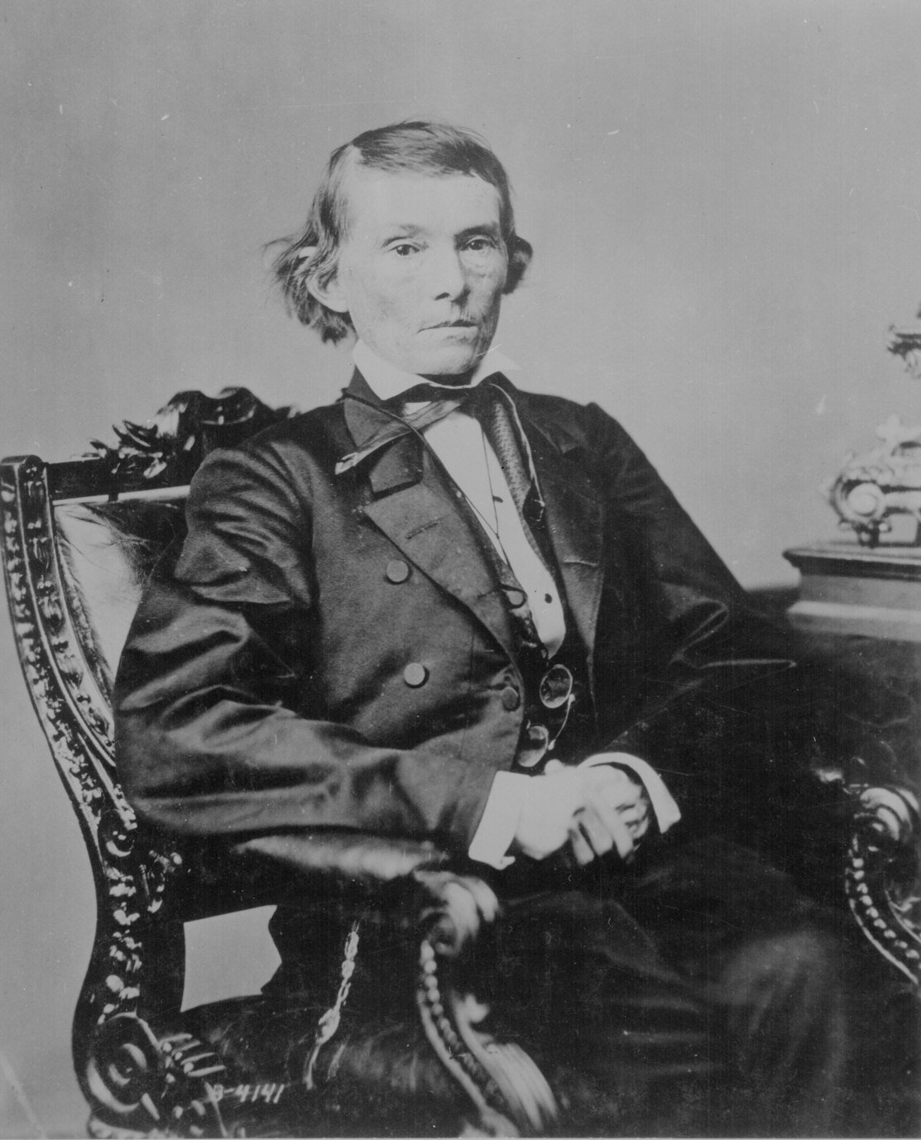
-The Georgia Platform -Alexander Stephen
The GA Platform:
A convention held in Milledgeville to debate the Compromise of 1850.
GA wanted the North to support the Fugitive Slave Act.
The GA Platform was written in support for the compromise.
Alexander Stephens and three others supported the Union and were credited with preventing war and secession

Slide 33
Kansas-Nebraska Act
Issue was again over slavery.
Both states would use popular sovereignty to determine the issue of slavery.
An election was held in Kansas to decide the issue of slavery.
In 1857, Kansas became a slave state. However, the U.S. Congress rejected the results of the vote and in 1861 Kansas joined the United States as a free state.

Slide 34
Dred Scott Case
The trials of Dred Scott increased divisions in the U.S.
Born into slavery in Virginia in 1799.
Traveled into free territory (Wisconsin and Illinois) with his owner.
Lived in free territory for nine years.
In 1846, Scott went to court in Missouri to argue for his freedom.

Slide 35
Dred Scott continued…..
Dred Scott v. Sanford became a famous court case.
Scott lost his first court case; he appealed in 1850 and won.
His case was appealed again by the Missouri Supreme Court and overturned.
Scott’s case made it all the way to the Supreme Court, which ruled against him.

Slide 36
Election of 1860
Four presidential candidates running for the presidency: Abraham Lincoln, John Bell, John Breckinridge, and Stephen Douglas.
The Republican Party is formed.
Abraham Lincoln
Anti-slavery position
-Lincoln supported Dred Scott and said he would try to end the spread of slavery.
Lincoln won in November 1860 without the support of southern states.
Lincoln’s victory causes the South to debate the issue of secession (leaving/withdraw from the Union).

Slide 37
Georgia constitution
Key Concepts include:
County unit system, reapportionment, “Articles”, separation of powers, checks and balances, and voting requirements

Slide 38
Georgia’s Constitution
Georgia adopted its first state constitution in 1777.
In 1983, Georgians approved the state’s tenth constitution.

Slide 39
Georgia Constitution
separation of powers: a division of responsibilities for government among the three branches (legislative, executive, judicial)
checks and balances: ensure that no one branch becomes too powerful

Slide 40
Legislative Branch
Georgia’s legislature is called General Assembly
180 members of the house of representatives; 56 members of the senate; elected by the voters; no term limits

Slide 41
Legislative Branch
Senate requirements
25 years old or older
Citizen of U.S.
Citizen of Georgia for 2 years
Resident of district for 1 year
House requirements
At least 21 years old
Citizen of U.S.
Citizen of GA for 2 years
Resident of district for 1 year

Slide 42
General Assembly
The General Assembly can pass laws on any matter not denied it by the U.S. constitution.
The General Assembly can pass legislation on such matters as taxes, education, contracts, real and personal property.

Slide 43
How a Bill Becomes a Law
Any citizen may suggest an idea for a law.
Any senator or representative can propose a bill for consideration.
All bills (proposed laws) that affect how a state raises or spends money must start in the house of representatives. (Bills about anything else may begin in either house).

Slide 44
How a Bill Becomes a Law
Bills in the Georgia Assembly go through almost the same steps as those in the U.S. Congress before they become a law.
There are nine steps to follow when a bill starts in the state house of representatives.

Slide 45
Executive Branch
The governor of Georgia is the state’s chief executive. To qualify for the office, a candidate must be at least 30 years old, a U.S. citizen for fifteen years, and a Georgia resident for six years. The term of office is four years, with a total of two consecutive terms allowed. The governor is elected by the people of Georgia.

Slide 46
Executive Branch/governor
Duties of the governor include suggesting new state programs and laws, proposing and directing the state budge and appointing members of state boards. He may also call special sessions of the legislature and may veto laws proposed by the legislature.

Slide 47
State departments
The Department of Education (DOE) certifies teachers, approves textbooks and distributes funds. State agency: Board of Education and the State Superintendent of Schools enforces traffic laws, helps
The Department of Human Resources (DHS) is one of the largest state agencies. Services include assistance for the aging, family and children’s services, and mental health. State agency: Board of Human Resources

Slide 48
State departments
The Department of Public Safety (DPS) enforces traffic laws, helps public safety agencies reduce crime and responds to natural and manmade disasters. State agency: Board of Public Safety
The Department of Transportation (DOT) plans, constructs and maintains highways and bridges. It supports other forms of transportation such as buses and bicycle trails. State agency: Board of Industry, Trade and Tourism.

Slide 49
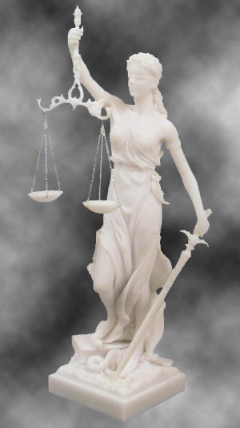
Judicial Branch
Consists of the state courts
Role is to interpret the state constitution
Protect citizens
Enforce the laws

Slide 50
Court Structure
Supreme
Court
Court of Appeals
Trial Courts

Slide 51
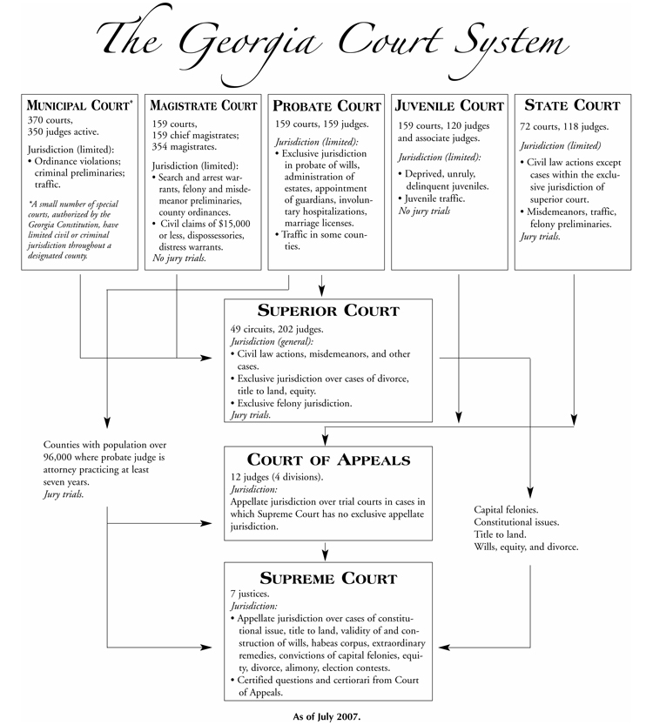

Slide 52
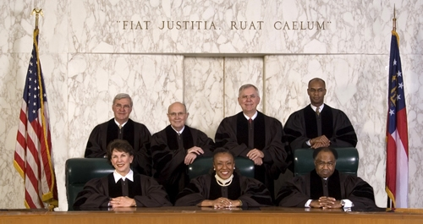
Judicial Branch continued
7 court justices elected by popular vote
6 yr. terms
Governor may appoint justices if they resign or die before the end of their term
Chief justice is elected by peers

Slide 53
Judicial Branch continued
Supreme Court- the highest court in the land
Appellate Court- only reviews cases on appeal from lower ranking courts; no juries or witnesses
1. Interprets the state constitution
*Divorce* Title to land * Wills
*Alimony * Equity * Habeas corpus
2. Automatically reviews all death penalty cases
3. Outlines the codes of judicial conduct for state judges
4. Regulates admission of attorneys to practice laws

Slide 54
Judicial Branch continued
Criminal Law
Cases involving a violation of the law
The state is called the “prosecution”
The prosecution brings criminal charges against an individual; a trial determines the guilt or innocence of the defendant (the accused)
Civil Law
Are personal and do not affect ALL of society
Issues such as citizenship, property rights, contracts, marriage, divorce, child custody, and inheritance

Slide 55
Judicial Branch continued
Plaintiff- the person or group that brings the legal action
Defendant- the person or group to whom the legal action was brought against
A Felony is a serious crime such as murder or burglary, punishable by a year or more in prison and a fine of at least $1000, or both
Misdemeanors are less serious crime punishable by less than a year in prison, a fine of less than $1000, or both

Slide 57
Judicial Branch continued
Juveniles have a special status under the law
Must follow laws that do not apply to adults:
Stay in school until 18
Can’t run away from home
No alcohol until 21
No cigarettes until 18

Slide 58
Judicial Branch/juvenile system
Delinquent Act- An act considered a crime if committed by an adult.
A status offense –An act NOT considered a crime if committed by an adult. Ex. Running away and repeated Truancy (skipping school)

Slide 59
Steps to the Juvenile Justice Process
INTAKE
DETENTION
FORMAL HEARING
SENTENCING

Slide 60
The Seven Delinquent Behaviors
In 1994, the Georgia Legislature passed an amendment to the Georgia Juvenile Code (SB 440) that permits youths ages 13-17 who are charged with violent crimes to be under the jurisdiction of the superior court and treated as an adult.

Slide 61
Civil war
You should know about:
Antietam, Gettysburg,
Emancipation Proclamation, Chickamauga, Sherman’s Atlanta Campaign, and more.

Slide 62
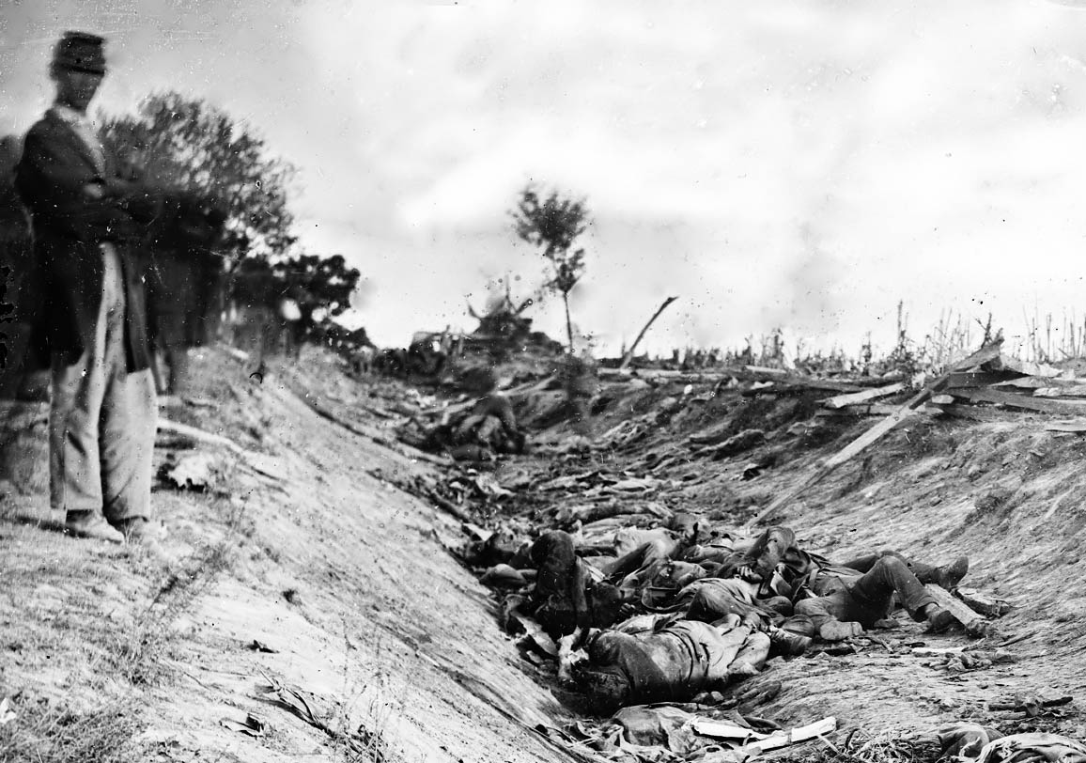
Antietam
Fought on September 17, 1862.
Fought at Antietam Creek, Maryland
Confederate General: Robert E. Lee
Union General: George McClellan
Confederate casualties were about 13,700.
Union lost about 12,400 men.
The Battle of Antietam proved to be one of the bloodiest single days in the war.
Although McClellan protected the capital from Confederate forces, he allowed Lee’s army to escape to Virginia.

Slide 63
Emancipation Proclamation
Announced by Abraham Lincoln
January 1, 1863
Freed (emancipated) slaves in the Confederate States.
Northern states could now feel that they were fighting not only to save the Union, but also to end slavery.

Slide 64
Civil War continued
Gettysburg
Chickamauga
Both armies run into each other accidentally.
Fighting ensues for three days.
Over 50,000 total casualties suffered.
Lee forced to retreat.
A major Union victory (considered the turning point of the war for the North).
Picket’s charge on July 3, 1863 helped secure a Union victory.
Fought September 18-20, 1863.
Three days of fighting.
Bloodiest battle fought in Georgia.
Control of the railroad near Chattanooga, Tennessee at stake.
A Confederate victory.
Over 34,000 total casualties.

Slide 65
Union Blockade of Georgia’s coast
Many of Georgia’s ports were blocked throughout the war.
Darien
Brunswick
Savannah was Georgia’s biggest port.
Strong Confederate forts protected some cities from falling under the blockade.
In April of 1862, Union artillery bombarded the Fort Pulaski and caused the Confederate forces to surrender.
As a result, the Union troops used the fort to block ships from entering Savannah. Savannah fell under the blockade.
The blockade made it difficult for farmers and merchants to sell their wares. It also made it hard for the Confederate army to receive new supplies from their allies in other countries.

Slide 66
Andersonville Prison
Andersonville Prison opened in February 1864.
Andersonville Prison was located in Georgia.
During the Civil War, tens of thousands of Union soldiers were imprisoned there. Conditions were very bad. Unhealthy sanitation conditions, malnutrition, and overcrowding led to mass amounts of casualties.
Out of 45,000 men that were imprisoned at Andersonville, almost 13,000 died.

Slide 67
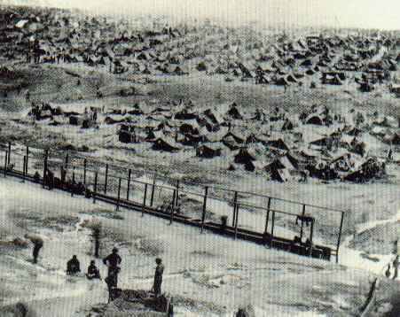
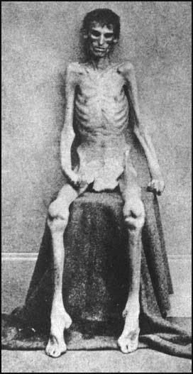
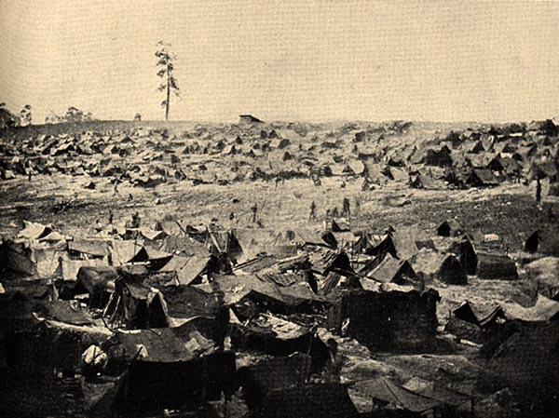
I actually survived Andersonville.

Slide 68
Sherman
Considered the father of total war.
By 1864, was 2nd in command of the Union Army (under Ulysses S. Grant).
Planned to invade Atlanta, which was the main supply line for the Confederacy.
On November 2, 1864, receives permission to march to Savannah.

Slide 69
Sherman continued…
The Battle of Atlanta:
August 31, 1864, Sherman’s army destroy railroad lines in Jonesboro. Fighting occurs with Southern troops under the command of General Hood. Hood’s confederate army suffer 1,700 killed during the fight.
By November 15, 1864, 30% of the city of Atlanta is destroyed.
November 16, 1864, Sherman begins his march to the sea using total war.
Total war – Sherman plans to live off of the land and steal, confiscate, or kill anything to make his campaign successful.
March to the sea:
Sherman sets out for Savannah with over 60,000 men.
His march will break up into 4 lines and span about 40 miles wide.

Slide 70
Reconstruction
You should know about:
Freedmen’s Bureau, 13th, 14th, & 15th Amendments, KKK, Henry McNeal Turner, sharecropping, and more.

Slide 71
Freedmen’s Bureau
Lawmakers created the Freedmen’s Bureau.
helped the people who were enslaved.
provided food and clothing.
built schools for African Americans.
In Georgia, the bureau helped white landowners create contracts so that African Americans could be paid for their labor.

Slide 72
13th, 14th , and 15th Amendments
Thirteenth Amendment to the U.S. Constitution:
This amendment officially ended slavery in the U.S.
The Fourteenth Amendment:
defines U.S. citizenship and includes newly freed slaves.
The Fifteenth Amendment:
ensures that the right to vote cannot be denied to any U.S. citizen on account of “race, color, or previous condition of servitude.”
At that time, women still could not yet vote, and the voting age was 21.

Slide 73
Henry McNeal Turner
One of the first African Americans elected to the Georgia General Assembly (1867)

Slide 74
Sharecropping and Tenant Farming
Sharecropping- under this system, the landowners provided land, a house, farming tools and animals, seed, and fertilizer. The workers agreed to give the owner a share of the harvest.
Tenant farming- (similar to sharecropping) The main difference was that tenants usually owned some agricultural equipment and farm animals, such as mules. They also bought their own seed and fertilizer.

Slide 75
Ku Klux Klan
One of the secret organizations that tried to keep freedmen from exercising their new civil rights.
They terrorized and intimidated African Americans to keep them from voting.

Slide 76
Developing national identities
You should know about:
Bourbon Triumvirate, Henry Grady, Rebecca Latimer Felton, the 1906 Atlanta Riot, Leo Frank case, Disenfranchisement, Booker T. Washington, W.E.B. DuBois, Reasons for World War I, and more.

Slide 77
Bourbon Triumvirate
The Bourbon Triumvirate were Alfred Colquitt, Joseph Brown, and John Gordon.
wanted Georgia’s economy to be industrialized, not based solely on agriculture.
During their time in power, the cotton textile industry grew.
Production of cottonseed oil, cattle feed, and fertilizer began.
Atlanta became prosperous again.

Slide 78
Henry Grady
Henry Grady was a journalist from Georgia.
called the “voice of the New South”
He coined the phrase “New South”
Increased the circulation of the Atlanta Constitution from 10,000 to 140,000

Slide 79
International Cotton Exposition
The International Cotton Exposition was held in Atlanta, in 1881.
was a fair to showcase the economic recovery of the South and to lure northern investors
displayed equipment for making textiles.
millions of dollars were invested in Atlanta.
New jobs were created.
Similar expositions would be held there in 1887 and 1895.
Atlanta became known as the center of the New South.

Slide 80
Tom Watson and the Populists
Watson was wealthy, but he was concerned about Georgia’s poor and struggling farmers.
Small farmers in Georgia were upset because they were not prospering during this time.
Prices of farm products were dropping.
Farmers owed many loans and were charged a great deal of money by railways to ship their products.
Farmers formed groups to help one another.

Slide 81
Tom Watson continued….
The formation of these groups/alliances was called populism.
The Farmers’ Alliance was one of these groups.
these groups formed a political party called the People’s Party.
Thomas Watson was a leader of the populists.
Under Watson’s leadership, the People’s Party became powerful in Georgia.
The Democrats worried that the People’s Party might take control. To avoid this, the Democrats won the election by breaking the law, or “stealing” the election.

Slide 82
Rebecca Latimer Felton
Rebecca Latimer Felton was a writer, teacher, and reformer.
helped to instate Prohibition
ended the convict lease system, a system of leasing convicts to private businesses as cheap labor.
At the age of 87, Felton became the first woman to serve in the U.S. Senate, in 1922.

Slide 83
The 1906 Atlanta Riot
-It started as a result of a local newspaper printing false reports of black assaults.
A crowd of over 5000 whites and African Americans had gathered on Decatur Street.
The riot lasted two days.
At least 18 African Americans and three whites were killed; hundreds of people were injured.

Slide 84
Leo Frank Case
Leo Frank was a Jewish man from Georgia who was lynched, or hung, by a mob because of anti-Semitism.
Frank was accused of murdering a young girl employee.
The governor of Georgia, John Slaton, reviewed Frank’s case and eventually decided that Frank was innocent.

Slide 85
The County Unit System
In 1917, Georgia established the county unit system. This was a way of giving votes in primary elections.
Each county was given a certain number of votes, called unit votes.
Three categories: urban, town, and rural.
The candidate who received the most votes in a county won all of the unit votes given to that county.
The problem with this system was that it did not always represent what the population wanted.
As a result, the county unit system was eventually abolished

Slide 86
Jim Crow Laws
The Thirteenth, Fourteenth, and Fifteenth Amendments increased the rights of African Americans after the Civil War.
When formerly Confederate states rejoined the Union, they had to first agree to honor the amendments.

Slide 87
Jim Crow Laws continued..
Most, however, only followed the Thirteenth Amendment – no more slavery.
The southern states did not honor the other Amendments because they feared equal rights for African Americans.
Southern states regularly denied rights to African Americans.

Slide 88
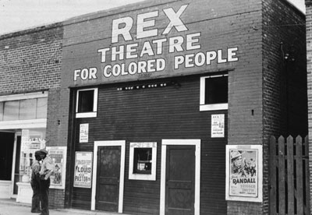
Jim Crow laws continued…
Georgia and other southern states passed state and local legislation called Jim Crow laws.
Jim Crow laws mandated the segregation of African Americans and whites.
Signs were hung in public places designating “Whites Only” for some public places and “Colored Only” for others

Slide 89
Plessy v. Ferguson
Some African Americans challenged the Jim Crow laws in court.
The most famous challenge was between Homer Plessy and a railroad company in Louisiana.
The company tried to make Plessy move from a “Whites Only” passenger car. Plessy, however, refused and was arrested.
In 1896, the U.S. Supreme Court disagreed with Plessy.
The court ruled that segregation was not against the Constitution.
This idea became known as “separate but equal,” which meant that it was legal for states to keep the races separate as long as there were equal facilities for both races.
Most public facilities, however, such as hospitals and schools, were not of the same quality for African Americans as those for whites.

Slide 90
Disenfranchisement
Disenfranchisement - the act of denying a person the right to vote
Disenfranchisement of African American men was accomplished partly by poll taxes, property tests, and literacy tests. A poll tax was a fee that a voter had to pay in order to vote. A voter also had to demonstrate that he owned property

Slide 91
Booker T. Washington
(1856-1915)
Was born into slavery.
Grew up during Reconstruction
Educated by a freedmen’s school.
Championed education for other African Americans.
Washington headed the Tuskegee Institute in 1881 in Alabama.
a college that prepared African Americans for agricultural and domestic work.

Slide 92
Booker T. Washington continued…
Became a well known educator and thinker.
Explained the idea of accommodationism at the 1895 Cotton States and International Exposition in Atlanta.
He encouraged African Americans to embrace jobs in agriculture, mechanics, commerce, and domestic service.
Believed seeking social equality was a mistake.
Believed progress would come gradually (should not be forced).
called for whites to take the initiative in improving social and economic relations between the races.
His ideas of shared responsibility and the importance of education over equality came to be known as the Atlanta Compromise.

Slide 93
W.E. B. DuBois
(1868-1963)
A prominent professor at Atlanta University in 1897.
Criticized the idea of accommodationism.
Believed the idea accepted the racism of southern whites.
Thought Blacks should fight for total racial equality.

Slide 94
W.E.B. DuBois continued…
Founded the Niagra Movement.
Civil Rights Activists gathered at Niagra Falls and listed demands, which included the end of segregation and discrimination.
Activists of the Niagra Movement founded the National Association for the Advancement of Colored People (NAACP).
Du Bois took a leadership position with the NAACP.

Slide 95
John and Lugenia Burns Hope
John and Lugenia Burns Hope devoted their time advancing civil rights and education for African Americans.
John Hope
became the first African American president of Morehouse College in 1906.
became the first African American president of Atlanta University.
Atlanta University became the first college in the nation to offer graduate education for African Americans.
supported public education, healthcare, job opportunities, and recreational facilities for African Americans.

Slide 96
Lugenia Burns Hope
Lugenia Hope:
Worked for many organizations to assist African Americans in GA.
created the first woman-run social welfare agency for African Americans in GA.
was a member of the National Association of Colored Women (NACW).

Slide 97
Alonzo Herndon
Born a slave in 1858
Herndon learned to be a barber and later moved his business to Atlanta; he opened up three more shops for white customers and began buying property as he became more and more prosperous.
He later bought a small insurance company which is now known as the Atlanta Mutual Insurance Company. It is one of the largest African American-owned businesses in the United States with a net worth of over $200 million.

Slide 98
Reasons for World War I
In June 1914, Archduke Franz Ferdinand heir to the throne of Austria-Hungary, was assassinated by Serbian nationalists. Soon after, Austria-Hungary declared war on Serbia. Within a few months, the allies of these countries had joined the war. World War I had begun.
There were several causes for World War I. These included ethnic and ideological conflicts, nationalism, and political and economic rivalries.

Slide 99
The Rise of Nationalism
Nationalism—the belief that loyalty to a person's nation and its political and economic goals comes before any else.
Many people in Europe believed in this and wanted to see their country to become #1.
Helped countries draft soldiers into the army.

Slide 100
Georgia’s contributions to WWI
Georgians were less than enthusiastic about the prospect of America entering World War I.
Even before America had declared war on Germany and its allies, the Georgian economy had begun to suffer.
Shipments of cotton, timber, and tobacco were unable to reach the European market.
Georgia’s attitude quickly changed when America declared war on April 6, 1917.
Georgia played a crucial and patriotic role in America’s war effort.

Slide 101
Georgia’s contributions to WWI
During the war, over 100,000 Georgian men and women contributed to the Allied victory.
Georgia was a key state for the United States military.
Before the war, Georgia already housed five large federal military installations.
These bases became vital to the United State’s war effort.
By the end of the war, Georgia had more military training camps than any other state in the country.

Slide 102
Georgia’s contributions to WWI
World War I was the first war that used airplanes as weapons.
An air force flight school was housed in Georgia.
Over 2,000 combat pilots were trained on Georgian soil.
These pilots went on to fly missions in Europe.
Georgia housed a prisoner of war camp that eventually held over 4,000 prisoners.

Slide 103
Causes of the Great Depression
People borrowed more than they could afford
Factories produced more than they could sell
Farmers produce to much crop
Drought

Slide 104
Eugene Talmadge
Governor of GA
Refused to follow the New Deal
Put all his friends in power
Declared martial law on GA
Federal government took over New Deal in GA

Slide 105
Civilian Conservation Corps
Provide jobs for young single building forest trails, planting trees to reforest the land and control flooding, and building parks.

Slide 106
-Agricultural Adjustment Act - Rural Electrification Act
Agricultural Adjustment Act
Rural Electrification Act
Grants of money from the government to property owners and not to tenant farmers (poor blacks).
Government pays to extend power lines to rural areas.
Before only cities had power
Power companies would not go out to the country because of expense

Slide 107
Social Security Act
Help those at retirement age
All Americans contribute money
Withdrawal from it when they retire

Slide 108
World war II
Key concepts to know:
Lend-Lease, the bombing of Pearl Harbor, Bell Aircraft, Holocaust, FDR and Warm Springs and more.

Slide 109
Lend- Lease
In early 1941, when the British ran out of cash with which to buy American supplies, Congress authorized Roosevelt to lend or lease arms to them.
After Germany turned on and invaded the Soviet Union in June 1941, Roosevelt gave lend-lease aid to the Soviets as well.

Slide 110
The bombing of Pearl Harbor
Japan attacked Pearl Harbor, Hawaii on December 7, 1941.
A date which will live in infamy!

Slide 111
Bell Aircraft
FDR’s close relationship with the state led to the building of the Bell Aircraft plant in Marietta.
The plant produced military planes and created jobs for over 28,000 Georgians.
Once the war ended, plant employees used their skills to find other industrial jobs instead of returning to the farm.
Many attribute the growth of Georgia’s industry in the 20th century to the funds and resources brought into the state during this time.

Slide 112
Carl Vinson
Congressman Carl Vinson helped to build the U.S. navy in the years leading up to World War II.
Representative Vinson wrote many bills that expanded the U.S. Navy.
1. enabled the U.S. to ship supplies to Allies during the Lend-Lease Act
2. overcome the attack of Pearl Harbor eventually send troops into battle.
3. Hundreds of ships built during this expansion were built in the shipyards of Savannah and Brunswick, Georgia.

Slide 113
Richard Russell
Senator Richard Russell served on the Senate Naval Affairs Committee.
He worked to bring wartime opportunities to Georgia.
He helped to bring over a dozen military bases to Georgia, including the largest infantry base in the United States.
Over 300,000 Georgians would serve during the war, but troops from all over the country trained in Georgian camps.

Slide 114
Franklin D. Roosevelt
By the time World War II began, President Roosevelt had a close relationship with Georgia.
Since the 1920s, he had visited Warm Springs regularly in hopes of curing his polio.
He had spent a lot of time campaigning in the state and had many friends there.

Slide 115
Warm Springs
Roosevelt continued to visit Warm Springs throughout the war.
He died there in 1945, while he was still president.

Slide 116
Holocaust
“The final solution of the Jewish People”
Hitler believed that he needed to kill all Jews
Setup death camps
6 million Jews killed
5-6 million others people killed
Killed
Jews, Poles, Czechs, Russians, Gypies, homosexuals, mentally or physically disabled

Slide 117
Holocaust and Georgia
At the same time they learned of the atrocities in Europe, Jewish communities in the U.S. faced increased discrimination at home.
Though the U.S. was not officially engaged in the war, local communities organized support efforts.
Atlanta’s Jewish social service agencies raised funds to combat discrimination abroad.
Their successful fundraising continued throughout the war.
The Holocaust ended in 1945, when the Allied powers won the war and freed the people held captive in the camps.

Slide 118
Post- WWII Georgia
You need to know about:
William B. Hartsfield, Herman Talmadge, Major league sports, Benjamin Mays, The 1946 governor’s race, Brown vs. Board of Education, Martin Luther King, Jr. , Andrew Young, Jimmy Carter, 1996 Olympics, Home Depot, Coca-Cola, Delta, Georgia Pacific, and much more!

Slide 119
Herman Talmadge
Governor of GA
Restructured highway department
Created Georgia Forestry Commission
Passed Minimum Foundation Program for Education act – Extended schools to 9 months
Elected to US senate
Served from 1956-81

Slide 120
Benjamin Mays
Civil Rights Leader
Became a member of the city’s Board of Education
President of Morehouse College

Slide 121
1946 Governor’s Race
Democratic Primary
Eugene Talmadge
Eurith Rivers
James Carmichael
Carmichael wins popular vote
Talmadge wins the county unit vote
Talmadge becomes gov
Talmadge dies and his son Herman Talmadge becomes gov
Bypassing Melvin Thompson the vice governor
Herman locks himself in office declares himself governor
Thompson eventually becomes gov.

Slide 122
Brown v. Board of Education
1950, 7 year old (African American) Linda Brown tries to enroll in a white school in Topeka Kansas
Denied
NAACP and father sue
1954 Separate-but-Equal was found Unconstitutional
Plessy v. Ferguson overturned
Schools must now desegregate

Slide 123
Martin Luther King, Jr.
Preacher; lived in Atlanta; entered Morehouse College in 1944
Developed non-violent social change
4 prong approach to gaining civil rights
1. non-violent action
2. legal remedies
3. ballots
4. economic boycott

Slide 124
Martin Luther King, Jr. continued…
Boycott business
Lunch Counter Sit ins
1964 awarded Nobel Prize for actions
1965 led march in Selma, Alabama to support voting rights
Pushed congress to pass the Voting Rights Act of 1965 – African guaranteed right to vote
March 11, 1969, James Earl Ray shot and killed King.

Slide 125
1956 State Flag Controversy
Georgia changes its flag to include the Confederacy
Many upset
Symbolizes the old racist south
Others want to keep Georgia history alive

Slide 126
Student Non-Violent Coordinating Committee (SNCC)
Pronounced “snick”
Led by John Lewis
Students who fought for rights using non-violence
Conducted Sit ins- sit down and refuse to move

Slide 127
Sibley Commission
Public hearings to see how people in GA felt about integration
2 out of 3 Georgians would rather see schools closed than integrated
Districts could choose if they wanted to integrate
Private schools are created

Slide 128
Hamilton Holmes & Charlayne Hunter
UGA’s first black students
Gov. Vandiver allowed it
Charlayne Hunter becomes famous Newspaper & TV reporter
Hamilton Holmes becomes Phi Beta Kappa
Becomes Orthopedic Surgeon
Dies in 1995

Slide 129
Albany Movement
6 years after Brown v. Board Albany still segregated
“freedom riders” arrive to support
Albany Movement created to desegregate and get Africans to vote
People arrested and jailed

Slide 130
March on Washington
August 28, 1963
Political rally
Theme “jobs, justice and peace”
80% African 20% White
King gives “I have a dream” speech

Slide 131
Civil Rights Act
1964
Desegregated all public facilities
Restaurants
Theaters
Hotels
Public recreation areas
Schools
Libraries

Slide 132
Maynard Jackson as mayor of Atlanta
1st African American Mayor of southern city
Served 8 years
Morehouse Graduate
Brought Olympics to GA
African American business thrived

Slide 133
Andrew Young
Civil Rights leader
Marched in Civil Rights Movement
Pastor
Mayor of Atlanta after Jackson
U.S. Ambassador to the UN
1981 elected mayor
Brought Olympics to GA
Revamped Atlanta Zoo
Reelected by 80%

Slide 134
William Hartsfield
Mayor of Georgia
6 terms
Made Atlanta aviation hub
Helped with civil rights
Hired African American police
Invited civil rights leaders to city

Slide 135
Lester Maddox
1967 elected gov.
Segregationalist
Restaurant owner
Improved education

Slide 136
Georgia based companies

Slide 137
Atlanta Sports Teams

Slide 138
Hartsfield International Airport
It is the world’s busiest airport
Located 7 miles south of the business district of Atlanta
The airport is the primary hub of Delta airlines, Air Tran, and Airways

Slide 139
Interstate Highway System
Georgia's 1,244 miles of interstate highways perform several functions vital to the state's economy: Spaghetti Junction connecting Georgia to the rest of the nation, linking the state's major cities, and helping move suburban commuters to and from work centers. Part of the nationwide Dwight D. Eisenhower National System of Interstate and Defense Highways, Georgia's interstate highways helped establish the state—especially its capital, Atlanta—as a vital transportation hub for the Southeast.

Slide 140
1996 Olympics
The games had a profound impact on the city of Atlanta and many in the metro area consider the Games to be instrumental in transforming Atlanta into a modern city. One instance is the mid-rise dormitories built for the Olympic Village, as one of these complexes became the first residential housing for Georgia State University, and has recently been transferred for use by the Georgia Institute of Technology. Another example is Centennial Olympic Stadium, which by design was later converted into the baseball-specific Turner Field for the Atlanta Braves after the Games concluded, as there was no long-term need for a track and field venue in the city. Centennial Olympic Park was also built for the events and is still in use.

